Slide 1
MIT 6.875/18.425
Foundations of Cryptography
Lecture 4

Slide 2
Lecture 3 Recap
Theorem: Next-bit Unpredictability = Indistinguishability for PRGs.
Key Techniques: Hybrid Argument, Distinguishing-to-Predicting Reduction.
Theorem: Computationally Indistinguishable PRG based on the existence of One-Way Permutations
New Notion: PSRG Extenders
New Notion: Pseudo Random Functions (PRFs)

Slide 3
TODAY
1. Finish: Stateless Secret Key Encryption based on PRFs
2. Theorem: If there are computationally indistinguishable PRGs, then there are computationally indistinguishable PRFs.
The Goldreich-Goldwasser-Micali (GGM) construction.
3. Applications of PRFs:
a. Identification Protocols
b. Authentication
c. Applications to Learning Theory
4. Pseudo Random Permutations (PRP)

Slide 4
Recall: Pseudorandom Functions
Collection of functions $ℱ_{ℓ}=\{f_{k}:\{0,1\}^{ℓ}→\{0,1\}^{m}\}_{k∈\{0,1\}^{n}}$
indexed by a key $k$
$n$: key length, $ℓ$: input length, $m:$ output length.
Independent parameters, all poly(sec-param) = poly($n$)
#functions in $ℱ_{ℓ}$ $≤$ $2^{n}$ (singly exponential in $n$)
$Gen\left(1^{n}\right):$ Generate a random $n$-bit key $k$.
$Eval\left(k,x\right)$ is a poly-time algorithm that outputs $f_{k}\left(x\right).$

Slide 5
Computationally Indistinguishable Pseudorandom Functions
Collection of functions $ℱ_{ℓ}=\{f_{k}:\{0,1\}^{ℓ}→\{0,1\}^{m}\}_{k∈\{0,1\}^{n}}$
indexed by a key $k$
$n$: key length, $ℓ$: input length, $m:$ output length.
Independent parameters, all poly(sec-param) = poly($n$)
#functions in $ℱ_{ℓ}$ $≤$ $2^{n}$ (singly exponential in $n$)
$$≈$$
Collection of ALL functions ${ALL}_{ℓ}=\{f:\{0,1\}^{ℓ}→\{0,1\}^{m}\}$
#functions in ${ALL}_{ℓ}$ $≤$ $2^{m2^{ℓ}}$ (doubly exponential in $ℓ$)

Slide 6






PRF vs. Random functions
The pseudorandom world
The random world
$f←$ $ℱ_{ℓ}$
$f←$ ${ALL}_{ℓ}$
$$f(x)$$
$$x$$
$$f(x)$$
$$x$$
Distinguisher D
Distinguisher D
$$0/1$$
$$0/1$$
For all ppt D, there is a negligible function $μ$ s.t.
$$|$$
$$|$$
$$≤μ(n)$$
$$Pr⁡[{f← ℱ_{ℓ}\text{:} D}^{f}\left(1^{n}\right)=1]$$
$$−$$
$$Pr⁡[{f← {ALL}_{ℓ}\text{:} D}^{f}\left(1^{n}\right)=1]$$
Notation: D^{f} means D which can make quries to f

Slide 7
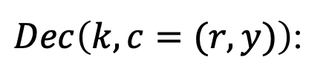
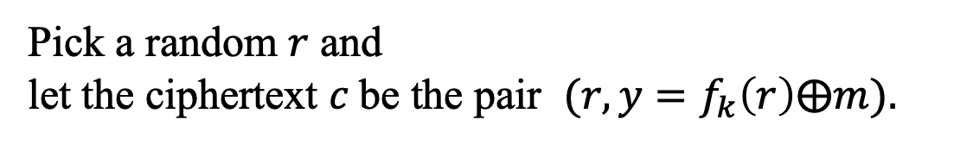
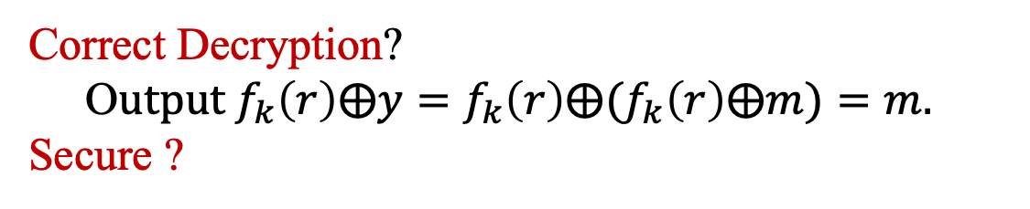
PRF $⟹$ Stateless Secret-key Encryption
$Gen\left(1^{n}\right):$ Generate a random $n$-bit key k that defines
$$f_{k}:\{0,1\}^{ℓ}→\{0,1\}^{m}$$
(the domain size, $2^{ℓ}$, had better be super-polynomially large in n)
$Enc\left(k,m\right)$:
Pick a random $r$ and
let the ciphertext $c$be the pair $(r,{y=f}_{k}\left(r\right)⨁m).$
$Dec\left(k,c=(r,y)\right)$:
O$utput f_{k}(r)⨁y.$
Correct Decryption?
O$utput f_{k}\left(r\right)⨁y={f_{k}\left(r\right)⨁(f}_{k}\left(r\right)⨁m)=m.$
Secure ?

Slide 8










Recall: def of security for Secret-Key Encryption
(one message)
Left World:
Right world:
$k←$ $𝒦$
$k←$ $𝒦$
$c←$ Enc(k,$m_{0}$)
$c←$ Enc(k,$m_{1}$)
$$c$$
$$c$$
Distinguisher D
Distinguisher D
$$0/1$$
$$0/1$$
For all $m_{0}$, $m_{1}$, and all ppt D, there is a negligible function $μ$ s.t.
$$|$$
$$|$$
$$Pr⁡[k←𝒦:D(Enc\left(k,m_{0}\right))=1]$$
$$− Pr⁡[k←𝒦:D(Enc\left(k,m_{1}\right))=1]$$
$$≤μ(n)$$

Slide 9













Definition of Secret-Key Encryption secure against CPA
(chosen plaintext attack (CPA), for many messages)
Left Oracle $Left(∙,∙)$
Right Oracle $Right(∙,∙)$
$k←$ $𝒦$
$k←$ $𝒦$
$c←$ Enc(k,$m_{L}$)
$c←$ Enc(k,$m_{R}$)
$$c$$
$$m_{L},m_{R}$$
$$c$$
$$m_{L},m_{R}$$
Distinguisher D
Distinguisher D
$$0/1$$
$$0/1$$
Claim: For all ppt D, there is a negligible function $μ$ s.t.
$$|$$
$$|$$
$$Pr⁡[k←𝒦:D^{Left(∙,∙)}(1^{n})=1]$$
$$− Pr⁡[k←𝒦:D^{Right(∙,∙)}(1^{n})=1]$$
$$≤μ(n)$$

Slide 10














Claim: PRF $→$Secret-Key Encryption secure against CPA
(chosen plaintext attack (CPA), for many messages)
Left Oracle $Left(∙,∙)$
Right Oracle $Right(∙,∙)$
$k←$ $𝒦$
$k←$ $𝒦$
$c←$ Enc(k,$m_{L}$)
$c←$ Enc(k,$m_{R}$)
$$c$$
$$m_{L},m_{R}$$
$$c$$
$$m_{L},m_{R}$$
$$=(r,f(r)⨁m_{L})$$
$$=(r,f(r)⨁m_{R})$$
Distinguisher D
Distinguisher D
$$0/1$$
$$0/1$$
Claim: For all ppt D, there is a negligible function $μ$ s.t.
$$|$$
$$|$$
$$Pr⁡[k←𝒦:D^{Left(∙,∙)}(1^{n})=1]$$
$$− Pr⁡[k←𝒦:D^{Right(∙,∙)}(1^{n})=1]$$
$$≤μ(n)$$

Slide 11










Proof of security against CPA
Hybrid 0: D gets access to the Left oracle.
$c=$ $(r,{y=f}_{k}\left(r\right)⨁m_{L})$
$≈$ by PRF security
Hybrid 1: Replace $f_{k}$ by a random function.
$c=$ $(r,{y=r′}_{}⨁m_{L})$
$≈$ by birthday paradox
(w.h.p. all r’s distinct)
Hybrid 2: Replace $random+m$ by random.
$c=$ $(r,y=r′)$
$≈$ same distribution
Hybrid 3: Replace $f_{k}$ by a random function (like H1)
$c=$ $(r,{y=f}_{k}\left(r\right))$
$≈$ by PRF security
Hybrid 4: D gets access to the Right oracle (like H0)
$c=$ $(x,{y=f}_{k}\left(x\right)⨁m_{R})$
$≈$ same distribution

Slide 12
TODAY
0. Finish up secret-key encryption.
1. Theorem: If there are PRGs, then there are PRFs.
The Goldreich-Goldwasser-Micali (GGM) construction.
2. More Applications of PRFs:
a. Identification Protocols
b. Authentication
c. Applications to Learning Theory

Slide 13
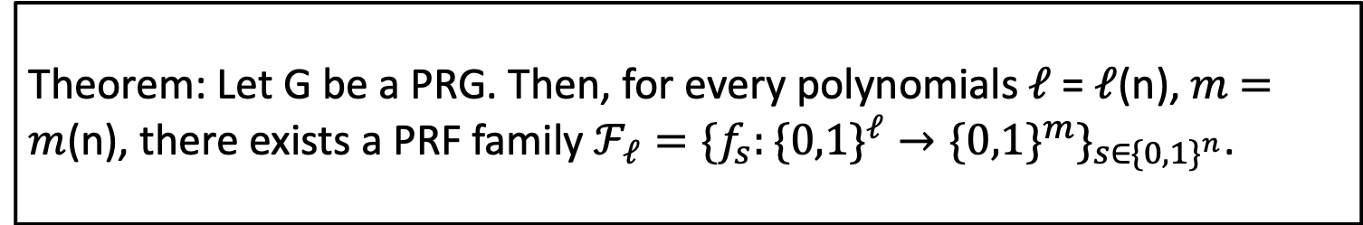
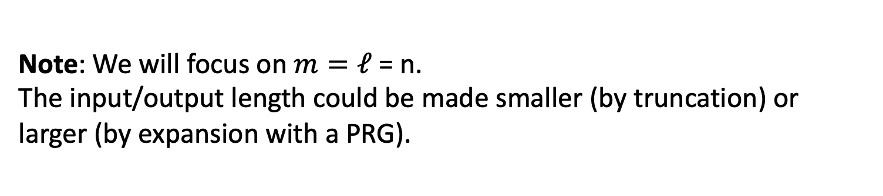
Goldreich-Goldwasser-Micali PRF
Theorem: Let G be a PRG. Then, for every polynomials $ℓ$ = $ℓ$(n), $m$ $=m$(n), there exists a PRF family $ℱ_{ℓ}=\{f_{s}:\{0,1\}^{ℓ}→\{0,1\}^{m}\}_{s∈\{0,1\}^{n}}$.
Note: We will focus on $m=ℓ$ = n.
The input/output length could be made smaller (by truncation) or larger (by expansion with a PRG).

Slide 14







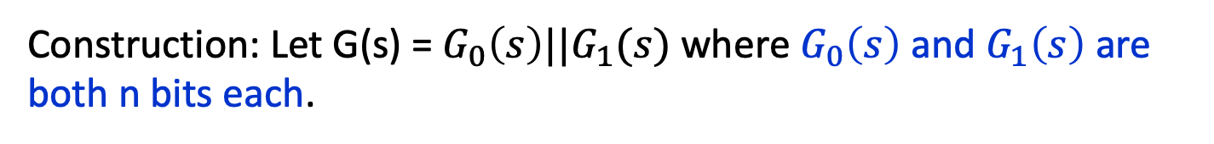
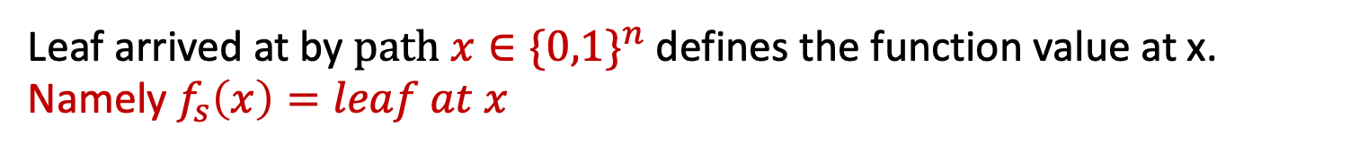




GGM PRF
Construction: Let G(s) = $G_{0}\left(s\right)||G_{1}(s)$ where $G_{0}\left(s\right)$ and $G_{1}\left(s\right)$ are both n bits each.
$$s$$
x₁=0
x₂=1
…
$$G_{0}\left(s\right)$$
$G_{1}(s)$
Depth $n$
${G_{0}(G}_{0}(s))$
${G_{1}(G}_{0}(s))$
${G_{0}(G}_{1}(s))$
${G_{1}(G}_{1}(s))$
${G_{0}(G}_{0}(…G_{0}(s))$
${G_{x_{n}}(G}_{x_{n−1}}(…G_{x_{1}}(s))$
${G_{1}(G}_{1}(…G_{1}(s))$
Leaf arrived at by $path x∈\{0,1\}^{n}$ defines the function value at x. Namely $f_{s}\left(x\right)=leaf at x$

Slide 15
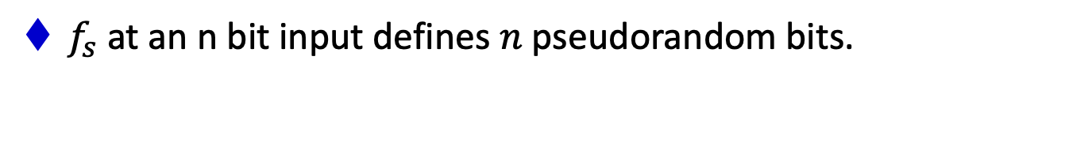




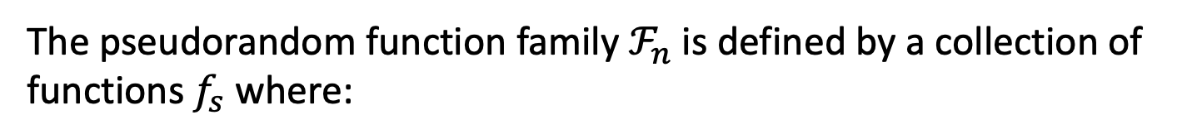
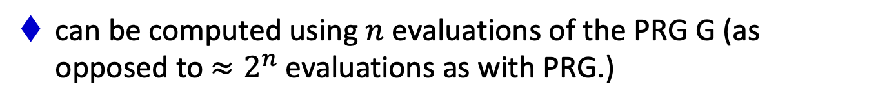
GGM PRF
Construction: Let G(s) = $G_{0}\left(s\right)||G_{1}(s)$ where $G_{0}\left(s\right)$ and $G_{1}\left(s\right)$ are both n bits each.
The pseudorandom function family $ℱ_{n}$ is defined by a collection of functions $f_{s}$ where:
$$f_{s}\left(x_{1}x_{2}{…x}_{n}\right)={G_{x_{ℓ}}(G}_{x_{ℓ−1}}(…G_{x_{1}}(s))$$
$n$-bit input
$n$-bit output
$f_{s}$ at an n bit input defines $n$pseudorandom bits.
can be computed using $n$ evaluations of the PRG G (as opposed to $≈2^{n}$ evaluations as with PRG.)

Slide 16




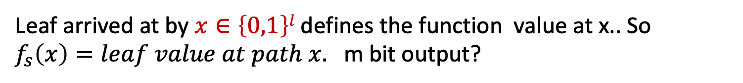



General Parameters: PRF from l bits to m bits
Construction: Let G(s) = $G_{0}\left(s\right)||G_{1}(s)$ where $G_{0}\left(s\right)$ and $G_{1}\left(s\right)$ are both n bits each.
$$s$$
$$G_{0}\left(s\right)$$
$G_{1}(s)$
Depth $l$
${G_{0}(G}_{0}(s))$
${G_{1}(G}_{0}(s))$
${G_{0}(G}_{1}(s))$
${G_{1}(G}_{1}(s))$
${G_{0}(G}_{0}(…G_{0}(s))$
${G_{x_{n}}(G}_{x_{n−1}}(…G_{x_{1}}(s))$
${G_{1}(G}_{1}(…G_{1}(s))$
Leaf arrived at by $x∈\left\{0,1\right\}l$ defines the function value at x.. So $f_{s}\left(x\right)=leaf value at path x.$ m bit output?

Slide 17









GGM PRF: Proof of Security
Key Question: What are the bybrids?
By contradiction. Assume there is a ppt D and a poly function $p$ s.t.
$$|$$
$$Pr⁡[{f← ℱ_{ℓ}\text{:} D}^{f}\left(1^{n}\right)=1]$$
$$|$$
$$≥1/p(n)$$
$$−$$
$$Pr⁡[{f← {ALL}_{ℓ}\text{:} D}^{f}\left(1^{n}\right)=1]$$
The pseudorandom world
The random world
$f←$ $ℱ_{ℓ}$
$f←$ ${ALL}_{ℓ}$
$$f(x)$$
$$x$$
$$f(x)$$
$$x$$
Distinguisher D
Distinguisher D
$$0/1$$
$$0/1$$

Slide 18














The pseudorandom world:
Hybrid 0
$$s$$
$$G_{0}\left(s\right)$$
$G_{1}(s)$
Key Idea:
Hybrid argument by levels of the tree
${G_{0}(G}_{0}(s))$
${G_{1}(G}_{0}(s))$
${G_{x_{ℓ}}(G}_{x_{ℓ−1}}(…(s)))$
${ b}_{1}$
${ b}_{2}$
${ b}_{3}$
$$…$$
${ b}_{x}$
$$…$$
${ b}_{2^{n}}$
$$x$$
$$f(x)$$
Hybrids are over the coin tosses of D
and the seeds s.
D

Slide 19












The pseudorandom world:
Hybrid 0
Hybrid 1
$$s$$
$s_{0}$ and $s_{1}$ are random
$$G_{0}\left(s\right)$$
$G_{1}(s)$
$$s_{0}$$
$s_{1}$
${G_{0}(G}_{0}(s))$
${G_{1}(G}_{0}(s))$
${G_{1}(G}_{0}(s))$
${G_{x_{ℓ}}(G}_{x_{ℓ−1}}(…(s)))$
${ b}_{1}$
${ b}_{2}$
${ b}_{3}$
$$..$$
${ b}_{x}$
$$…$$
${ b}_{2^{n}}$
${ b}_{1}$
${ b}_{2}$
${ b}_{3}$
$$…$$
${ b}_{x}$
$$…$$
${ b}_{2^{n}}$
$$x$$
$$f(x)$$
$$x$$
$$f(x)$$
D
D

Slide 20

























Hybrid 1
Hybrid 2
$s_{0}$ and $s_{1}$ are random
$s_{00},…$ $s_{11}$ are random
$$s_{0}$$
$s_{1}$
$$s_{00}$$
$$s_{01}$$
$s_{10}$
$s_{11}$
${G_{1}(G}_{0}(s))$
${ b}_{1}$
${ b}_{2}$
${ b}_{3}$
$$..$$
${ b}_{x}$
$$…$$
${ b}_{n}$
${ b}_{1}$
${ b}_{2}$
${ b}_{3}$
$$..$$
${ b}_{x}$
$$…$$
${ b}_{2^{n}}$
$$x$$
$$f(x)$$
$$x$$
$$f(x)$$
D
D

Slide 21


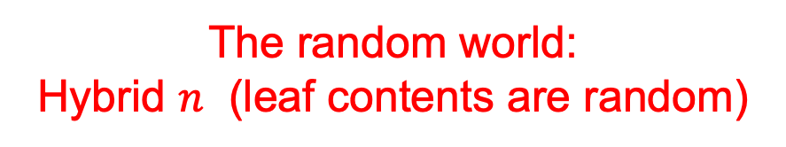








The random world:
Hybrid $n$ (leaf contents are random)
…
${ b}_{1}$
${ b}_{2}$
${ b}_{n}$
${ b}_{1}$
${ b}_{2}$
${ b}_{3}$
$$..$$
${ b}_{x}$
$$…$$
${ b}_{2^{n}}$
$$x$$
$$f(x)$$
D

Slide 22







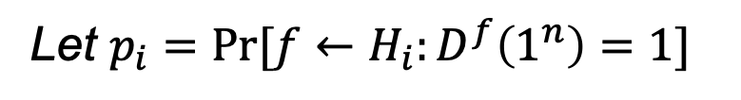






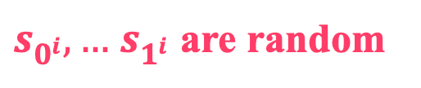
Hybrid $i$
$s_{0^{i}},…$ $s_{1^{i}}$ are random
Let $p_{i}=Pr[f←H_{i}:D^{f}\left(1^{n}\right)=1]$
We know: $p_{0}−p_{ℓ}≥ε$
$$s_{0^{i}}$$
$s_{1^{i}}$
By a hybrid argument:
For some $i:$ $p_{i}−p_{i+1}≥ε/n$
${ b}_{1}$
${ b}_{2}$
${ b}_{3}$
$$..$$
${ b}_{x}$
$$…$$
${ b}_{2^{n}}$
$$x$$
$$f(x)$$
D

Slide 23

Q: Are the hybrids efficiently sampleable?
Hybrid $i$
$s_{0^{i}},…$ $s_{1^{i}}$ are random
A: Yes!
But How?
Lazy Evaluation.
No need to fill the whole tree. For each x query of D just go down the path x outlines till level i, where you fill the node you encounter with a random value, and then fill the rest of the path with pseudo-random values
Save node value filled at level i so if a next query x’ of D has a common prefix with x, you answer D’s queries consistently.
$$s_{0^{i}}$$
$s_{1^{i}}$
${ b}_{1}$
${ b}_{2}$
${ b}_{3}$
$$..$$
${ b}_{x}$
$$…$$
${ b}_{n}$
$$x$$
$$f(x)$$
D

Slide 24


















Proof Plan:
Use the Hybrids H_{i} and H_{i+1} to distinguish between the outputs of PRG G and random and derive a contradiction
Hybrid $i$
Hybrid $i+1$
$$s_{0^{i}}$$
$s_{1^{i}}$
$$s_{0^{i}}$$
$s_{1^{i}}$
$${G_{0}(s}_{0^{i}})$$
$${G_{1}(s}_{1^{i}})$$
$${G_{1}(s}_{0^{i}})$$
$${G_{0}(s}_{1^{i}})$$
${ b}_{1}$
${ b}_{2}$
${ b}_{3}$
$$..$$
${ b}_{x}$
$$…$$
${ b}_{n}$
${ b}_{1}$
${ b}_{2}$
${ b}_{3}$
$$..$$
${ b}_{x}$
$$…$$
${ b}_{2^{n}}$

Slide 25
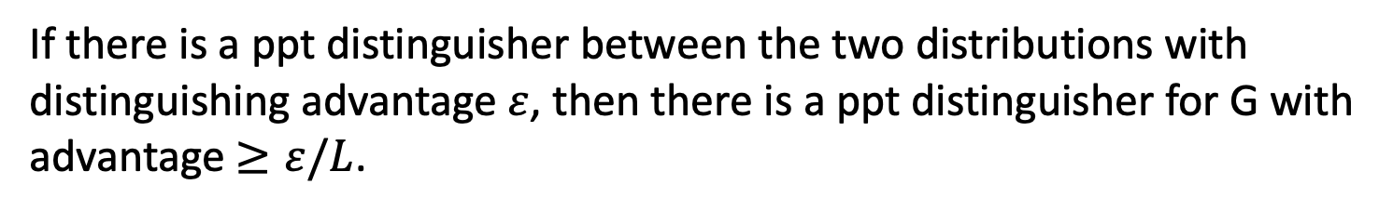
PRG Repetition Lemma
Lemma: Let G: {0,1}^{n}->{0,1}^{2n} be a PRG. Then, for every polynomial L=L(n), the following two distributions are computationally indistinguishable:
$$\left(G\left(s_{1}\right),G\left(s_{2}\right),…,G\left(s_{L}\right)\right)≈\left(u_{1},u_{2},…,u_{L}\right) where u^{′}s from U2n$$
Proof:
By Hybrid Argument.
If there is a ppt distinguisher between the two distributions with distinguishing advantage $ε$, then there is a ppt distinguisher for G with advantage $≥ε/L$.

Slide 26










Putting it together to obtain a contradiction?
Start with a collection of samples which are
Either or
And plant them in level i+1, then answer the questions of D
Note: either we are sampling in hybrid H_{i} or hybrid H_{i-1}
$\left(G\left(s_{1}\right),G\left(s_{2}\right),…,G\left(s_{L}\right)\right)$ $(u_{1},u_{2},…,u_{L})$
Hybrid $i$
Hybrid $i+1$
$$s_{0^{i}}$$
$s_{1^{i}}$
$$s_{0^{i}}$$
$s_{1^{i}}$
$${G_{0}(s}_{0^{i}})$$
$${G_{1}(s}_{1^{i}})$$
$${G_{1}(s}_{0^{i}})$$
$${G_{0}(s}_{1^{i}})$$
${ b}_{1}$
${ b}_{2}$
${ b}_{3}$
$$..$$
${ b}_{x}$
$$…$$
${ b}_{2^{n}}$
${ b}_{1}$
${ b}_{2}$
${ b}_{3}$
$$..$$
${ b}_{x}$
$$…$$
${ b}_{2^{n}}$

Slide 27

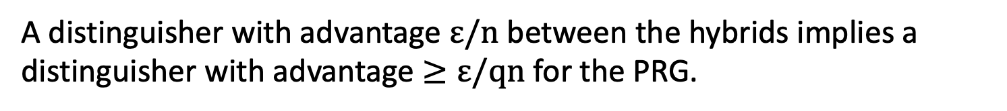

Putting it together to obtain a contradiction?
A distinguisher with advantage $ε/n$ between the hybrids implies a distinguisher with advantage $≥ε/qn$ for the PRG.
(where $q$ is the number of queries that $D$ makes)
Hybrid $i$
Hybrid $i+1$
$$s_{0^{i}}$$
$s_{1^{i}}$
$$s_{0^{i}}$$
$s_{1^{i}}$
$${G_{0}(s}_{0^{i}})$$
$${G_{1}(s}_{1^{i}})$$
$${G_{1}(s}_{0^{i}})$$
$${G_{0}(s}_{1^{i}})$$
${ b}_{1}$
${ b}_{2}$
${ b}_{3}$
$$..$$
${ b}_{x}$
$$…$$
${ b}_{2^{ℓ}}$
${ b}_{1}$
${ b}_{2}$
${ b}_{3}$
$$..$$
${ b}_{x}$
$$…$$
${ b}_{2^{ℓ}}$

Slide 28
Theorem: If G is strong-PRG, then F is PRF
Proof outline: By contradiction. Assume, algorithm D^{f} exists which “distinguishes” F_{n} from H_{n} with probability ε after poly many queries to f (f is either from F_{n} or all from H_{n}), then can construct
algorithm A to “distinguish” outputs of G(U_{n} ) from U_{2n} with
probability ε’= ε/n
Hybrid argument by levels of the tree
Hi : functions defined by filling truly random labels in nodes at level i and then filling lower levels with Pseudo-random values from i+1 down to n
Let p_{i} = prob ( D^{f} (1^{n}) =1: f∈H_{i} ).
Then p₁ = prob (D^{f} (1^{n}) =1: f∈F_{n} ) and
p_{n} = prob (D^{f}(1^{n}) =1 : f∈H_{n} )
and |p_{n}-p₁|>ε ⇒∃ 0<i<n s.t. ⏐p_{i+1} - p_{i} ⏐≥ ε/n= ε’

Slide 29
Proof of Security
Now use the distinguisher D & i s.t. ⏐p_{i+1} - p_{i} ⏐≥ ε/n= ε’ to distinguish S ⊆ outputs of generator from S ⊆ U_{2n} Algorithm (S) for S set of 2n size strings:
Start with empty tree
1.Run Distinguisher D^{f}(1^{n}) Phase-1 On query x=x₁,...,x_{n} to f:
Pick pair (s₀,s₁) randomly fromS ignore levels 1…i-1;
with pair (s₀,s₁)
fill pair of nodes x₁,...,x_{i-1}0 and x₁,...,x_{i-1}1 at level i
[unless already filled]
set b=x_{i} and answer G_{xnxn-1} .._{xi+1} (s_{b}) = G_{xn}(G_{xn-1} (… G_{xi+1}(s_{b})) …)
2.Run D^{f}(1^{n}) Phase-2. if it outputs 1, Output “S random”
if it outputs 0, output “S pseudo-random”
Claim: |prob (S⊆ G(U_{n}):A(S) =1 ) – prob :S⊆ U_{2n}: A(S)=1 )|>ε/n

Slide 30
Repettion-Lemma:
∀PPT A, ∀Poly P, n sufficiently large,
| Pr [A(S) = 1, S⊆ G(U_{k}) s.t |S|=P(n] −
Pr [A(S) = 1 | S⊆U_{2k} s.t. |S|=P(n] | = neg(n)
Claim 1[|prob (A(S): S⊆ G(U_{n})) =1 ) - prob (A(S):S⊆ U_{2n})) =1 )|>e’]
contradicts Easy-Lemma
Pf:
if S⊆ G(U_{k}) then during the execution of A(S), we are
answering the queries of D , in accordance with a function f drawn from D_{i-1} and the probability that D in phase 2 will output 1 is p_{i-1}
However if S⊆ U_{2n} then during the execution of A(S)
we are answering the queries of D , in accordance with a function f
from D_{i} and the probability that D in phase 2 will output 1 is p_{i}
Since|p_{i}-p_{i-1}| > e’, the response of D will distinguish between
S⊆ G(U ) and S⊆ U contradicting the repetition lemma. QED

Slide 31
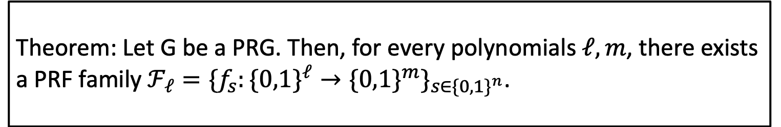
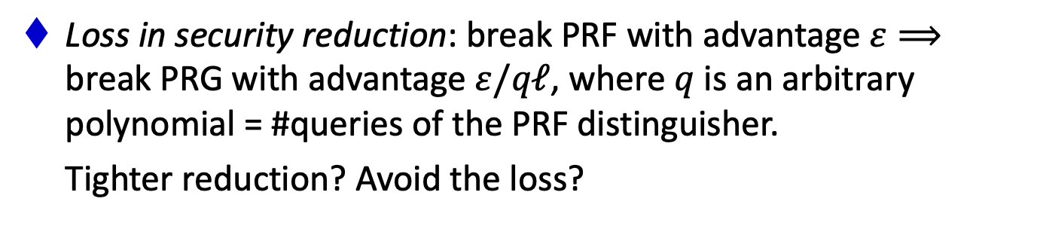
GGM PRF
Theorem: Let G be a PRG. Then, for every polynomials $ℓ,m$, there exists a PRF family $ℱ_{ℓ}=\{f_{s}:\{0,1\}^{ℓ}→\{0,1\}^{m}\}_{s∈\{0,1\}^{n}}$.
What could be better?
Expensive: $ℓ$ invocations of a PRG.
Sequential: bit-by-bit, $ℓ$ sequential invocations of a PRG.
Loss in security reduction: break PRF with advantage $ε⟹$ break PRG with advantage $ε/qℓ$, where $q$ is an arbitrary polynomial = #queries of the PRF distinguisher.
Tighter reduction? Avoid the loss?

Slide 32
And based on even more Reductions
One-way functions (OWF) exist implies Hard Core bit
Hard Core bit imply Extender
Extender imply PRG from n to 2n bits
PRG implies PRF
Each has a cost: start with security parameter n, end up
with n’=n^{C ,} deterioration of ε in the reduction.
What’s an alternative?

Slide 33
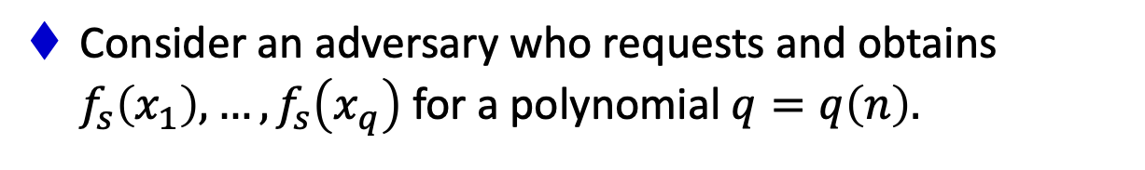
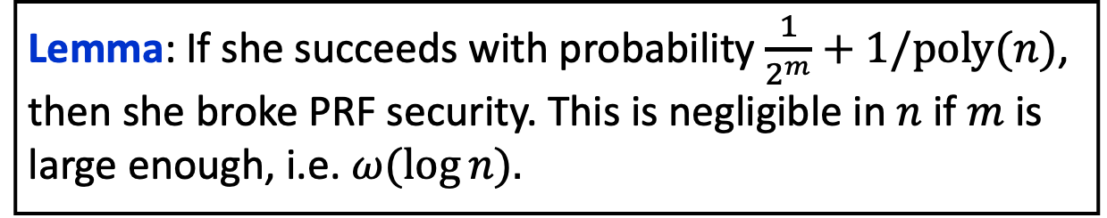
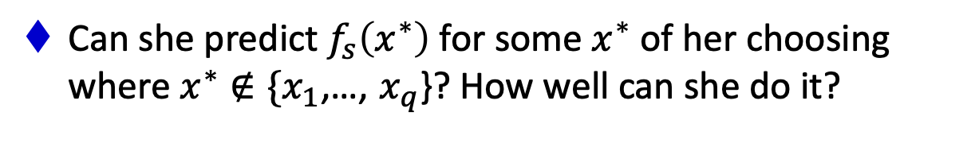
Unpredictability for PRF
Let $f_{s}:\{0,1\}^{ℓ}→\{0,1\}^{m}$ be a pseudorandom function.
Consider an adversary who requests and obtains $f_{s}\left(x_{1}\right),…,f_{s}\left(x_{q}\right)$ for a polynomial $q=q\left(n\right).$
Can she predict $f_{s}\left(x^{∗}\right)$ for some $x^{∗}$ of her choosing where $x^{∗}∉\{x_{1}$,…, $x_{q}$}? How well can she do it?
Lemma: If she succeeds with probability $\frac{1}{2^{m}}+1/poly(n)$, then she broke PRF security. This is negligible in $n$ if $m$ is large enough, i.e. $ω(\log{n).}$

Slide 34
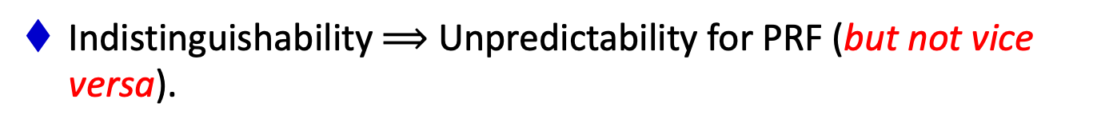
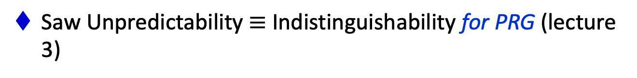
Unpredictability vs. Indistinguishability for PRF
Let $f_{s}:\{0,1\}^{ℓ}→\{0,1\}^{m}$ be a pseudorandom function.
Consider an adversary who requests and obtains $f_{s}\left(x_{1}\right),…,f_{s}\left(x_{q}\right)$ for a polynomial $q=q\left(n\right).$
Can she predict $f_{s}\left(x^{∗}\right)$ for some $x^{∗}$ of her choosing where $x^{∗}∉\{x_{1}$,…, $x_{q}$}? How well can she do it?
Saw Unpredictability $≡$ Indistinguishability for PRG (lecture 3)
Indistinguishability $⟹$ Unpredictability for PRF (but not vice versa).

Slide 35
Prediction Test for Functions?
(analogue to Next-Bit Test)
Prediction Test for functions:
Requests Y_{i} =f(X_{i}) for X_{i}, i=1..q
Request Y for X∉{X₁,X₂ ,…, X_{q}}
Decide whether given Y is
Y= F_{S} (X) or Y∈_{R}{0,1}^{n}
Claim: Is Prediction Test ≅ Statistical Tests for functions? Prove it : Homework

Slide 36
Pseudo- Random Permutation (PRP):
Let H_{n} = {f: {0,1}^{n} -> {0,1}^{n}} all Permutations from n bits to n bits
Definition: F= {F_{n} }_{n} where F_{n} ⊆ H_{n} is a collection of pseudo random permutations:
1.There exists PPT algorithm G (1^{n}) to selects f_{i} ∈ F_{n}
2. There exists PPT algorithm Eval s.t. Eval(x, i) =f_{i}(x)
3. For all PPT statistical tests for functions D^{f},
for all sufficiently large n
| prob(D^{f}(1^{n}) =1: f ∈ H_{n}) - prob(:D^{f}(1^{n}) =1: f∈F_{n} ) | = negl(n)
Theorem[LR]: OWF imply PRP

Slide 37
TODAY
0. Finish up secret-key encryption.
1. Theorem: If there are PRGs, then there are PRFs.
The Goldreich-Goldwasser-Micali (GGM) construction.
2. More Applications of PRFs:
a. Identification Protocols
b. Authentication
c. Applications to Learning Theory

Slide 38
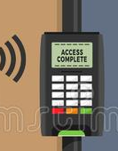


Friend-or-Foe Identification
Adversary: person-in-the-middle.
Can listen to / modify the communications. Wants to impersonate Tim.

Slide 39




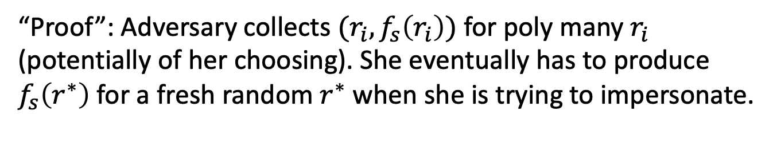

Challenge-Response Protocol
Random $r$
$$(ID,f_{s}\left(r\right))$$
PRF K$ey s$
(ID number $ID$, PRF Key $s$)
“Proof”: Adversary collects $(r_{i},f_{s}\left(r_{i}\right))$ for poly many $r_{i}$ (potentially of her choosing). She eventually has to produce $f_{s}\left(r^{∗}\right)$ for a fresh random $r^{∗}$ when she is trying to impersonate.
This is hard as long as the input and output lengths of the PRF are long enough, i.e. $ω(\log{n).}$

Slide 40
TODAY
1. Theorem: If there are PRGs, then there are PRFs.
The Goldreich-Goldwasser-Micali (GGM) construction.
2. More Applications of PRFs:
a. Identification Protocols
b. Authentication
c. Applications to Learning Theory

Slide 41
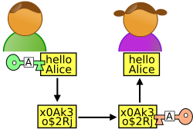




Secure Communication
m
$m⊕k$
$m′⊕k$
Alice
Bob
Can toggle between m and m’
K$ey k$
Key $k$
One-time pad (and encryption schemes in general) are malleable.

Slide 42


Secure Communication
m
$(r,f_{k}(r)⊕m$)
$(r,f_{k}\left(r\right)⊕m^{′})$
Alice
Bob
Can toggle between m and m’
K$ey k$
Key $k$
One-time pad (and encryption schemes in general) are malleable.

Slide 43

Message Authentication Codes
m
${{MAC}_{k}\left(m\right)= f}_{k}(m)$
Alice
Bob
K$ey k$
Key $k$
MACs give us integrity, but not privacy.

Slide 44



Message Authentication Codes
m
${ (c=\left(x,f_{k}\left(x\right)⨁m\right), tag=f}_{k′}(c))$
Alice
Bob
K$eys k,k′$
Keys $k,k′$
MACs give us integrity, but not privacy.
Solution: first Encrypt, then MAC

Slide 45
TODAY
1. Theorem: If there are PRGs, then there are PRFs.
The Goldreich-Goldwasser-Micali (GGM) construction.
2. More Applications of PRFs:
a. Identification Protocols
b. Authentication
c. Applications to Learning Theory

Slide 46
Negative Results in Learning Theory
Theorem [Kearns and Valiant 1994]:
Assuming PRFs exist, there are hypothesis classes that cannot be learned by polynomial-time algorithms.

Slide 47
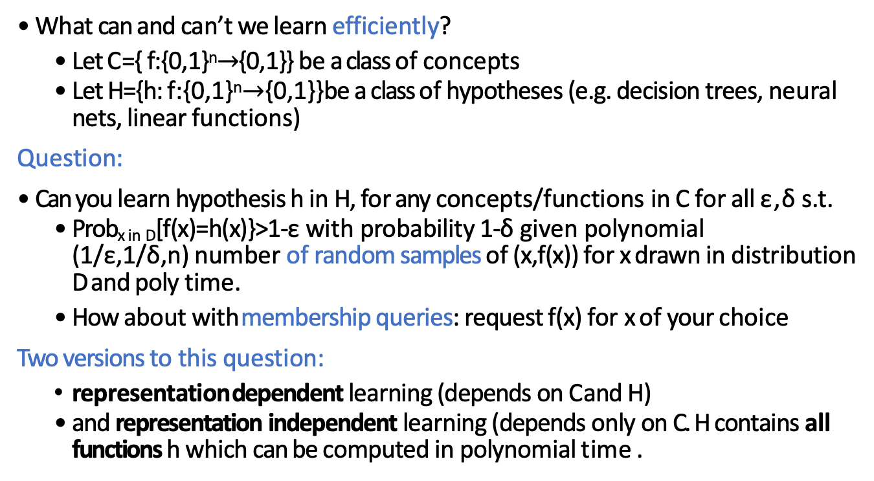
Computational Hardness of Learning
What can and can’t we learn efficiently?
  Let C ={ f:{0,1}^{n}$→${0,1}} be a class of concepts
  Let H={h: f:{0,1}^{n}$→${0,1}} be a class of hypotheses (e.g. decision trees, neural
nets, linear functions)
Question:
Can you learn hypothesis h in H, for any concepts/functions in C for all ε,δ s.t.
  Prob_{x in D}[f(x)=h(x)}>1-ε with probability 1-δ given polynomial (1/ε,1/δ,n) number of random samples of (x,f(x)) for x drawn in distribution D and poly time.
  How about with membership queries: request f(x) for x of your choice
Two versions to this question:
  representation dependent learning (depends on C and H)
  and representation independent learning (depends only on C. H contains all
functions h which can be computed in polynomial time .

Slide 48
[Pitt-Valiant]: Its all about representation
Claim: k-term DNF is learnable by k-CNF
Claim [Valiant]:k-CNF is properly learnable by k-CNF. Corollary: k-term DNF can be learnable by a k-CNF.

Slide 49
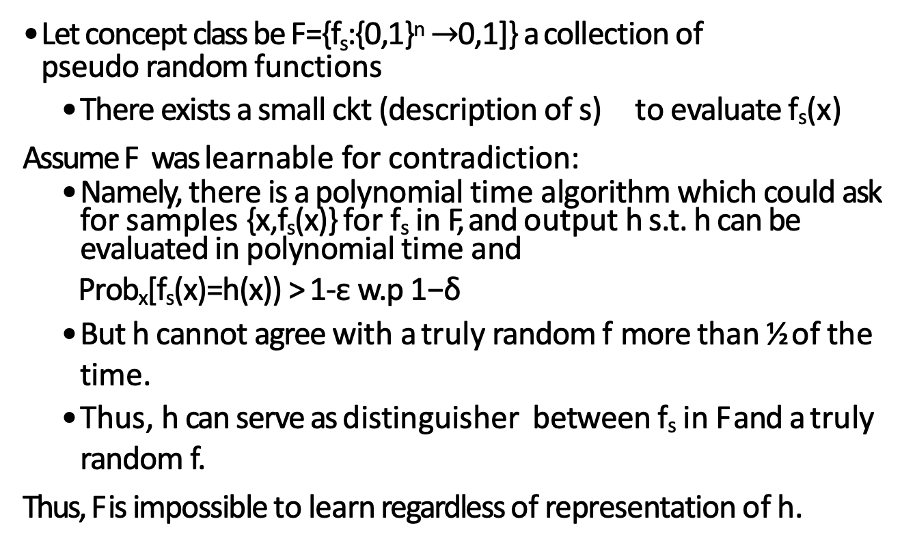
PRFs imply Representation Independent Learning is Hard for concepts in P
Let concept class be F={f_{s}:{0,1}^{n} $→$0,1]} a collection of pseudo random functions
  There exists a small ckt (description of s) to evaluate f_{s}(x)
Assume F was learnable for contradiction:
  Namely, there is a polynomial time algorithm which could ask for samples {x,f_{s}(x)} for f_{s} in F, and output h s.t. h can be evaluated in polynomial time and
Prob_{x}[f_{s}(x)=h(x)) > 1-ε w.p 1−δ
  But h cannot agree with a truly random f more than ½ of the time.
  Thus, h can serve as distinguisher between f_{s} in F and a truly random f.
Thus, F is impossible to learn regardless of representation of h.

Slide 50
From Learning to Cryptography: Interesting Consequences
PRFs cannot be implemented by linear threshold functions as can be learned
PRF cannot be implemented by polynomial size formula in DNF form, as can be learned for uniform distribution

Slide 51
PRFs and Learning: Still hard to Learn even when
PRFs
Constrained
Aggregate
Key homomorphic
Related-key secure
Learning is HARD
Can label some of the examples of the concept yourself
Can get sums of labels in an interval you specify
Labels satisfy arithmetic
Can receive answers to Queries on related concepts

