Slide 1
MIT 6.875/6.5620/18.425
Foundations of Cryptography
Lecture 2
Shafi Goldwasser
Course website: https://mit6875.github.io/

Slide 2
Lecture 1 Recap

Slide 3
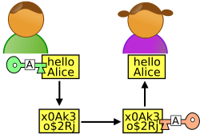
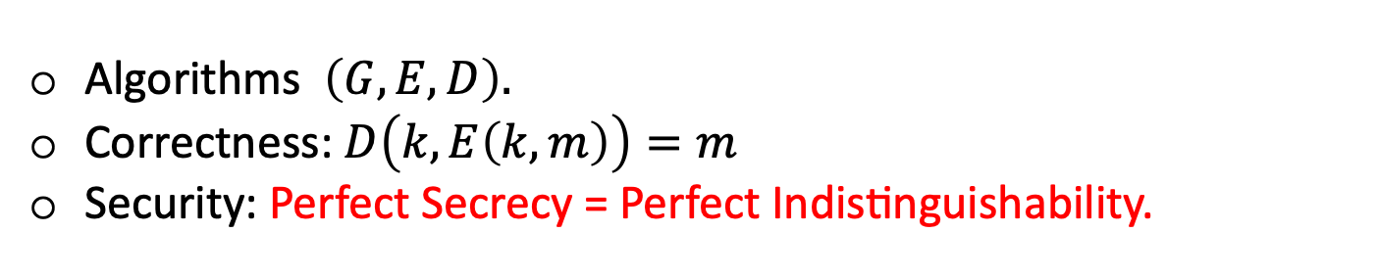
Secure Communication
m
Alice
Bob
Key k
Key k
Eavesdropper “Eve”
Alice and Bob met to agree on a secret key k in G(1^{n})
Algorithms $\left(G,E,D\right).$
Correctness: $D\left(k,E\left(k,m\right)\right)=m$
Security: Perfect Secrecy = Perfect Indistinguishability.

Slide 4
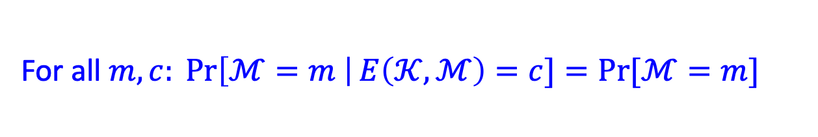
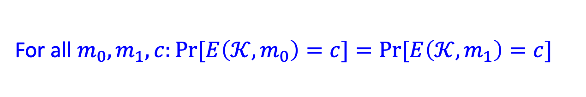
How to Define Security
Perfect secrecy: A Posteriori = A Priori
For all $m,c: \operatorname{Pr}\left[ℳ=m \right|E\left(𝒦,ℳ\right)=c]=Pr⁡[ℳ=m]$
Perfect indistinguishability:
For all $m_{0},m_{1},c:Pr⁡[E\left(𝒦,m_{0}\right)=c]=Pr⁡[E\left(𝒦,m_{1}\right)=c]$
The two definitions are equivalent!

Slide 5

Is there a perfectly secure scheme?
One-time Pad: $E\left(k,m\right)=k⨁m$
However: Keys are as long as Messages
WORSE, Shannon’s theorem:
for any perfectly secure scheme, |key|$≥$|message|.
Can we overcome Shannon’s conundrum?

Slide 6
How to get around Impossibilities
Weaken the adversary model
Weaken your definition of security
Find new class of assumptions

Slide 7
Still Prepare for Worst Case Adversary Strategy
  But Bounded by Probabilistic Polynomial Time
Adversary runs in polynomial time O(n^{c}) for some c>0. where n is its input length (security parameter).
Adversary is randomized: can flip fair coins
  Las Vegas: ∀input, A is correct or with negligible probability A outputs ⫠
  Monte Carlo: ∀input, A is correct with all but negligible probability

Slide 8
Life
The Axiom of Modern Crypto
Feasible Computation = Probabilistic polynomial-time*
(p.p.t. = Probabilistic polynomial-time)
(polynomial in a security parameter n)
,Alice and Bob are fixed p.p.t. algorithms.
(e.g., run in time n^2)
Eve is any p.p.t. algorithm.
(e.g., run in time n^4, or n^100, or n^10000,…)
* in recent years, quantum polynomial-time

Slide 9
Getting around Impossibilities
Weaken the adversary model
Weaken your definition of security
Find new class of assumptions

Slide 10
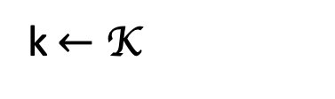
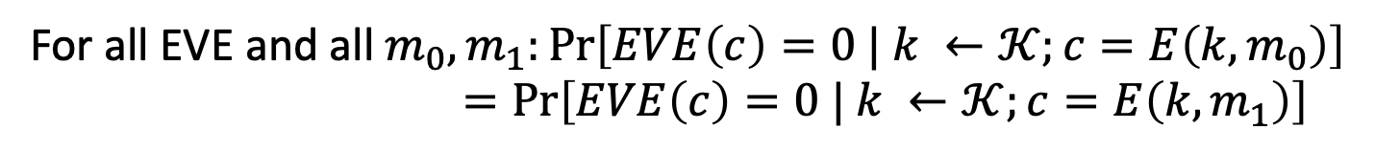


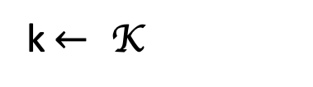
Recall: Perfect Indistinguishability
For all $m_{0},m_{1},c:Pr⁡[E\left(𝒦,m_{0}\right)=c]=Pr⁡[E\left(𝒦,m_{1}\right)=c]$
World 0:
World 1:
k$←$ K
=
k$← \text{K}$
$$c=E\left(k,m_{0}\right)$$
$$c=E\left(k,m_{1}\right)$$
is a distinguisher.
For all EVE and all $m_{0},m_{1}:\operatorname{Pr}\left[EVE\left(c\right)=0 | k ←𝒦;c=E\left(k,m_{0}\right)\right]$
$=\operatorname{Pr}\left[EVE\left(c\right)=0 | k ←𝒦;c=E\left(k,m_{1}\right)\right]$

Slide 11
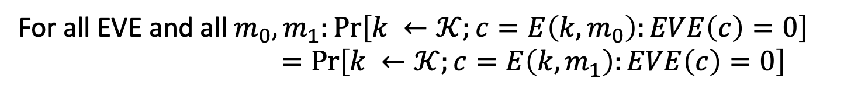
Recall: Perfect Indistinguishability
For all $m_{0},m_{1},c:Pr⁡[E\left(𝒦,m_{0}\right)=c]=Pr⁡[E\left(𝒦,m_{1}\right)=c]$
World 0:
World 1:
k$←$ K
=
k$← \text{K}$
$$c=E\left(k,m_{0}\right)$$
$$c=E\left(k,m_{1}\right)$$
is a distinguisher.
For all EVE and all $m_{0},m_{1}:\operatorname{Pr}\left[k ←𝒦;c=E\left(k,m_{0}\right):EVE\left(c\right)=0\right]$
$=\operatorname{Pr}\left[k ←𝒦;c=E\left(k,m_{1}\right):EVE\left(c\right)=0\right]$
Notion: left to right. Why? Tradition…
https://www.youtube.com/watch?v=gRdfX7ut8gw

Slide 12
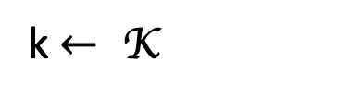

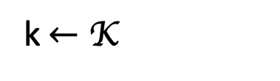
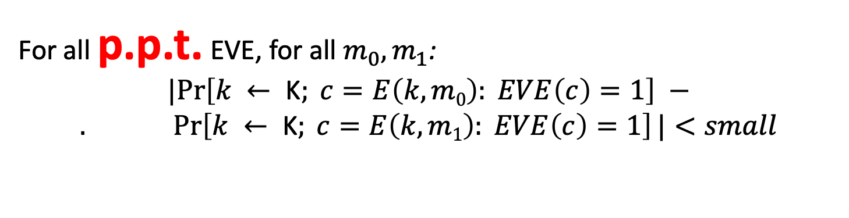


Computational Indistinguishability
World 0:
World 1:
k$←$ K
$$≈$$
k$← \text{K}$
$$c=E\left(k,m_{0}\right)$$
$$c=E\left(k,m_{1}\right)$$
Can’t distinguish these worlds apart
For all p.p.t. EVE, for all $m_{0},m_{1}$:
$$|Pr\left[k ← \text{K}; c=E\left(k,m0\right): EVE\left(c\right)=1\right] −$$
$$. Pr\left[k ← \text{K}; c=E\left(k,m1\right): EVE\left(c\right)=1\right]|<small$$
What is small?
Notes:
This is a subtle definition. Think carefully about the order of quantifiers. This says “for every polynomial function p(n), and for every polynomial function q(n) there is an n_0 s.t. for all n > n_0, Pr[p(n)-time EVE distinguishes] <= 1/2 + 1/q(n).”
Question to reader: What effect does switching the order of quantifiers have? i.e. in the def above, “There is a negligible function mu s.t. for all p.p.t. EVE,…”?

Slide 13
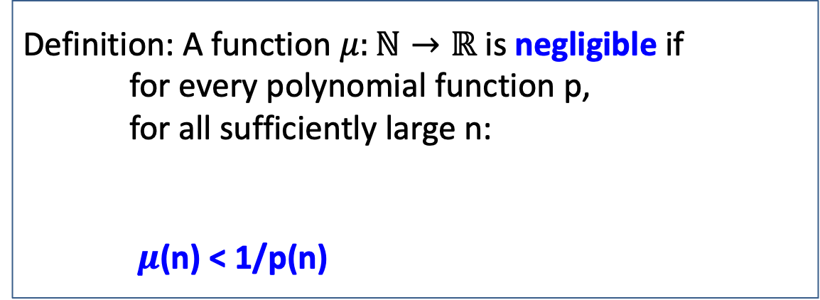

New Notion: Negligible Functions
Functions that grow slower than 1/p(n) for any polynomial p.
Definition: A function $μ:ℕ→ℝ$ is negligible if
for every polynomial function p,
for all sufficiently large n:
$μ$(n) < 1/p(n)
there exists an $n_{0}$ s.t.
for all ${n>n}_{0}:$
Key property: Events that occur with negligible probability look to poly-time algorithms like they never occur.
Notes:
Question slide

Slide 14

New Notion: Negligible Functions
Functions that grow slower than 1/p(n) for any polynomial p.
Definition: A function $μ:ℕ→ℝ$ is negligible if
for every polynomial function p,
for all sufficiently large n:
$μ$(n) < 1/p(n)
there exists an $n_{0}$ s.t.
for all ${n>n}_{0}:$
Question: Let $μ\left(n\right)=1/n^{100}$ if n is prime and
$μ\left(n\right)=1/2^{n}$ otherwise. Is $μ$ negligible?
Notes:
Question slide

Slide 15
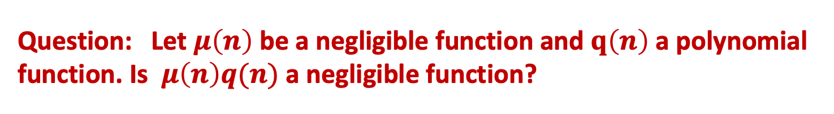
New Notion: Negligible Functions
Functions that grow slower than 1/p(n) for any polynomial p.
Definition: A function $μ:ℕ→ℝ$ is negligible if
for every polynomial function p,
for all sufficiently large n:
$μ$(n) < 1/p(n)
there exists an $n_{0}$ s.t.
for all ${n>n}_{0}:$
Question: Let $μ\left(n\right)$ be a negligible function and $q\left(n\right)$ a polynomial function. Is $μ\left(n\right)q(n)$ a negligible function?
Notes:
Question slide

Slide 16
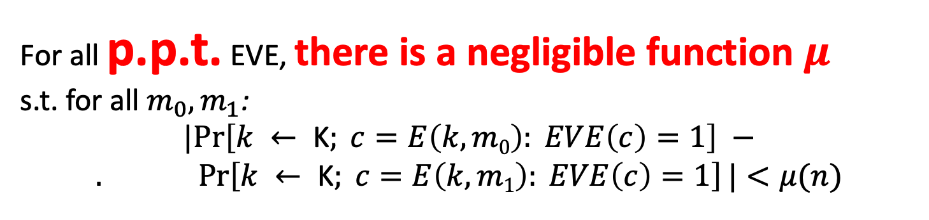
Computational Indistinguishability (take 2)
World 0:
World 1:
k$←$ K
$$≈$$
k$← \text{K}$
$$c=E\left(k,m_{0}\right)$$
$$c=E\left(k,m_{1}\right)$$
is a distinguisher.
For all p.p.t. EVE, there is a negligible function $μ$
s.t. for all $m_{0},m_{1}$:
$$|Pr\left[k ← \text{K}; c=E\left(k,m0\right): EVE\left(c\right)=1\right] −$$
$$. Pr\left[k ← \text{K}; c=E\left(k,m1\right): EVE\left(c\right)=1\right]|<μ(n)$$
Notes:
This is a subtle definition. Think carefully about the order of quantifiers. This says “for every polynomial function p(n), and for every polynomial function q(n) there is an n_0 s.t. for all n > n_0, Pr[p(n)-time EVE distinguishes] <= 1/2 + 1/q(n).”
Question to reader: What effect does switching the order of quantifiers have? i.e. in the def above, “There is a negligible function mu s.t. for all p.p.t. EVE,…”?

Slide 17
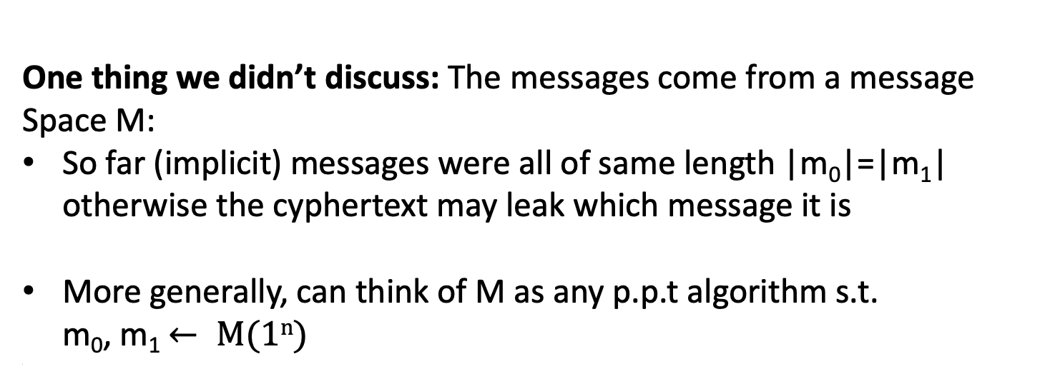
The Message Space
One thing we didn’t discuss: The messages come from a message Space M:
So far (implicit) messages were all of same length |m₀|=|m₁| otherwise the cyphertext may leak which message it is
More generally, can think of M as any p.p.t algorithm s.t.
m₀, m₁ $← M(1n)$
\
The scheme should work regardless of the message space.
Notes:
Question slide

Slide 18

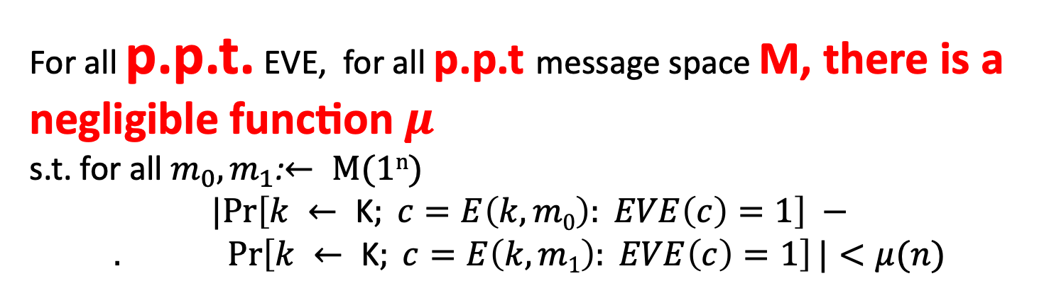
Computational Indistinguishability (take 3)
World 0:
World 1:
k$←$ K
$$≈$$
k$← \text{K}$
$$c=E\left(k,m_{0}\right)$$
$$c=E\left(k,m_{1}\right)$$
is a distinguisher.
For all p.p.t. EVE, for all p.p.t message space M, there is a negligible function $μ$
s.t. for all $m_{0},m_{1}$:$← M(1n)$
$$|Pr\left[k ← \text{K}; c=E\left(k,m0\right): EVE\left(c\right)=1\right] −$$
$$. Pr\left[k ← \text{K}; c=E\left(k,m1\right): EVE\left(c\right)=1\right]|<μ(n)$$
Notes:
This is a subtle definition. Think carefully about the order of quantifiers. This says “for every polynomial function p(n), and for every polynomial function q(n) there is an n_0 s.t. for all n > n_0, Pr[p(n)-time EVE distinguishes] <= 1/2 + 1/q(n).”
Question to reader: What effect does switching the order of quantifiers have? i.e. in the def above, “There is a negligible function mu s.t. for all p.p.t. EVE,…”?

Slide 19
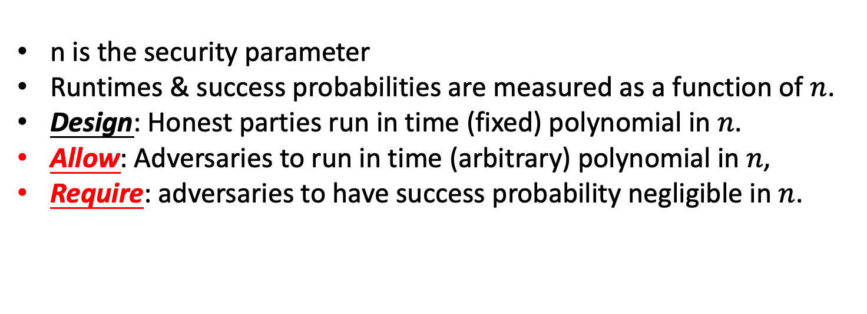
The security Parameter
n is the security parameter
Runtimes & success probabilities are measured as a function of $n$.
Design: Honest parties run in time (fixed) polynomial in $n$.
Allow: Adversaries to run in time (arbitrary) polynomial in $n$,
Require: adversaries to have success probability negligible in $n$.
Notes:
Question slide

Slide 20
Now Can Ask New Questions
Can A and B meet to agree on key and subsequently exchange P(n) messages securely, where P is any polynomial?
Yes
Can A and B exchange messages without meeting
Yes
How?

Slide 21
How to Get Around Impossibilities
Weaken the adversary model
Weaken your definition of security
Make assumptions

Slide 22
Our First Crypto Tool:
Pseudorandom Generators (PRG)

Slide 23
Ambitious Plan for next 2 lectures
New Primitive: Secure Pseudo Random Generators (PRG)
PRG imply stateful Encryption schemes that satisfy Computational Indistinguishability
with |keys| << |message bits|
Build PRG from any One-Way Functions: the ASSUMPTION
Candidate One-Way Functions from number theory, lattices
New Primitive: Secure Pseudo Random Functions (PRF)
imply stateless Encryption schemes which is Computational Indistinguishability

Slide 24
Pseudo-random Generators
Informally: Deterministic Programs that stretch a “truly random” seed into a (much) longer sequence of “seemingly random” bits.
seed
PRG G
b1 b2 b3 ...
How to define “seemingly random”?
Can such a G exist?

Slide 25
What about Sources of True Randomness for the seed?
Specialized Hardware: e.g. Transistor noise
User Input: Every time random number used,
user is queried
Usually biased, but can “extract” unbiased bits assuming the source has “some structure and enough entropy” [von Neumann, Elias, Blum]
True randomness is an expensive non-replicable commodity.

Slide 26
How to formally Define a Strong
Pseudo Random Number Generator?
Def 1 [Indistinguishability]
“No polynomial-time algorithm can distinguish between the output of a PRG on a random seed vs. a truly random string”
= “as good as” a truly random string for all practical purposes.
ALL THREE DEFS EQUIVALENT!
Def 2 [Next-bit Unpredictability]
“No polynomial-time algorithm can predict the (i+1)^{th} bit of the output of a PRG given the first i bits, better than chance”
Def 3 [Incompressibility]
“No polynomial-time algorithm can compress the output of the PRG into a shorter string”

Slide 27

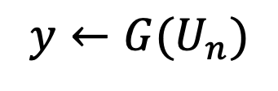

PRG Def 1: Indistinguishability
WORLD 1:
The Pseudorandom World
WORLD 2:
The Truly Random World
$$y←{G(U}_{n})$$
$$y←U_{m}$$
PPT Distinguisher gets y but cannot tell which world she is in

Slide 28
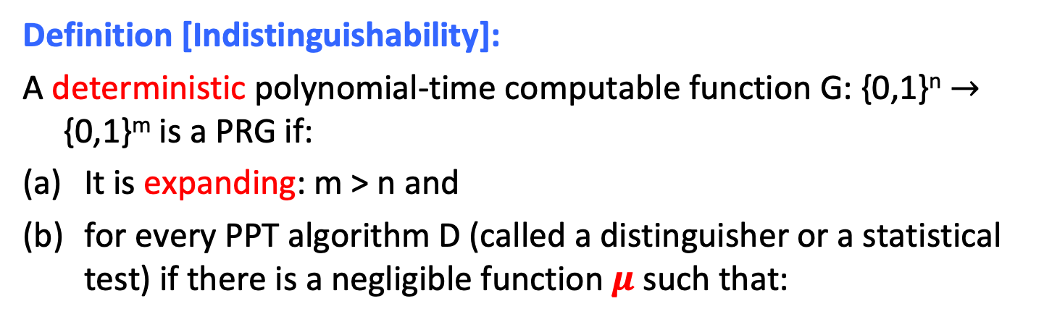
PRG Def 1: Indistinguishability
Definition [Indistinguishability]:
A deterministic polynomial-time computable function G: {0,1}^{n} $→$ {0,1}^{m} is a PRG if:
It is expanding: m > n and
for every PPT algorithm D (called a distinguisher or a statistical test) if there is a negligible function $μ$ such that:
$$| Pr⁡[ D(G(U_{n})) = 1 ] – Pr⁡[ D(Um) = 1 ] | =μ(n)$$
Notation: U_{n} (resp. U_{m}) denotes the random distribution on n-bit (resp. m-bit) strings; m is shorthand for m(n).

Slide 29

PRG Def 1: Indistinguishability
Definition [Indistinguishability]:
A deterministic polynomial-time computable function G: {0,1}^{n} $→$ {0,1}^{m} is a PRG if:
It is expanding: m > n and
for every PPT algorithm D (called a distinguisher or a statistical test) if there is a negligible function $μ$ such that:
$$| Pr⁡[ D(G(U_{n})) = 1 ] – Pr⁡[ D(Um) = 1 ] | =μ(n)$$
Statistical Test: D that takes a sequence and outputs 0 or 1

Slide 30
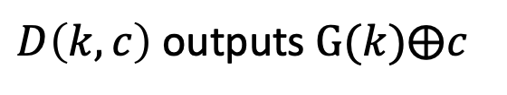

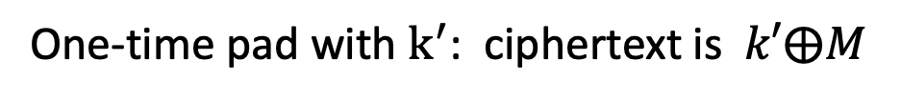
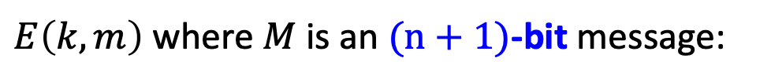
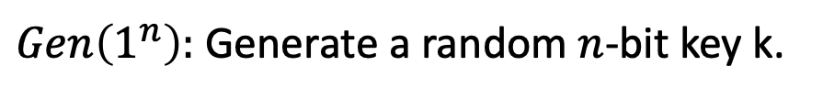

App: PRG $⟹$ Overcoming Shannon’s Conundrum
(or, How to Encrypt n+1 bits using an n-bit key)
$Gen\left(1^{n}\right):$ Generate a random $n$-bit key k.
$E\left(k,m\right)$ where $M$ is an $(n+1)$-bit message:
Expand k into a (n+1)-bit pseudorandom string $k^{′}= G(k)$
One-time pad with $k^{′}$: ciphertext is $k′⨁M$
$D\left(k,c\right)$ outputs $G(k)⨁c$
$$Correctness:$$
$D\left(k,c\right)$ outputs $G\left(k\right)⨁c=G\left(k\right)⨁G\left(k\right)⨁M=M$

Slide 31


Randomness is the foundation of cryptography: keys must be unpredictable
Cryptographic algorithms use additional randomness (beyond the key)
If the random bits are revealed (or are predictable) the entire
structure can collapse
Cryptography
Randomness

Slide 32
Why is this a GREAT definition
Good for all Applications:
As long as we can find truly random seeds, can replace true randomness by the output of PRG(seed) in ANY (polynomial-time) application.
If the application behaves differently, then it can be converted into a (polynomial-time) statistical test between PRG(seed) and a truly random string.

Slide 33


Cryptography
Randomness is a Fundamental Resource
Simulation/Sampling/MCMC
Distributed Computing
Probabilistic Algorithms
Randomness

Slide 34
Randomness in Machine Learning
Randomness Source
1
input
LLM algorithm
output
Crucial for training (SGD, ERM use sampling) and for generating
Raises interesting questions
Can bad use of randomness lead to bias outcomes
Can use of special PSRG enforce ML-desirable properties

Slide 35
Pseudorandom Generators and (T)CS

Slide 36
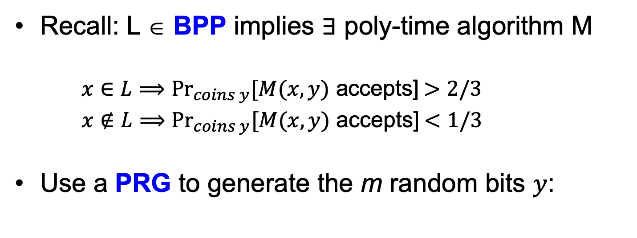
Application of PRGs: De-randomization
Recall: L ∈ BPP implies ∃ poly-time algorithm M
  $x∈L⟹{Pr}_{coins y}[M(x,y)$ accepts] $>2/3$
  $x∉L⟹{Pr}_{coins y}[M(x,y)$ accepts] $<1/3$
Use a PRG to generate the m random bits $y$:
G
seed
output string y
Run M(x,y)

Slide 37
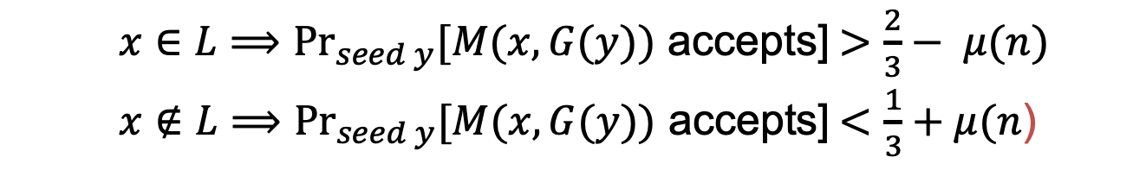
Application of PRGs: De-randomization
Theorem: if PRGs exist, then $BPP⊆ ∩_{ε>0}TIME\left(2^{m^{ε}}\right).$
(in English) if PRGs exist, then every randomized poly-time algorithm can be simulated in deterministic sub-exponential time.
Proof Sketch: use PRG that expands from ${n=m}^{ε}$ bits to $m$ bits.
  $x∈L⟹{Pr}_{seed y}[M(x,G(y))$ accepts] $>\frac{2}{3}− μ(n)$
  $x∉L⟹{Pr}_{seed y}[M(x,G(y))$ accepts] $<\frac{1}{3}+μ(n$)
Why?
If the above is not true, M is a distinguisher for the PRG!
Note:
M is a (known, fixed, fixed poly-time) distinguisher.

Slide 38
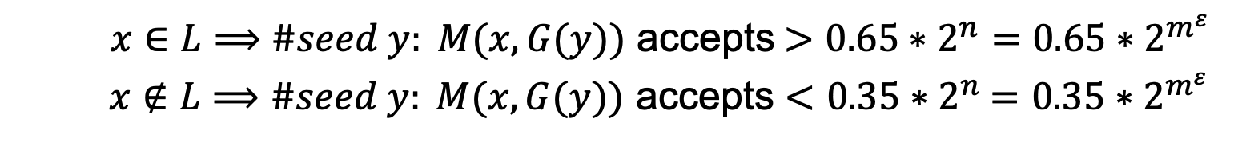

Application of PRGs: De-randomization
Theorem: if PRGs exist, then $BPP⊆ ∩_{ε>0}TIME\left(2^{m^{ε}}\right).$
(in English) if PRGs exist, then every randomized poly-time algorithm can be simulated in deterministic sub-exponential time.
Proof Sketch: use PRG that expands from ${n=m}^{ε}$ bits to $m$ bits.
  $x∈L⟹\#seed y: M(x,G(y))$ accepts $>0.65∗2^{n}=0.65∗2^{m^{ε}}$
  $x∉L⟹\#seed y: M(x,G(y))$ accepts $<0.35$ $∗2^{n}$ $=0.35∗2^{m^{ε}}$
Here is the deterministic algorithm: enumerate over all seeds $y$and run $M\left(x,G\left(y\right)\right).$ If #accepts $>0.65∗2^{m^{ε}}$, accept else reject.

Slide 39
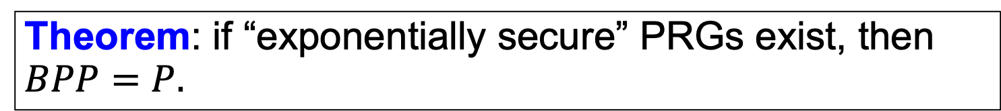
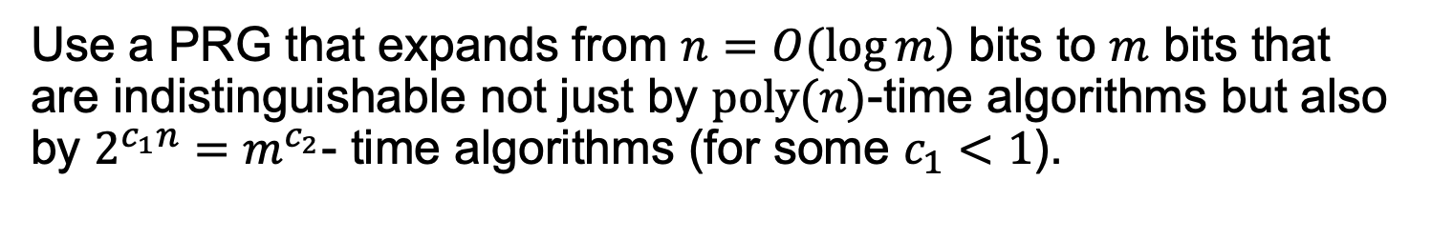
Application of PRGs: De-randomization
Theorem: if “exponentially secure” PRGs exist, then $BPP=P.$
Proof Sketch:
Use a PRG that expands from $n=O(\log{m)}$ bits to $m$ bits that are indistinguishable not just by $poly(n)$-time algorithms but also by $2^{c_{1}n}=m^{c_{2}}$- time algorithms (for some $c_{1}<1$).
The previous proof goes through mutatis mutandis, using crucially the fact that the randomized algorithm (adversary for us) runs in fixed polynomial-time.
Notes:
Of course, the PRG output *can* be distinguished from random by a 2^n time algorithm, so c_1 necessarily has to be < 1.

Slide 40

$$Million \$ Question:$$
Do PRGs exist?
(Exercise: If P=NP, PRGs do not exist.)

Slide 41
Maybe too Strong a Definition?
Can you ever show that a particular PRG passes all statistical tests ?
Yes
But not directly working with this definition,
First, reduce it to another definition “Next bit Unpredictability”
Then, construct a PRG which passes “Next Bit Unpedictability”

Slide 42
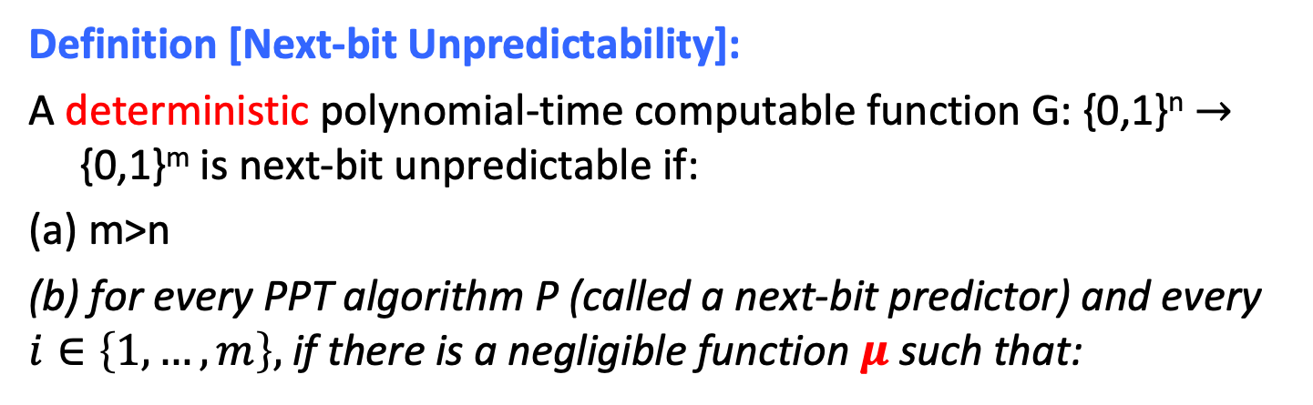

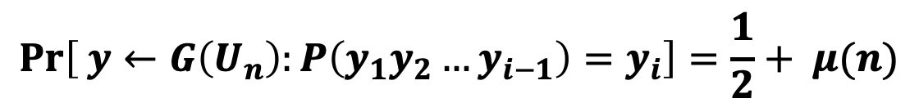
PRG Def 2: Next-bit Unpredictability
Definition [Next-bit Unpredictability]:
A deterministic polynomial-time computable function G: {0,1}^{n} $→$ {0,1}^{m} is next-bit unpredictable if:
(a) m>n
(b) for every PPT algorithm P (called a next-bit predictor) and every $i∈\left\{1,…,m\right\},$ if there is a negligible function $μ$ such that:
$$\operatorname{Pr}\left[ y←G\left(U_{n}\right):P\left(y_{1}y_{2}…y_{i−1}\right)=y_{i}\right]=\frac{1}{2}+ μ(n)$$
Notation: $y_{1}{,y}_{2},…y_{m}$ are the bits of the m-bit string $y$.
If (b) holds, we say that G “passes all next bit tests “

Slide 43
Def 1 and Def 2 are Equivalent
Theorem:
A PRG G is indistinguishable if and only if it is next-bit unpredictable.

Slide 44
Def 1 and Def 2 are Equivalent
Theorem:
A PRG G passes all (poly-time) statistical tests if and only if it passes (poly-time) next-bit tests.

Slide 45
NBU and Indistinguishability
Next-bit Unpredictability (NBU): Seemingly much weaker requirement. Only says that next bit predictors, a particular type of distinguishers, cannot succeed.
Yet, surprisingly, Next-bit Unpredictability (NBU) = Indistinguishability.
NBU often much easier to use.

Slide 46
Constructing PRGs:
The Foundational Methodology (much of this course)
Reduce to simpler primitives.
Digital Signatures
PRF
PRG
Hashing
OWF
well-studied, average-case hard, problems

Slide 47
One-Way Functions
Easy to compute in PPT
x
f(x)
hard to invert in
PPT on average
f: {0,1}* ⇒ {0,1}* is a one-way function(OWF) if:
Easy to Evaluate: ∃ PPT algorithm A s.t. A(x)=f(x) ∀ x.
Hard to Invert: ∀PPT algorithms Inv, ∀ n sufficiently large, prob ( Inv(y) =x’ s.t. y=f(x’)) < neg(n)
x ∈ {0,1}^{n}, y=f(x), coins of Inv
Length preserving OWF:functions s.t. |f (x)| =|x |.
One-way Permutations: One-to-one length preserving OWF

Slide 48
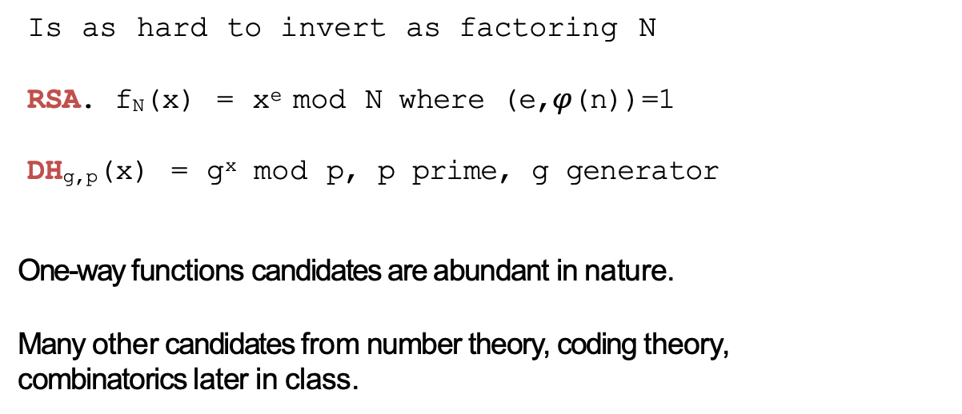
One-way Functions: Candidates
Subset sum:
₂𝑛+1₎
f(𝑎₁, … , 𝑎_{𝑛}, 𝑥₁, … , 𝑥_{𝑛}) = (𝑎₁, … , 𝑎_{𝑛},σ^{𝑛} 𝑥_{𝑖}𝑎_{𝑖} mod
𝑖=1
where 𝑎_{𝑖} random n-bit nu₂ mbers, and 𝑥_{𝑖} are random bits.
Rabin: f_{N}(x) = x² mod N
Is as hard to invert as factoring N
RSA. f_{N}(x) = x^{e} mod N where (e,$φ$(n))=1
DH_{g,p}(x) = g^{x} mod p, p prime, g generator
One-way functions candidates are abundant in nature.
Many other candidates from number theory, coding theory,
combinatorics later in class.

Slide 49
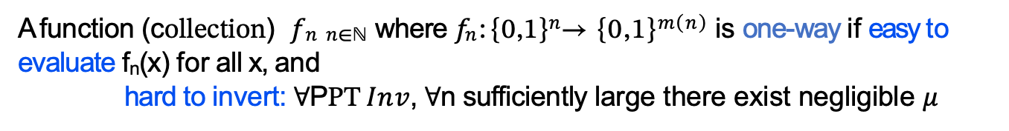
Collection of One-way Functions
A function (collection) 𝑓_{𝑛 𝑛∈ℕ} where 𝑓_{𝑛}: {0,1}^{𝑛}→ {0,1}^{𝑚(𝑛)} is one-way if easy to evaluate f_{n}(x) for all x, and
hard to invert: ∀PPT 𝐼𝑛𝑣, ∀n sufficiently large there exist negligible $μ$
_{𝑥}′
Pr 𝐼𝑛𝑣 𝑦 = 𝑥′ 𝑠. 𝑡. 𝑦 = 𝑓_{𝑛} ≤ $μ$ (𝑛)
over 𝑥 ← 0,1 ^{𝑛}; 𝑦 = 𝑓_{𝑛} 𝑥 ;
Can always find an inverse with unbounded time
… but should be hard with probabilistic polynomial time

Slide 50
Attempt: Strong- PRG from one-way permutations
Idea: Let f be one-way permutation.
Choose random seed s in {0,1}^{n}
Compute f(s) f²(s) f³(s) … f ^{m}(s)
Output in reverse order
Why is this a good idea, Intuitively, ?
  Somewhat Unpredictable: From f^{i}(s) can’t compute f^{i-1}(s)
Why not good enough ?
  Even though you cannot predict f^{i-1}(s) some bits of it may
be predictable.
Exercise: There are one-way functions for which it is
easy to compute the first half of the bits of the inverse.
Still, may be can be salvaged: there must be some bits of f⁻¹(s) that are hard to compute for a random s.

Slide 51



Hard Core Predicates for OWF
A hard-core predicate for one-way function f:{0,1}* →{0,1}* is a Boolean predicate B: {0,1}* → {0,1} such that
B(x) is easy to compute given x but hard to predict given f(x)
Hard
∀ PPT algorithm P (“predictor”),
Prob [ P(y) = B(x) ]= ½ + negl(n)
(over x in {0,1}^{n} , y=f(x)
and Pred’s coins )
x
Easy
y=f(x)
Easy
Unpredictable
B(X)

Slide 52
Discussion on the Definition
Some functions can have information-theoretically hard to
guess predicates (e.g., compressing functions)
We’ll be interested in settings where 𝑥 is uniquely determined given f 𝑥 (𝑖. 𝑒 𝑝𝑒𝑟𝑚𝑢𝑡𝑎𝑡𝑖𝑜𝑛𝑠) yet B(𝑥)is hard to predict given F 𝑥 .
Ex: LSB(x) is hard-core for RSA(x) but not for DH(x)
Is there a universal hard-core predicate?

Slide 53
Constructing PSRG
Theorem: If there exist one-way-permutations f with hard core bit B, then there exist strong PRG
G:{0,1}^{n}->{0,1}^{P(n)} for any polynomial P.
Proof: Let P be a polynomial function, set m=P(n)
On input seed s from U_{n},
G(s): (1) compute f(s) f(f(s)) … f(f^{m-1}(s))
(2) output B(s) B(f(s)) … B(f^{m-1}(s))

Slide 54
Picture Better than 1000 words
Input
Internal Configuration
f(s)
Output
B(s) B(f(s))
B(f ⁽²⁾(s))
s
f⁽²⁾(s)
f⁽³⁾(s)
f^{m}(s)
B(f ^{(m-1)}(s))

Slide 55
Proof : Show outputs of G pass all next-bit tests.
Suppose, for contradiction, ∃bit location j<m and next bit predictor P s.t.
Pr _{y G(Un)}[P(y₁y₂…y_{j-1}) = y_{i}] > ½ + 1/P(n) for poly P
←
Then show a predictor P’ for Hard-Core B of f:
P’(f(x)):
compute
compute
f(f(x)) …
B(f(x)) …
^{y}j-1
^{y}j-1 ⁾
f (f ^{j-1}(x))
B(f ^{j-1}(x)) y₁
=
=
3. Output P(y₁ …
EUREKA: the next bit y_{I.} in the sequence should be B(x)
And we assumed that P predicts next bit y_{i} with prob. ½+ 1/P(n)

Slide 56
Proof : Show outputs of G pass all next-bit tests.
Suppose, for contradiction, ∃bit location j<m and next bit predictor P s.t.
Pr _{y G(Un})[P(y₁y₂…y_{j-1}) = y_{i}] > ½ + 1/P(n) for poly P
←
Then show a predictor P’ for Hard-Core B of f:
P’(f(x)):
compute
compute
f(f(x)) …
B(f(x)) …
^{y}j-1
^{y}j-1 ⁾
f (f ^{j-1}(x))
B(f ^{j-1}(x)) y₁
=
=
3. Output P(y₁ …
Claim: Pr[P’(f(x)=B(x)]=Prob[ P(b₁ … b_{j-1} )=b_{j} ]>½ + 1/P(n) contradiction Essential to Proof: f is a permutation ⇒y₁ … y_{j-1} is the same distribution
as P is expecting and will perform well on.

