Slide 1
MIT 6.875
Foundations of Cryptography
Lecture 10

Slide 2
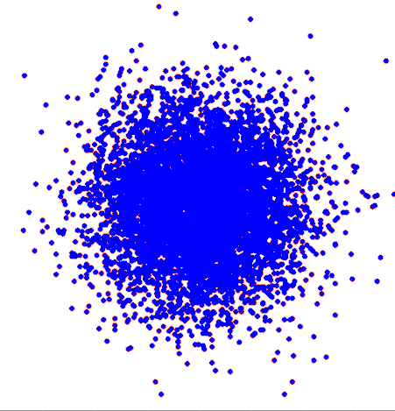
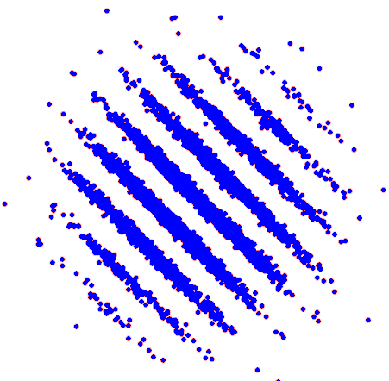
The 2D Gaussian Distribution
The 2D “Pancake” Distribution
Notes:
Party trick: Which one isn’t a Gaussian point cloud?
Add: Gaussian pancakes show 2D pic // Gaussian show 2D pic
The computational difficulty of distinguishing these pictures will keep your emails safe even from quantum attackers, and will enable secure computation on distributed data.

Slide 3
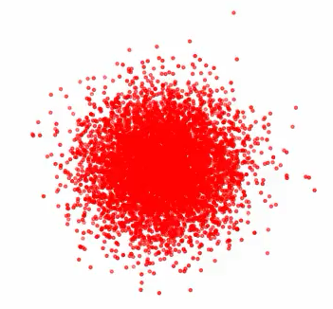
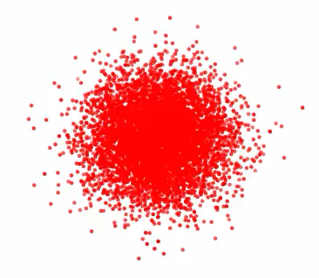
The Gaussian Pancake Problem
The 3D Gaussian Distribution
The 3D Pancake Distribution
Notes:
Party trick: Which one isn’t a Gaussian point cloud?
Add: Gaussian pancakes show 2D pic // Gaussian show 2D pic
The computational difficulty of distinguishing these pictures will keep your emails safe even from quantum attackers, and will enable secure computation on distributed data.

Slide 4
Lectures 7-10
Constructions of Public-key Encryption
✅ Diffie-Hellman/El Gamal
✅ Trapdoor Permutations (RSA)
✅ Quadratic Residuosity/Goldwasser-Micali
4: Post-Quantum Security & Lattice-based Encryption

Slide 5
Lattices
-b₁+3b₂
b₁+b₂
b₂
b₁
b₁-b₂
O
n-Dimensional Lattice:
All integer combinations of n basis vectors b₁,b₂,…,b_{n}
Notes:
A periodic grid of points
Here is one possible grid.
To be more precise, the grid defines two vectors b1 and b2, which form a basis of the lattice, and each lattice pt is an integer linear combination of the basis vectors

Slide 6
Lattices
O
b₂
b₁
Fact:
Same Lattice, (Infinitely) Many Bases
Notes:
Of course this is not the only way to overlay a grid on the lattice. Here is another
Defines a different basis b1 and b2
The lattice is still made up of all integer lin comb
Indeed, inf many baess

Slide 7

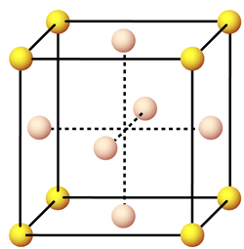
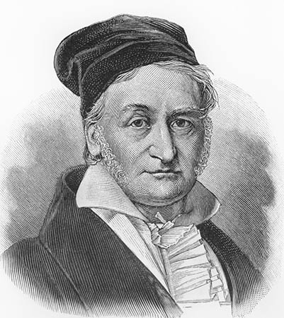

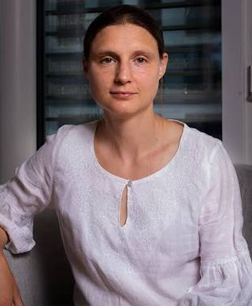
Lattices in Mathematics
An Example: Sphere Packing.
What is the densest packing of disjoint spheres in n dimensions?
Kepler Conjecture (3D): Face-centered cubic (FCC).
Gauss: FCC is the best lattice packing.
Hales: FCC is the best packing, period!
How about n dimensions?
Answer known only for n = 1,2,3,8 and 24.
Notes:
Latices come up in many places in math geometry num theory
Here is a classical problem: sphere packing
What is the max number of equal size oranges you can pack in a given space?
What is the densest packing of disjoint eq size spheres in n dim?
Classical kepler 3D 1600s
200 years later Gauss
200 years later Hales
Open for n dim
Known only for these dim
Last two in the last year.

Slide 8
(Hard) Computational Problems
b₁-2b₂
O
b₂
b₁
Shortest Vector Problem
Given an (arbitrary) basis, find a shortest non-zero vector
Notes:
Distances in the Euclidean norm (others are possible as well)

Slide 9

(Hard) Computational Problems
$$⨂$$
t
O
b₂
b₁
Closest Vector Problem
Given an (arbitrary) basis and a vector, find a closest lattice vector
Notes:
So what are these wonderful lattices that I have been talking abt? An n-dimensional lattice is defined the following way: first pick your n favorite vectors b1 … bn For the purposes of illustration, I will always look at 2-D lattices, so I pick b1 and b2, and I look at all possible combinations of b1 and b2 with integer coefficients. So I get b1+b2, b2-2b1, b2-b1,… and so forth.. I get what looks like a regular grid of points, and this, ladies and gentlemen, is an n-dimensional lattice.

Slide 10
(Hard) Computational Problems
-3b₂+4b₁
O
b₁
b₂
α-Approximate Shortest Vector Problem
Given a basis, find an α-approximate shortest non-zero vector

Slide 11
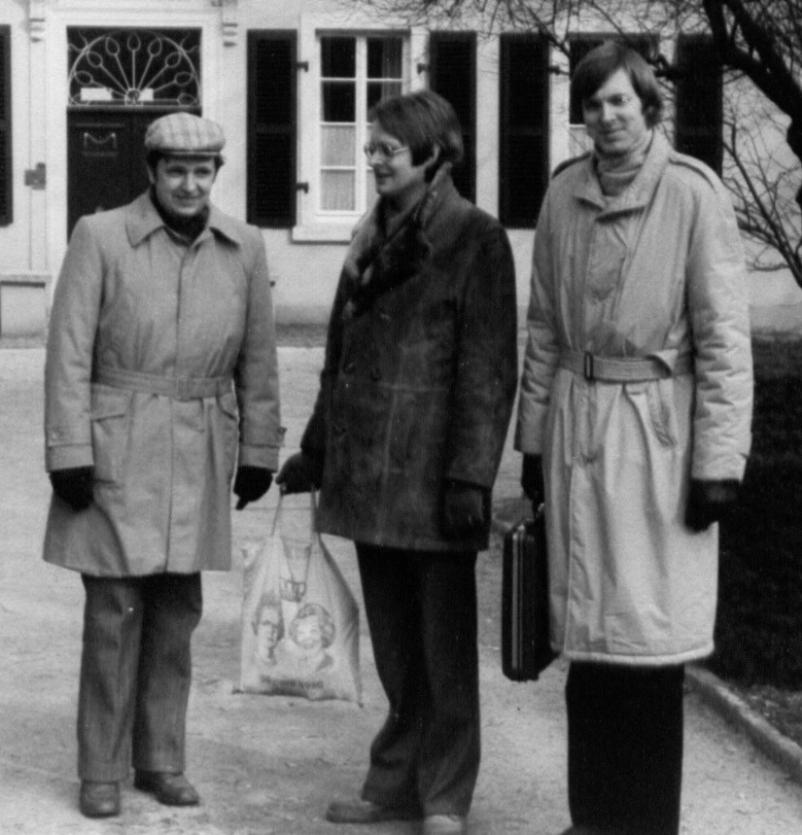
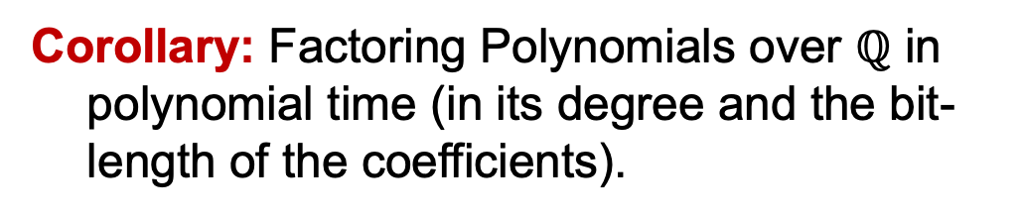
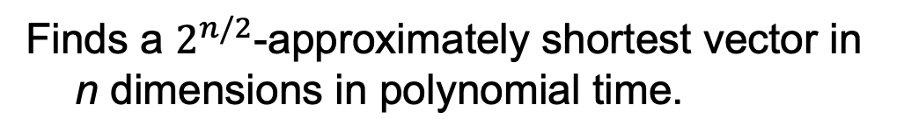
The LLL Algorithm (1982)
The LLL (Lenstra-Lenstra-Lovász) Algorithm:
Finds a $2^{n/2}$-approximately shortest vector in n dimensions in polynomial time.
Corollary: Factoring Polynomials over $ℚ$ in polynomial time (in its degree and the bit-length of the coefficients).
Corollary: Factoring numbers when a few bits of the factors are known.
Corollary: “Break” a large number of “cryptosystems”.
Notes:
Diophantine problems? Quadratic reciprocity? Minkowski.

Slide 12

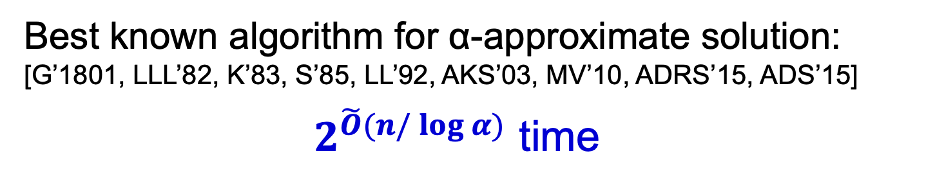



The Curse of Dimensionality
Best known algorithm for α-approximate solution:
[G’1801, LLL’82, K’83, S’85, LL’92, AKS’03, MV’10, ADRS’15, ADS’15]
$2^{\tilde{O}(n/\log{α})}$ time
(even for quantum algorithms!)
$$2^{700}$$
N=1000
running time
$$2^{40}$$
$$2^{15}$$
approximation factor
Notes:
Diophantine problems? Quadratic reciprocity? Minkowski.

Slide 13




Cryptographers
Hard Problems
Computational asymmetry
easy
hard
good guys
bad guys
Notes:
Diophantine problems? Quadratic reciprocity? Minkowski.

Slide 14
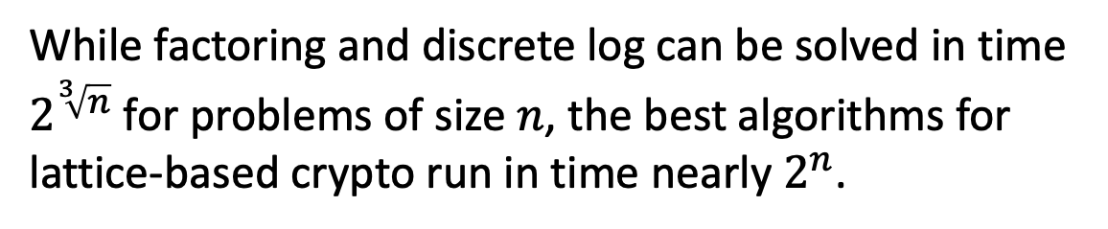
Why Lattice-based Crypto?
Exponentially Hard
(so far)
While factoring and discrete log can be solved in time $2^{\sqrt[3]{n}}$ for problems of size $n$, the best algorithms for lattice-based crypto run in time nearly $2^{n}$.

Slide 15
Why Lattice-based Crypto?
Exponentially Hard
(so far)
□ Quantum-Resistant
(so far)

Slide 16

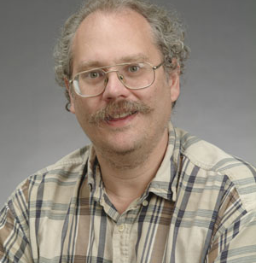

Quantum Computers Break Crypto
(Very large scale)
(if they exist)
Shor’s Algorithm for Factoring and Discrete Logarithms.

Slide 17
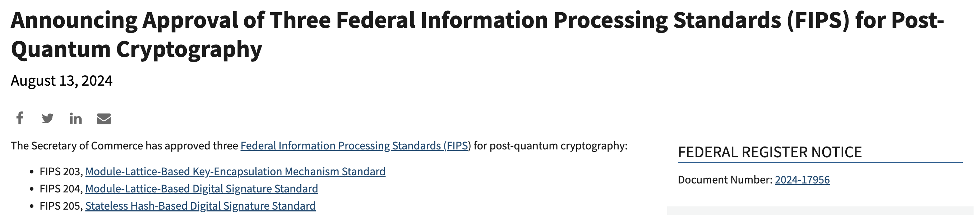
NIST Post-Quantum Cryptography Standardization
Cryptography that is (believed to be) secure against quantum attacks.
FIPS 203: Encryption, CRYSTALS-Kyber.
FIPS 204: Digital Signatures, CRYSTALS-Dilithium.
lattice-based
FIPS 205: Digital Signatures, SPHINCS+.
In progress: Digital Signatures, Falcon.
Source: https://www.nist.gov/news-events/news/2024/08/announcing-approval-three-federal-information-processing-standards-fips

Slide 18
Why Lattice-based Crypto?
Exponentially Hard
(so far)
□ Quantum-Resistant
(so far)
Worst-case hardness
(unique feature of lattice-based crypto)

Slide 19


Cryptography-Grade Hardness
For LATTICE PROBLEMS
Worst-case Hard
Average-case Hard
At least one instance
hard
Average instance
hard
Ajtai
SAFEST TO ASSUME
NEEDED IN CRYPTO
Regev
Notes:
Hardness of a problem could be interpreted in many different ways – it could either mean that the problem is worst-case hard, in other words at least one instance of the problem is hard to solve, or it could mean that problem is average-case hard, in other words a random instance, an average instance of the problem is hard to solve. On the one hand, worst-case hardness is a very mild safe ass, since all you are assuming is …
On the other hand, the kind of assumption that you need for cryptography is an average-case hardness ass. It is no good if your encryption scheme is secure for some key, you need it to be secure for most keys.
Fortunately for us, this gentleman named Ajtai actually showed that for lattice problems, the two notions of hardness coincide. Namely, if a lattice problem is worst-case hard, then it is also average-case hard.

Slide 20
Why Lattice-based Crypto?
Exponentially Hard
(so far)
□ Quantum-Resistant
(so far)
Worst-case hardness
(unique feature of lattice-based crypto)
Simple and Efficient
Enabler of Surprising Capabilities
(Fully Homomorphic Encryption)

Slide 21

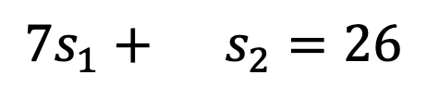
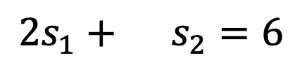
Solving Linear Equations
$$5s_{1}+11s_{2}=2$$
$$2s_{1}+ s_{2}=6$$
$$7s_{1}+ s_{2}=26$$
where all equations are over $ℤ$, the integers

Slide 22
Solving Linear Equations
s
Given:
A
and
A
GOAL: Find s.
More generally, $n$ variables and $m≫n$ equations.

Slide 23

Solving Linear Equations
s
Given:
A
and
A
GOAL: Find s.
EASY! For example, by Gaussian Elimination

Slide 24
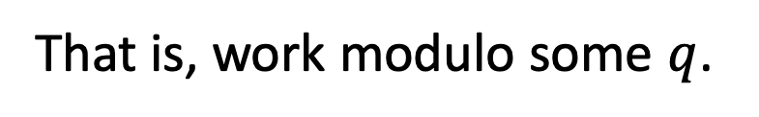
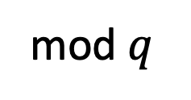

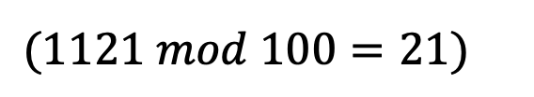
Solving Linear Equations
s
mod $q$
Given:
A
and
A
GOAL: Find s.
How to make it hard:
Chop the head?
That is, work modulo some $q$.
$(1121 mod 100=21)$
Still EASY! Gaussian Elimination mod $q$

Slide 25

Solving Linear Equations
s
Given:
A
and
A
+
e
GOAL: Find s.
How to make it hard: Chop the tail?
Add a small error to each equation.
Still EASY! Linear regression.

Slide 26

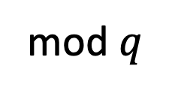
Solving Linear Equations
s
mod $q$
Given:
A
and
A
e
+
GOAL: Find s.
How to make it hard: Chop the head and the tail?
Add a small error to each equation and work mod $q$.
Turns out to be very HARD!

Slide 27
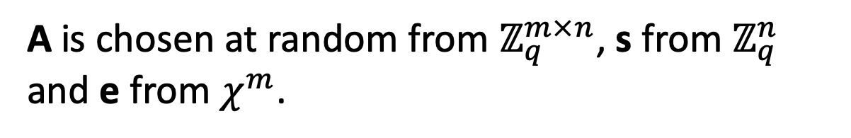
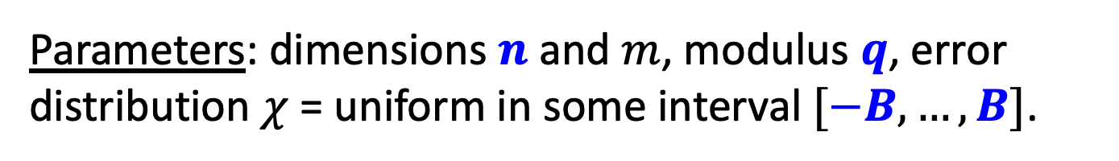
Solving Noisy Modular Linear Equations
Learning with Errors (LWE)
s
Given:
A
and
A
+
e
GOAL: Find s.
Parameters: dimensions $n$ and $m$, modulus $q$, error distribution $χ$ = uniform in some interval $[−B,…,B]$.
A is chosen at random from $ℤ_{q}^{m×n}$, s from $ℤ_{q}^{n}$ and e from $χ^{m}$.

Slide 28

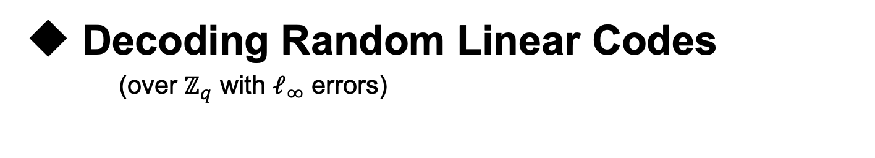
Learning with Errors (LWE)
Decoding Random Linear Codes
(over $ℤ_{q}$ with $ℓ_{∞}$ errors)
Learning Noisy Linear Functions
Worst-case hard Lattice Problems
[Regev’05, Peikert’09]
Notes:
The same kind of problems with fhe

Slide 29
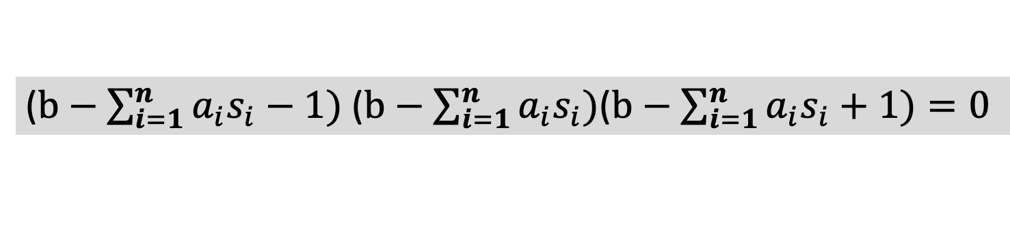

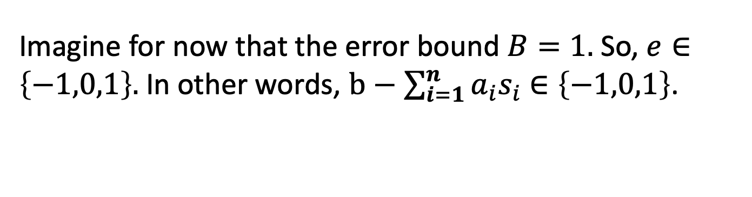
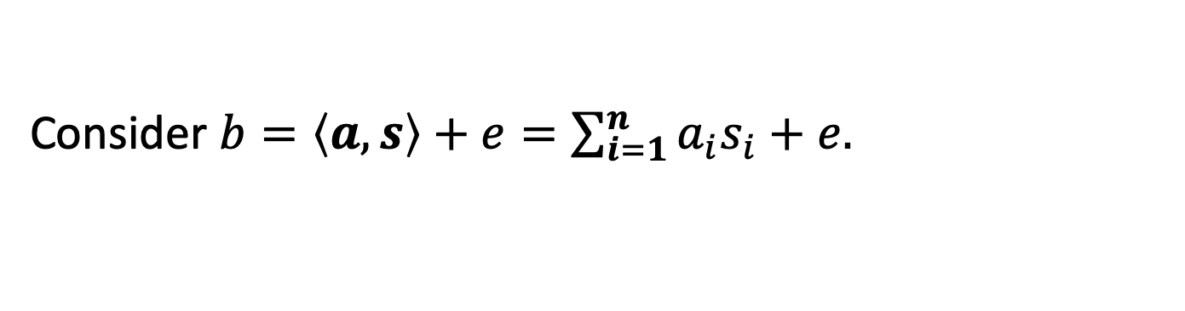
Attack 1: Linearization
Given $A,As+e$, find $s$.
Idea (a) Each noisy linear equation is an exact polynomial eqn.
Consider $b=\left\langle a,s\right\rangle +e=\sum_{i=1}^{n}{a_{i}s_{i}}+e.$
Imagine for now that the error bound $B=1.$ So, $e∈\left\{−1,0,1\right\}.$ In other words, $b−\sum_{i=1}^{n}{a_{i}s_{i}}$ $∈\left\{−1,0,1\right\}$.
So, here is a noiseless polynomial equation on $s_{i}:$
($b−\sum_{i=1}^{n}{a_{i}s_{i}}−1)$ ($b−\sum_{i=1}^{n}{a_{i}s_{i})}$($b−\sum_{i=1}^{n}{a_{i}s_{i}}+1)=0$

Slide 30

Attack 1: Linearization
Given $A,As+e$, find $s$.
BUT: Solving (even degree 2) polynomial equations is NP-hard.
($b−\sum_{i=1}^{n}{a_{i}s_{i}}−1)$ ($b−\sum_{i=1}^{n}{a_{i}s_{i})}$($b−\sum_{i=1}^{n}{a_{i}s_{i}}+1)=0$

Slide 31



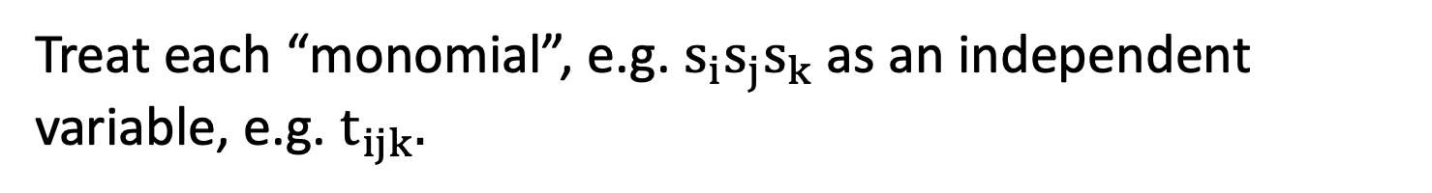
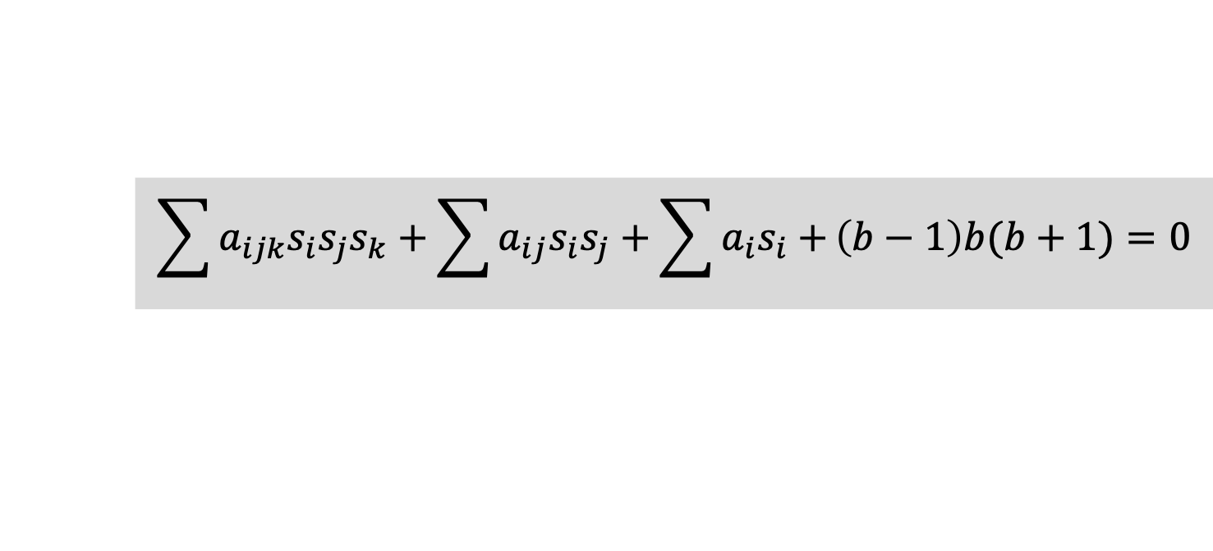
Attack 1: Linearization
($b−\sum_{i=1}^{n}{a_{i}s_{i}}−1)$ ($b−\sum_{i=1}^{n}{a_{i}s_{i})}$($b−\sum_{i=1}^{n}{a_{i}s_{i}}+1)=0$
Idea (b) Easy to solve given sufficiently many equations.
(using a technique called “linearization”)
$$\sum{a_{ijk}s_{i}s_{j}s_{k}}+\sum{a_{ij}s_{i}s_{j}+\sum{a_{i}s_{i}+}}\left(b−1\right)b(b+1)=0$$
Treat each “monomial”, e.g. $s_{i}s_{j}s_{k}$as an independent variable, e.g. $t_{ijk}.$
Now, you have a noiseless linear equation in $t_{ijk}$!!!

Slide 32

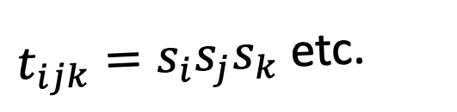
Attack 1: Linearization
$$\sum{a_{ijk}t_{ijk}}+\sum{a_{ij}t_{ij}+\sum{a_{i}t_{i}+}}\left(b−1\right)b(b+1)=0$$
Solution space
(with some eqns):
The real solution
$t_{ijk}=s_{i}s_{j}s_{k}$ etc.

Slide 33
Attack 1: Linearization
$$\sum{a_{ijk}t_{ijk}}+\sum{a_{ij}t_{ij}+\sum{a_{i}t_{i}+}}\left(b−1\right)b(b+1)=0$$
Solution space
(with more eqns):
The real solution
$t_{ijk}=s_{i}s_{j}s_{k}$ etc.

Slide 34
Attack 1: Linearization
$$\sum{a_{ijk}t_{ijk}}+\sum{a_{ij}t_{ij}+\sum{a_{i}t_{i}+}}\left(b−1\right)b(b+1)=0$$
Solution space
(with even more eqns):
The real solution
$t_{ijk}=s_{i}s_{j}s_{k}$ etc.

Slide 35
Attack 1: Linearization
$$\sum{a_{ijk}t_{ijk}}+\sum{a_{ij}t_{ij}+\sum{a_{i}t_{i}+}}\left(b−1\right)b(b+1)=0$$
Solution space
(keep going):
The real solution
$t_{ijk}=s_{i}s_{j}s_{k}$ etc.

Slide 36
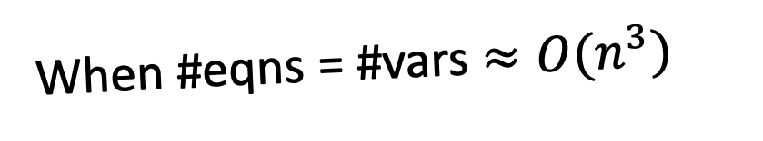
Attack 1: Linearization
$$\sum{a_{ijk}t_{ijk}}+\sum{a_{ij}t_{ij}+\sum{a_{i}t_{i}+}}\left(b−1\right)b(b+1)=0$$
When #eqns = #vars $≈O(n^{3})$
the only surviving solution to the linear system is the real solution.

Slide 37
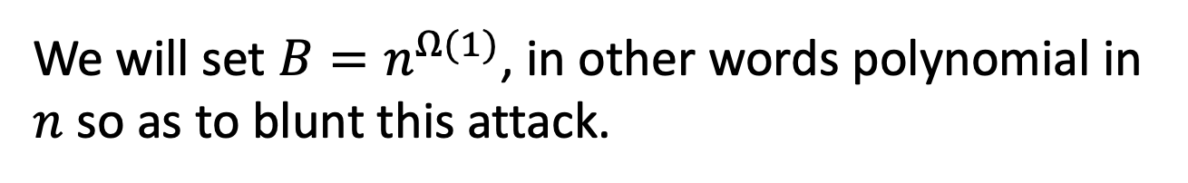

Attack 1: Linearization
Given $A,As+e$, find $s$.
Can solve/break as long as
$$m≫n^{2B+1}$$
We will set $B=n^{Ω(1)}$, in other words polynomial in $n$ so as to blunt this attack.

Slide 38
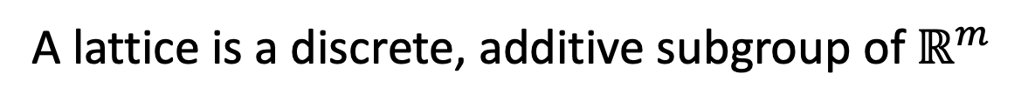
LWE and Lattices
_{a1*s1+a2*s2}
_{a1*s1+a2*s2+e}
_{a2}
_{a1}
O
A lattice is a discrete, additive subgroup of $ℝ^{m}$
Notes:
a1 and a2 are columns of A

Slide 39

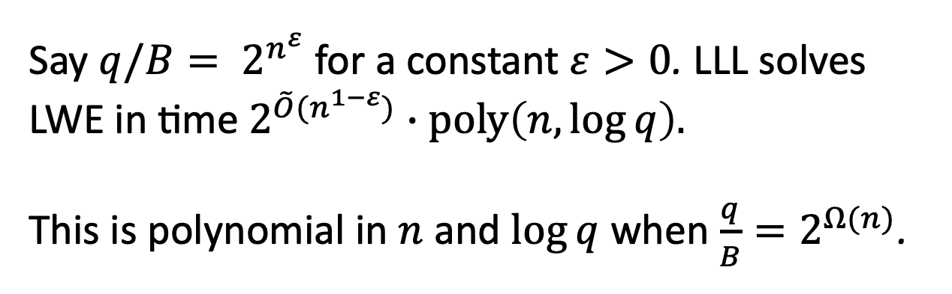
Attack 2: Lattice Reduction
Lenstra-Lenstra-Lovasz (LLL) Algorithm
Say $q/B= 2^{n^{ε}}$ for a constant $ε>0$. LLL solves LWE in time $2^{\tilde{O}{(n}^{1−ε})}∙poly\left(n,\log{q}\right).$
This is polynomial in $n$ and $\log{q}$ when $\frac{q}{B}=2^{Ω(n)}$.

Slide 40

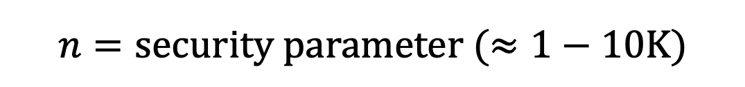
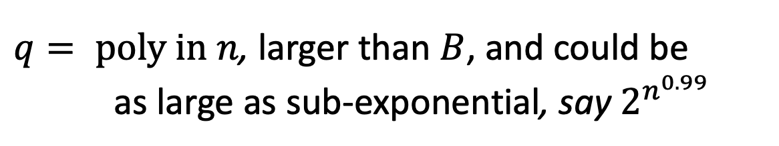


Setting Parameters
Cryptanalysis over three decades suggests we are safe with the following parameters:
$$n=security parameter (≈1−10K)$$
$$m=arbitrary poly in n$$
$$B=small poly in n, say \sqrt{n}$$
$q= poly in n$, larger than $B$, and could be
as large as sub-exponential, say $2^{n^{0.99}}$
even from quantum computers, AFAWK!

Slide 41
Decisional LWE
Can you distinguish between:
s
and
A
,
A
e
+
,
A
b
Theorem: “Decisional LWE is as hard as LWE”.

Slide 42
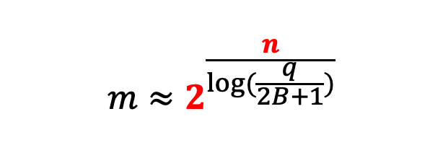

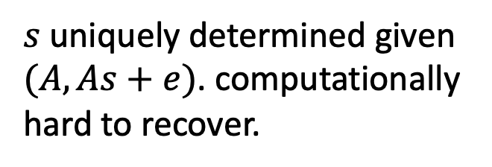
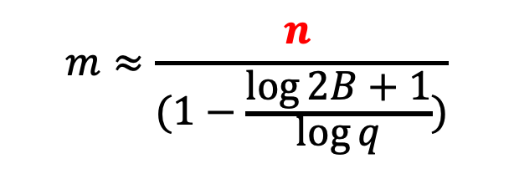
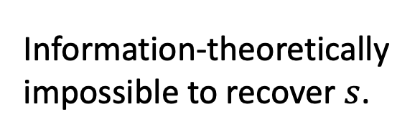
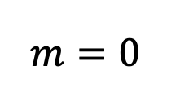
Information-Computation Gap
Fix $n, q,B.$
(Search) LWE:
easy
$$m=0$$
$$m≈2^{\frac{n}{\log{(\frac{q}{2B+1})}}}$$
$$m≈\frac{n }{(1−\frac{\log{2B+1}}{\log{q}}{)}}$$
Information-theoretically impossible to recover $s$.
$s$uniquely determined given $(A,As+e)$. computationally hard to recover.

Slide 43
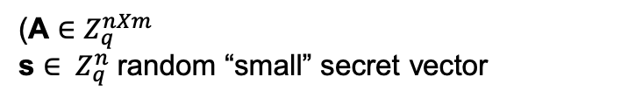

OWF and PRG
g_{A}(s,e) = As+e
(A $∈Z_{q}^{nXm}$
s ${∈ Z}_{q}^{n}$ random “small” secret vector
$e{∈ Z}_{q}^{n}$: random “small” error vector)
g_{A} is a one-way function (assuming LWE)
g_{A} is a pseudo-random generator (decisional LWE)
g_{A} is also a trapdoor function… (this is not obvious and we won’t see how in this class)
Notes:
The same kind of problems with fhe

Slide 44
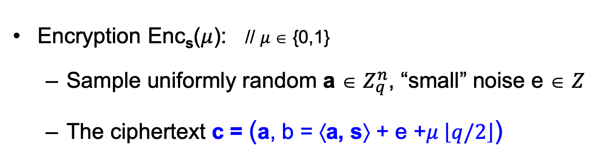
Basic (Secret-key) Encryption
[Regev05]
n = security parameter, q = “small” modulus
Secret key sk = Uniformly random vector s ∈ $Z_{q}^{n}$
Encryption Enc_{s}($μ$): // $μ$∈ {0,1}
  Sample uniformly random a ∈ $Z_{q}^{n}$, “small” noise e ∈ $Z$
  The ciphertext c = (a, b = ⟨a, s⟩ + e +$μ \left\lfloor q/2\right\rfloor$)
Decryption Dec_{sk}(c): Output Round_{q/2}(b − ⟨a, s⟩ mod q)
// correctness as long as |e| < q/4
Notes:
First iteration is incorrect because you only recover e+m upon decrypting
Solution: “error correct” or “make sure that m is a large number compared to e”

Slide 45
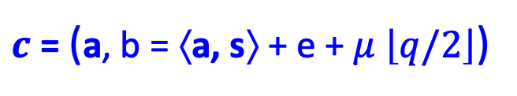

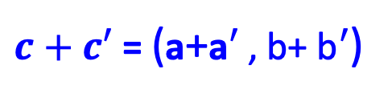
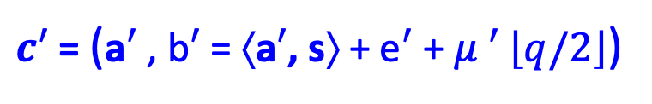
Basic (Secret-key) Encryption
[Regev05]
This scheme is additively homomorphic.
$c$ = (a, b = ⟨a, s⟩ + e + $μ$ $\left\lfloor q/2\right\rfloor$)
$$+$$
Enc_{s}(m)
$c′$ = (a$′$ , b$′$ = ⟨a$′$, s⟩ + e$′$ + $μ ′$ $\left\lfloor q/2\right\rfloor$)
Enc_{s}(m’)
$c+c′$ = (a+a$′$ , b+ b$′$ = ⟨ a +a$′$, s⟩ + (e+e$′$) + ($μ$+ $μ ′)$ $\left\lfloor q/2\right\rfloor$)
$c+c′$ = (a+a$′$ , b+ b$′$)
In words: $c+c′$ is an encryption of $μ$+ $μ ′$ (mod 2)
Notes:
First iteration is incorrect because you only recover e+m upon decrypting
Solution: “error correct” or “make sure that m is a large number compared to e”

Slide 46

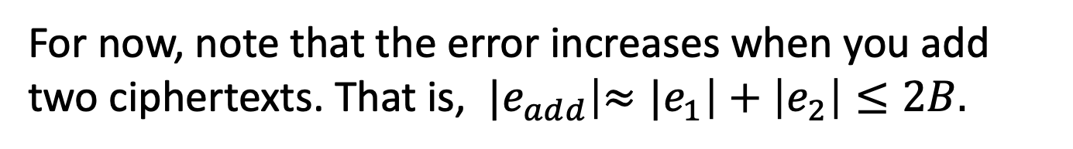
Basic (Secret-key) Encryption
[Regev05]
You can also negate the encrypted bit easily.
We will see later how to make this scheme into a fully homomorphic scheme.
For now, note that the error increases when you add two ciphertexts. That is, ${|e}_{add}\left|{≈|e}_{1}\right|+\left|e_{2}\right|≤2B.$
Setting $q=n^{\log{n}}$ and $B=\sqrt{n}$ (for example) lets us support any polynomial number of additions.
Notes:
First iteration is incorrect because you only recover e+m upon decrypting
Solution: “error correct” or “make sure that m is a large number compared to e”

Slide 47
NEXT UP:
Public-key Encryption from LWE

Slide 48
Public-key Encryption
[Regev05]
Here is a crazy idea. Public key has an encryption of 0 (call it $c_{0}$) and an encryption of 1 (call it $c_{1}$).
If you want to encrypt 0, output $c_{0}$and if you want to encrypt 1, output $c_{1}$.
Well, turns out to be a crazy bad idea.
If only we could produce fresh encryptions of 0 or 1 given just the pk…

Slide 49
Public-key Encryption
[Regev05]
Here is another crazy idea.
Public key has many encryptions of 0 and an encryption of 1 (call it $c_{1}$).
If you want to encrypt 0, output a random linear combination of the 0-encryptions.
If you want to encrypt 1, output a random linear combination of the 0-encryptions plus $c_{1}$.
This one turns out to be a crazy good idea.

Slide 50


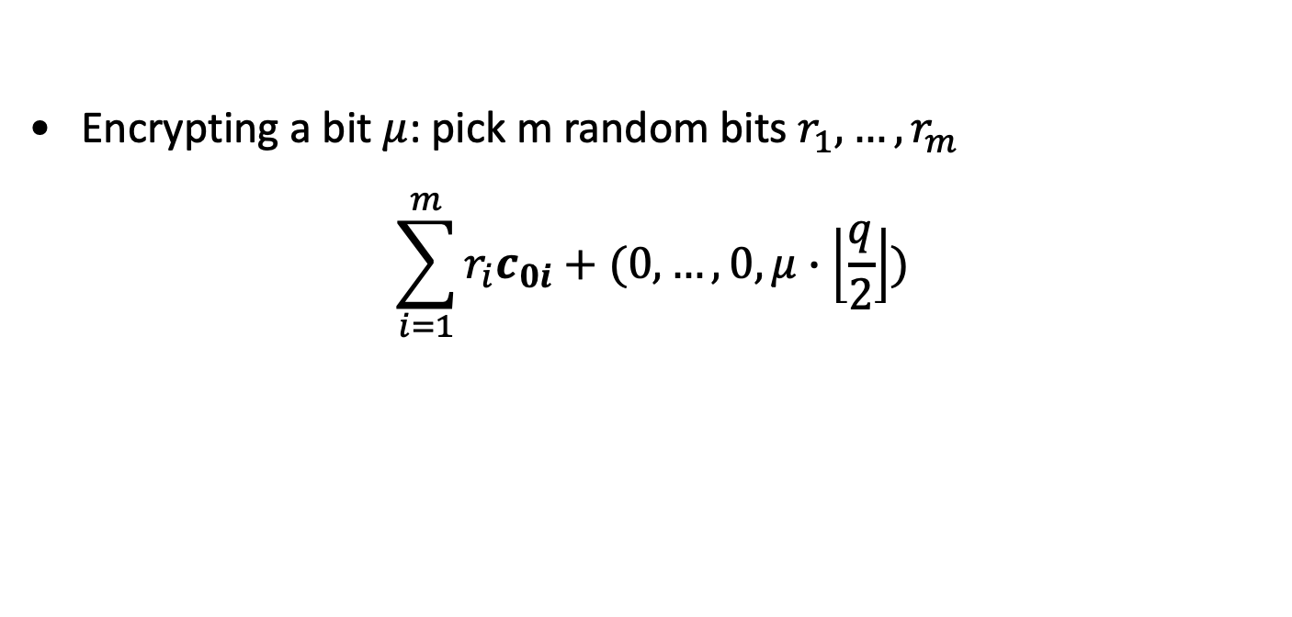
Regev’s Public-key Encryption
Secret key sk = Uniformly random vector s ∈ $Z_{q}^{n}$
Public key pk: for $i from 1 to m=poly(n)$
$$\left(c_{0i}=(a_{i},\left\langle a_{i},s\right\rangle +e_{i})\right)$$
Encrypting a bit $μ$: pick m random bits $r_{1},…,r_{m}$
$$\sum_{i=1}^{m}{r_{i}c_{0i}}+(0, …, 0, μ∙\left\lfloor \frac{q}{2}\right\rfloor )$$
Correctness: as long as $\left|\sum{r_{i}e_{i}}\right|<q/4$ is small enough.

Slide 51
Security: Leftover Hash Lemma
[Impagliazzo-Levin-Luby’90]
We want to understand how $rA, rb=r\left[A \right|b]$ is distributed when $A, b$ is random (and public).
$$r$$
$$c$$
$$a′$$
$$b′$$
$$A$$
$$b$$
$$≈$$
If $r$ is truly random, so is $r\left[A \right|b]$.
But $r$ is NOT truly random! It has small entries.
Nevertheless, $r$ has entropy. Leftover hash lemma tells us that matrix multiplication turns (sufficient) entropy into true randomness. We need $m≫\left(n+1\right)\log{q.}$

Slide 52
Security Proof
Theorem: under decisional LWE, the scheme is IND-secure. In fact, even more: a ciphertext together with the public key is pseudorandom.
Hybrid 1. Change the public key to random (from LWE).
$$\tilde{pk}= \left(A,b\right), \tilde{c}=Enc\left(\tilde{pk},μ\right)=rA, rb+μ \left\lfloor q/2\right\rfloor )$$
Hybrids 0 and 1 are comp. indist. by decisional LWE.

Slide 53
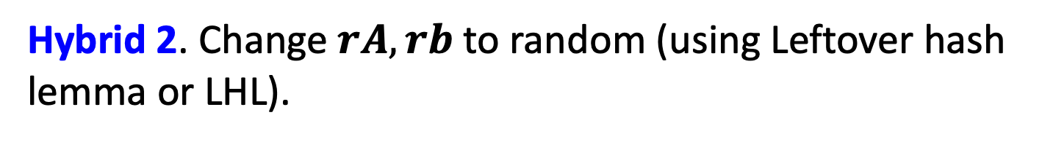
Security Proof
Theorem: under decisional LWE, the scheme is IND-secure. In fact, even more: a ciphertext together with the public key is pseudorandom.
Hybrid 2. Change $rA, rb$to random (using Leftover hash lemma or LHL).
$$\tilde{pk}= \left(A,b\right), \tilde{c}=Enc\left(\tilde{pk},μ\right)=u, u′+μ \left\lfloor q/2\right\rfloor )$$
Hybrids 1 and 2 are stat. indist. by LHL.

Slide 54
Security Proof
Theorem: under decisional LWE, the scheme is IND-secure. In fact, even more: a ciphertext together with the public key is pseudorandom.
Hybrid 3. Change $u′+μ \left\lfloor q/2\right\rfloor$to a random bit.
$$\tilde{pk}= \left(A,b\right), \tilde{c}=Enc\left(\tilde{pk},μ\right)=u, u′)$$
Hybrids 1 and 2 are perfectly indist.

Slide 55
NEXT UP:
Public-key Encryption from LWE

Slide 56
LWE with Small Secrets
s
Given:
A
and
A
+
e
GOAL: Find s.
Parameters: dimensions $n$ and $m$, modulus $q$, error distribution $χ$ = uniform in some interval $[−B,…,B]$.
A is chosen at random from $ℤ_{q}^{m×n}$, s from $χ^{n}$and e from $χ^{m}$.

Slide 57
LWE with Small Secrets
s
Given:
A
and
A
+
e
GOAL: Find (the small secret) s.
Theorem: LWE with small secrets is as hard as LWE.
Proof on the board.

Slide 58
Public-key Encryption
[Lyubashevsky-Peikert-Regev’10]
Secret key sk = Small secret s from $χ^{n}$
Public key pk: for $i from 1 to n$
$$c_{i}=(a_{i},\left\langle a_{i},s\right\rangle +e_{i})$$

Slide 59
Public-key Encryption
[Lyubashevsky-Peikert-Regev’10]
Secret key sk = Small secret s from $χ^{n}$
Public key pk: for $i from 1 to n$
$$(A,b=As+e)$$
A
,
s
e
A
+
Encrypting a message bit $μ$: pick a random vector $r$ from $χ^{n}$
$$(rA+e^{′}, rb+e^{′′}+μ \left\lfloor q/2\right\rfloor )$$
Decryption: compute
($rb+e^{′′}+μ \left\lfloor q/2\right\rfloor )−\left(rA+e^{′}\right)s$
and round to nearest multiple of q/2.

Slide 60
Correctness
Encrypting a message bit $μ$: pick a random vector $r$ from $χ^{n}$
$$(rA+e^{′}, rb+e^{′′}+μ \left\lfloor q/2\right\rfloor )$$
Decryption:
$$\text{(}rb+e^{′′}+μ \left\lfloor q/2\right\rfloor )−\left(rA+e^{′}\right)s$$
$$=r(As+e)+e^{′′}+μ \left\lfloor q/2\right\rfloor −\left(rA+e^{′}\right)s$$
$=re+e^{′′}−e^{′}s+μ \left\lfloor q/2\right\rfloor$
Decryption works as long as |$re−e^{′}s+e′′|<\frac{q}{4}.$

Slide 61
Security
Theorem: under decisional LWE, the scheme is IND-secure. In fact, even more: a ciphertext together with the public key is pseudorandom.
We show this by a hybrid argument.
Let’s stare at a public key, ciphertext pair.
$$pk= \left(A,b=As+e\right), c=Enc\left(pk,μ\right)=rA+e^{′}, rb+e^{′′}+μ \left\lfloor q/2\right\rfloor$$
Call this distribution Hybrid 0.

Slide 62
Security
Theorem: under decisional LWE, the scheme is IND-secure. In fact, even more: a ciphertext together with the public key is pseudorandom.
Hybrid 1. Change the public key to random (from LWE).
$$\tilde{pk}= \left(A,b\right), \tilde{c}=Enc\left(\tilde{pk},μ\right)=rA+e^{′}, rb+e^{′′}+μ \left\lfloor q/2\right\rfloor )$$
$$=r\left[A\right|b]+{[e}^{′}\left|e\right]+[0|μ \left\lfloor \frac{q}{2}\right\rfloor ]$$
Hybrids 0 and 1 are comp. indist. by decisional LWE.

Slide 63
Security
Theorem: under decisional LWE, the scheme is IND-secure. In fact, even more: a ciphertext together with the public key is pseudorandom.
Hybrid 2. Change $rA+e^{′}, rb+e′′$ into random.
$$\tilde{pk}= \left(A,b\right), \tilde{c}=Enc\left(\tilde{pk},μ\right)=a′, b′+μ \left\lfloor q/2\right\rfloor )$$
Hybrids 1 and 2 are comp. indist. by LWE.

Slide 64
Security
Theorem: under decisional LWE, the scheme is IND-secure. In fact, even more: a ciphertext together with the public key is pseudorandom.
Hybrid 2. Change $rA+e^{′}, rb+e′′$ into random.
$$\tilde{pk}= \left(A,b\right), \tilde{c}=Enc\left(\tilde{pk},μ\right)=a′, b′+μ \left\lfloor q/2\right\rfloor )$$
Now, we have the message $μ$ encrypted with a one-time pad which perfectly hides $μ$.

Slide 65
Public-key Encryption
[Regev05, Micciancio’10, Lyubashevsky-Peikert-Regev’10]
Secret key sk = Small secret s from $χ^{n}$
Public key pk: for $i from 1 to n$
$$(A,b=As+e)$$
Encrypting a message bit $μ$: pick a random vector $r$ from $χ^{n}$
$$(rA+e^{′}, rb+e^{′′}+μ \left\lfloor q/2\right\rfloor )$$
Decryption: compute
($rb+e^{′′}+μ \left\lfloor q/2\right\rfloor )−\left(rA+e^{′}\right)s$
and round to nearest multiple of q/2.

Slide 66
What’s up with the pancakes?

Slide 67
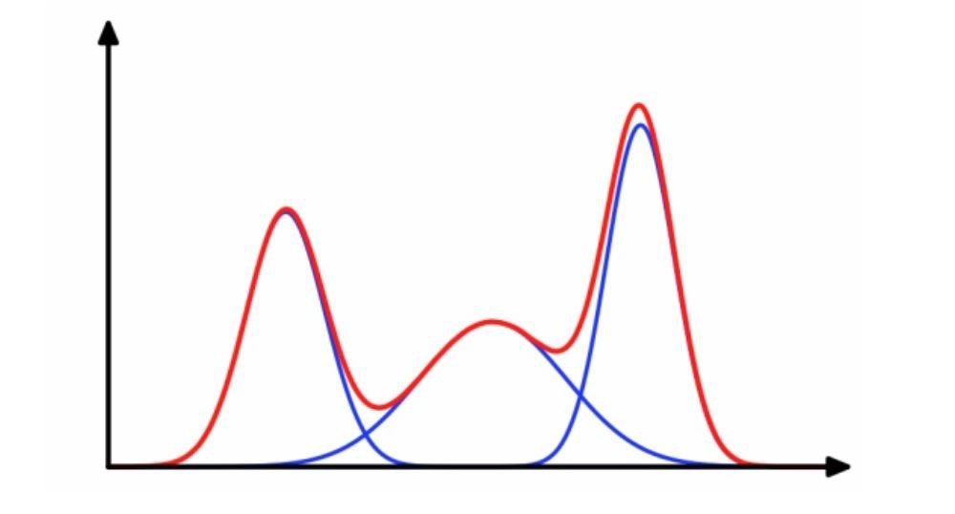
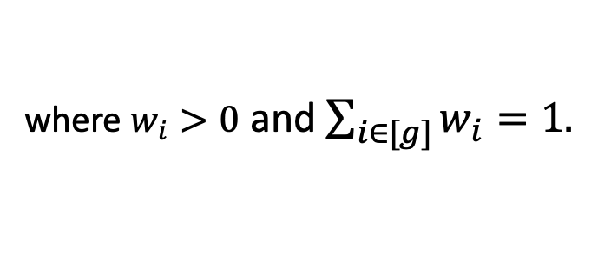

Lattices and Statistics
Example: Gaussian Mixture Learning
[Pearson 1894]
$$D=\sum_{i∈[g]}{w_{i} 𝒩(μ_{i},Σ_{i})}$$
where $w_{i}>0$ and $\sum_{i∈[g]}{w_{i}}=1.$

Slide 68


Lattices and Statistics
Example: Gaussian Mixture Learning
[Pearson 1894]
Information-theoretically: $poly(n,g,1/ε)$samples suffice for any $n,g,ε$ (assuming sufficiently well-separated Gaussians).
$$D=\sum_{i∈[g]}{w_{i} 𝒩(μ_{i},Σ_{i})}$$
Efficient Algorithms: runtime ${(n/ε)}^{f(g)}$ for some $f\left(g\right)≥g$ [An. Moitra-Valiant’10, Belkin-Sinha’10].
where $w_{i}>0$ and $\sum_{i∈[g]}{w_{i}}=1.$
Is this inherent?

Slide 69

Hardness of Gaussian Mixture Learning
Theorem
[Bruna-Regev-Song-Tang’20,
Gupte-N. Vafa-Vaikuntanathan’22]
Assuming the (exponential) hardness of lattice problems, learning a mixture of $g$ $n$-dim Gaussians requires time ${poly(n)∙2}^{Ω(g)}$. (recall: best known algorithms require $n^{Ω(g)}$ time.)

Slide 70


Proof by Picture: Lattices with $n$ short vectors
$$𝒪$$
Notes:
NSA: Lattice-based cryptography … are among the most efficient post-quantum designs. Based on their history of analysis and implementation efforts, NSA CSD expects that a NIST-candidate lattice-based signature and a NIST-candidate lattice-based key encapsulation mechanism will be approved for NSS.

Slide 71
… are hard to tell from ones with $n−1$ short vectors
(decisional SVP + duality)
$$𝒪$$
Notes:
NSA: Lattice-based cryptography … are among the most efficient post-quantum designs. Based on their history of analysis and implementation efforts, NSA CSD expects that a NIST-candidate lattice-based signature and a NIST-candidate lattice-based key encapsulation mechanism will be approved for NSS.

Slide 72
Add a small Gaussian to a “random” lattice point.
Smoothing Lemma [Micciancio-Regev’04]
$$𝒪$$

Slide 73

Now look what happens to this lattice!
$$𝒪$$

Slide 74
Epilogue

Slide 75

A Big Open Question
Public-key Encryption from One-way Functions?
Impagliazzo-Rudich: Black-box separations.
Roughly speaking, says that any construction of a public-key encryption scheme in a “OWF-oracle-model” can be broken with $O(Q^{2})$ queries if the honest parties make at most $Q$ queries.
[Barak-Mahmoody’09]
This is tight w.r.t. Merkle puzzles!

Slide 76
End of Lecture 10

Slide 77
Practical Considerations
I want to encrypt to Bob. How do I know his public key?
Public-key Infrastructure: a directory of identities together with their public keys.
Needs to be “authenticated”:
otherwise Eve could replace Bob’s pk with her own.

Slide 78
Practical Considerations
Public-key encryption is orders of magnitude slower than secret-key encryption.
We mostly showed (except El Gamal) how to encrypt bit-by-bit! Super-duper inefficient.
Exponentiation takes $O(n^{2})$ time as opposed to typically linear time for secret key encryption (AES).
The $n$ itself is large for PKE (RSA: $n≥2048$) compared to SKE (AES: $n=128$).
(For Elliptic Curve El-Gamal, it’s 320 bits)
Can solve problem 1 and minimize problems 2&3 using hybrid encryption.

Slide 79
Hybrid Encryption
To encrypt a long message $m$ (think 1 GB):
Pick a random key K (think 128 bits) for a secret-key encryption
Encrypt K with the PKE: $PKE.Enc(pk, K)$
Encrypt m with the SKE: $SKE.Enc(K, m)$
To decrypt: recover $K$ using $sk$. Then using $K$, recover $m$

