Slide 1
MIT 6.875
Foundations of Cryptography
Lecture 23

Slide 2

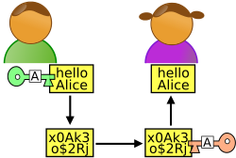

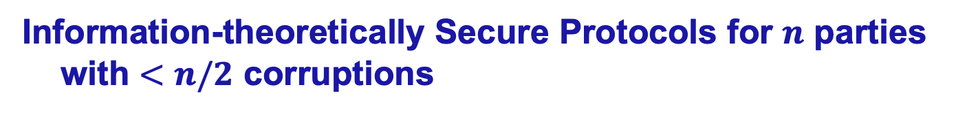
Secure Multi-party Computation
x
y
z
TODAY: HONEST MAJORITY
Information-theoretically Secure Protocols for $n$ parties with $<n/2$ corruptions
[BenOr-Goldwasser-Wigderson’88, Chaum-Crepeau-Damgard’88, BenOr-Rabin’89]

Slide 3
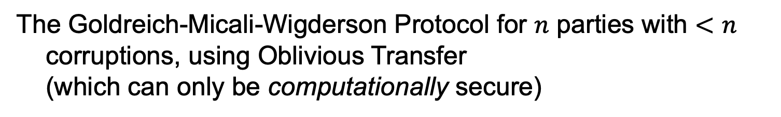
Secure Multi-party Computation
x
y
z
LAST LECTURE: $n−1$ out of $n$ corruptions
The Goldreich-Micali-Wigderson Protocol for $n$ parties with $<n$ corruptions, using Oblivious Transfer
(which can only be computationally secure)

Slide 4

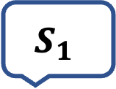
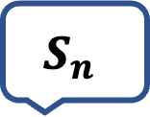
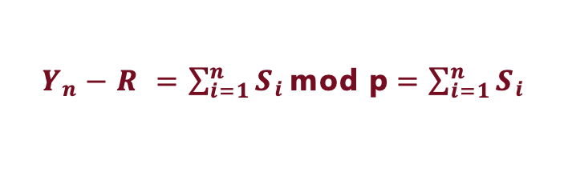
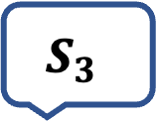
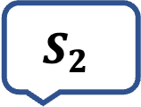
AN EXAMPLE
COMPUTING THE AVERAGE SALARY IN THIS ROOM
$$S_{1}$$
$$S_{2}$$
$$S_{3}$$
$$S_{n}$$
Y₁
Y₂
…
Y_{n-1}
SACHA
LALI
APARNA
VINOD
Y₁ = R+S₁
mod p
Y₂ = Y₁+S₂ mod p
Y₃ = Y₂+S₃ mod p
Y_{n} = Y_{n-1}+S_{n} mod p
Y_{n}
$Y_{n}−R =\sum_{i=1}^{n}{S_{i}}\text{mod} \text{p}$ $=\sum_{i=1}^{n}{S_{i}}$
Is this secure?
_{(if p large enough)}
Notes:
No, a collusion of two parties can recover a party’s secret salary.

Slide 5
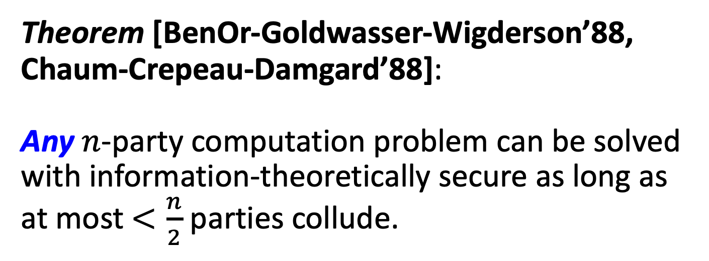
IT-Secure MPC with Honest Majority
Theorem [BenOr-Goldwasser-Wigderson’88, Chaum-Crepeau-Damgard’88]:
Any $n$-party computation problem can be solved with information-theoretically secure as long as at most $<\frac{n}{2}$ parties collude.
Key Tool: Shamir’s Secret Sharing

Slide 6




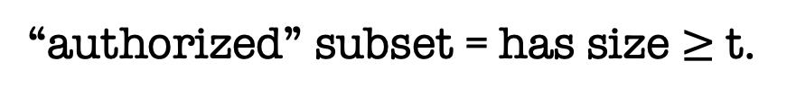



secret b
Key Tool: Secret-Sharing
share $s_{1}$
share $s_{2}$
share $s_{3}$
share $s_{4}$
share $s_{n}$
$$…$$
$$P_{1}$$
$$P_{2}$$
$$P_{3}$$
$$P_{4}$$
$$P_{n}$$
Dealer
Any “authorized” subset of players can recover b.
No other subset of players has any info about b.
Threshold (or t-out-of-n) SS [Shamir’79, Blakley’79]:
“authorized” subset = has size $≥$t.
Notes:
Information theoretic privacy
Clearly this has to be monotone

Slide 7
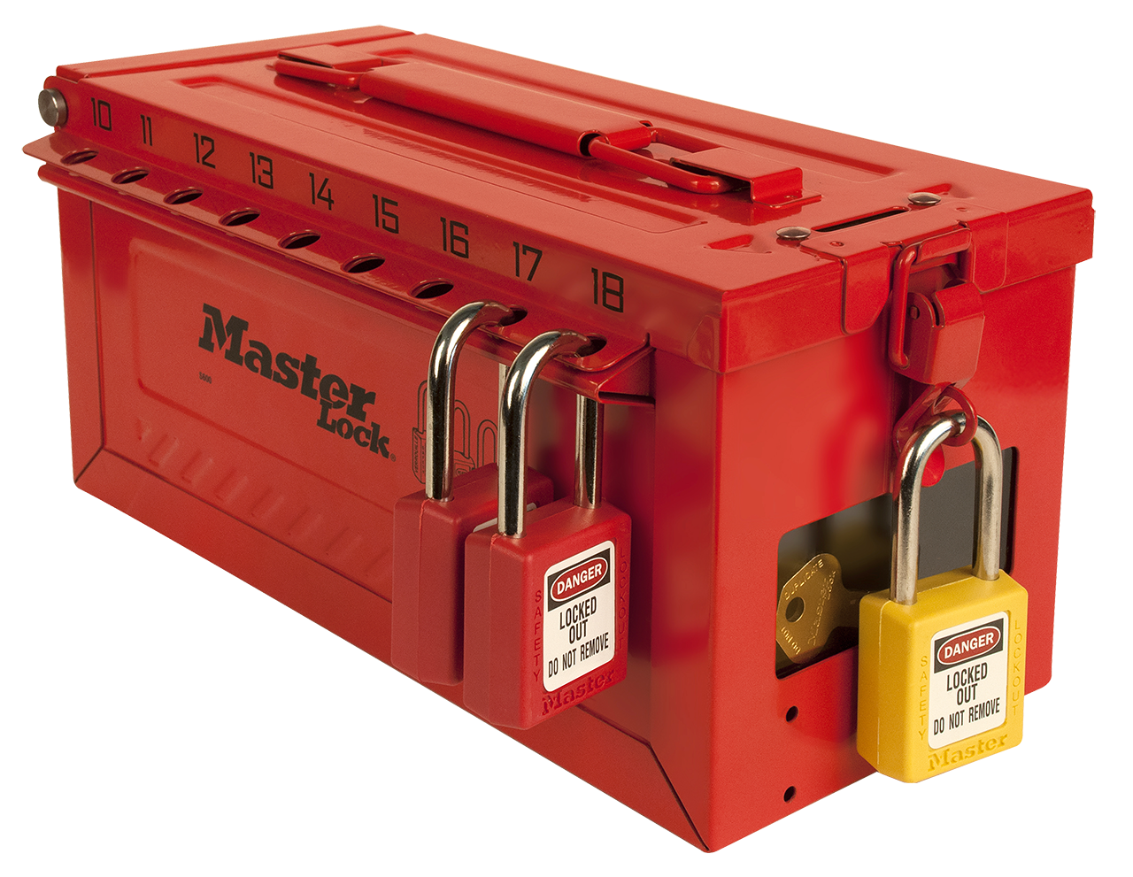






secret b$∈Z_{p}$
$n$-out-of-$n$ Secret Sharing
$$…$$
$$P_{1}$$
$$P_{2}$$
$$P_{3}$$
$$P_{4}$$
$$P_{n}$$
Dealer
share $s_{1}:$ random
share $s_{2}$: random
share $s_{3}$: random
share $s_{4}$: random
$$…$$
share $s_{n}=b−(s_{1}+s_{2}+…+s_{n−1})$ mod p
Notes:
Information theoretic privacy
Clearly this has to be monotone

Slide 8






secret b$∈Z_{p}$
$1$-out-of-$n$ Secret Sharing
$$…$$
$$P_{1}$$
$$P_{2}$$
$$P_{3}$$
$$P_{4}$$
$$P_{n}$$
Dealer
share $s_{1}=b$
share $s_{2}=b$
share $s_{3}=b$
share $s_{4}=b$
$$…$$
share $s_{n}=b$
Notes:
Information theoretic privacy
Clearly this has to be monotone

Slide 9

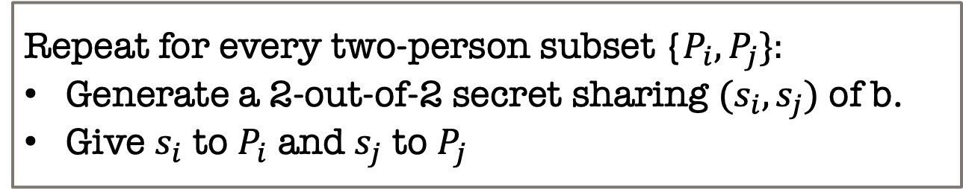
secret b$∈Z_{p}$
$2$-out-of-$n$ Secret Sharing?
$$…$$
$$P_{1}$$
$$P_{2}$$
$$P_{3}$$
$$P_{4}$$
$$P_{n}$$
Dealer
Here is a solution.
Repeat for every two-person subset {$P_{i},P_{j}\}:$
Generate a 2-out-of-2 secret sharing $(s_{i},s_{j})$ of b.
Give $s_{i}$ to $P_{i}$ and $s_{j}$ to $P_{j}$
What is the size of shares each party gets?
How does this scale to t-out-of-n?
Notes:
Information theoretic privacy
Clearly this has to be monotone

Slide 10
Shamir’s t-out-of-n Secret Sharing
Key Idea: Polynomials are Amazing!

Slide 11

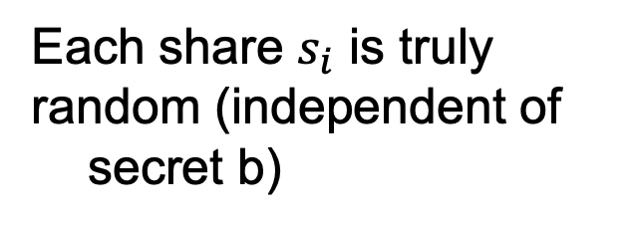






Shamir’s 2-out-of-n Secret Sharing
$$s_{1}$$
$$s_{2}$$
random line through (0,b)
$$(3,s_{3})$$
$$(2,s_{2})$$
$$s_{3}$$
$$(1,s_{1})$$
secret $b$
Each share $s_{i}$ is truly
random (independent of secret b)
Any two shares uniquely
determine b.

Slide 12
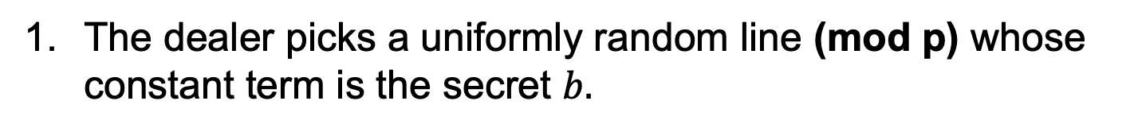
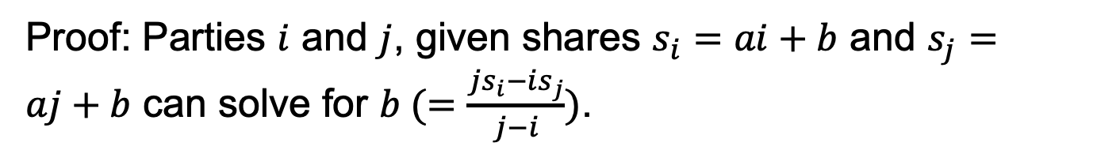
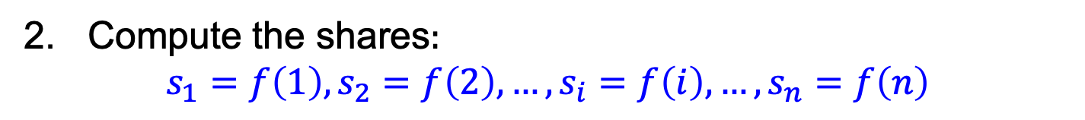
Shamir’s 2-out-of-n Secret Sharing
The dealer picks a uniformly random line (mod p) whose constant term is the secret $b.$
$f\left(x\right)=ax+b$ where $a$ is uniformly random mod $p$
2. Compute the shares$:$
$$s_{1}=f\left(1\right),s_{2}=f\left(2\right),…,s_{i}=f\left(i\right),{…,s}_{n}=f\left(n\right)$$
Correctness: can recover secret from any two shares.
Proof: Parties $i$ and $j$, given shares $s_{i}=ai+b$ and $s_{j}=aj+b$ can solve for $b (=\frac{js_{i}−is_{j}}{j−i})$.

Slide 13
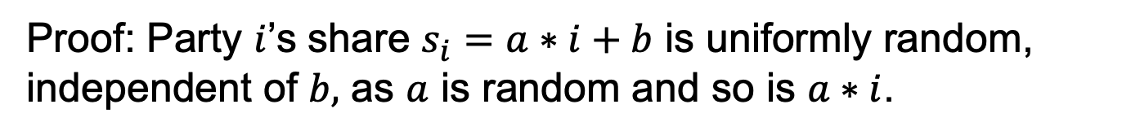
Shamir’s 2-out-of-n Secret Sharing
The dealer picks a uniformly random line (mod p) whose constant term is the secret $b.$
$f\left(x\right)=ax+b$ where $a$ is uniformly random mod $p$
2. Compute the shares$:$
$$s_{1}=f\left(1\right),s_{2}=f\left(2\right),…,s_{i}=f\left(i\right),{…,s}_{n}=f\left(n\right)$$
Security: any single party has no information about the secret.
Proof: Party $i$’s share $s_{i}=a∗i+b$ is uniformly random, independent of $b,$ as $a$ is random and so is $a∗i$.

Slide 14
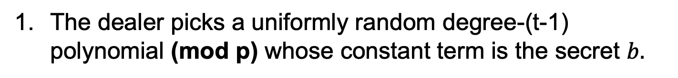
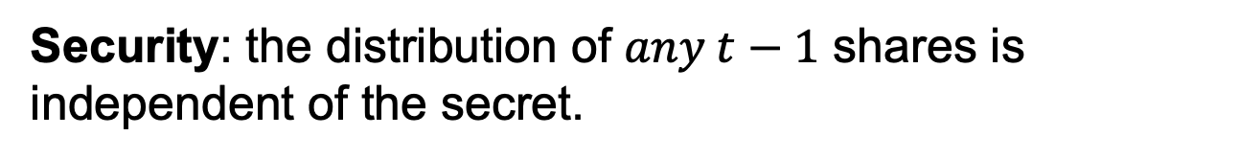
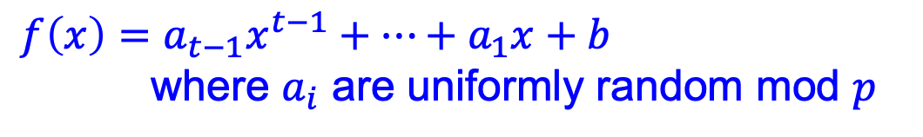
Shamir’s t-out-of-n Secret Sharing
Key Idea: Polynomials are Amazing!
The dealer picks a uniformly random degree-(t-1) polynomial (mod p) whose constant term is the secret $b.$
$f\left(x\right)=a_{t−1}x^{t−1}+…+a_{1}x+b$
where $a_{i}$ are uniformly random mod $p$
2. Compute the shares$:$
$$s_{1}=f\left(1\right),s_{2}=f\left(2\right),…,s_{i}=f\left(i\right),{…,s}_{n}=f\left(n\right)$$
Correctness: can recover secret from any $t$ shares.
Security: the distribution of $any t−1$ shares is independent of the secret.
Note: need p to be larger than the number of parties n.

Slide 15
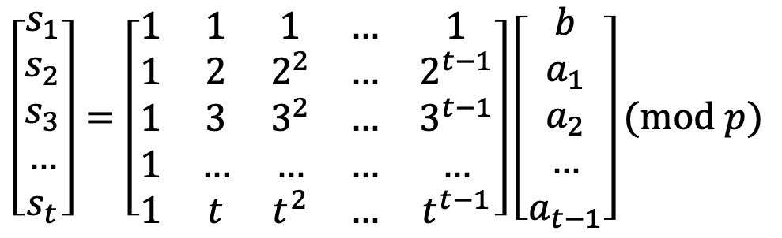
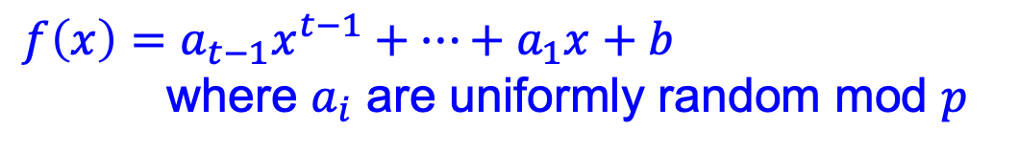
Shamir’s t-out-of-n Secret Sharing
Key Idea: Polynomials are Amazing!
$f\left(x\right)=a_{t−1}x^{t−1}+…+a_{1}x+b$
where $a_{i}$ are uniformly random mod $p$
$$s_{1}=f\left(1\right),s_{2}=f\left(2\right),…,s_{i}=f\left(i\right),{…,s}_{n}=f\left(n\right)$$
Correctness: via Vandermonde matrices.
Let’s look at shares of parties $P_{1},P_{2},…,P_{t}.$
$$\left[\begin{matrix}s_{1} \\ s_{2} \\ s_{3} \\ … \\ s_{t}\end{matrix}\right]=\left[\begin{matrix}1 & 1 & 1 & … & 1 \\ 1 & 2 & 2^{2} & … & 2^{t−1} \\ 1 & 3 & 3^{2} & … & 3^{t−1} \\ 1 & … & … & … & … \\ 1 & t & t^{2} & … & t^{t−1}\end{matrix}\right]\left[\begin{matrix}b \\ a_{1} \\ a_{2} \\ … \\ a_{t−1}\end{matrix}\right](mod p)$$
$t$-by-$t$ Vandermonde matrix which is invertible

Slide 16
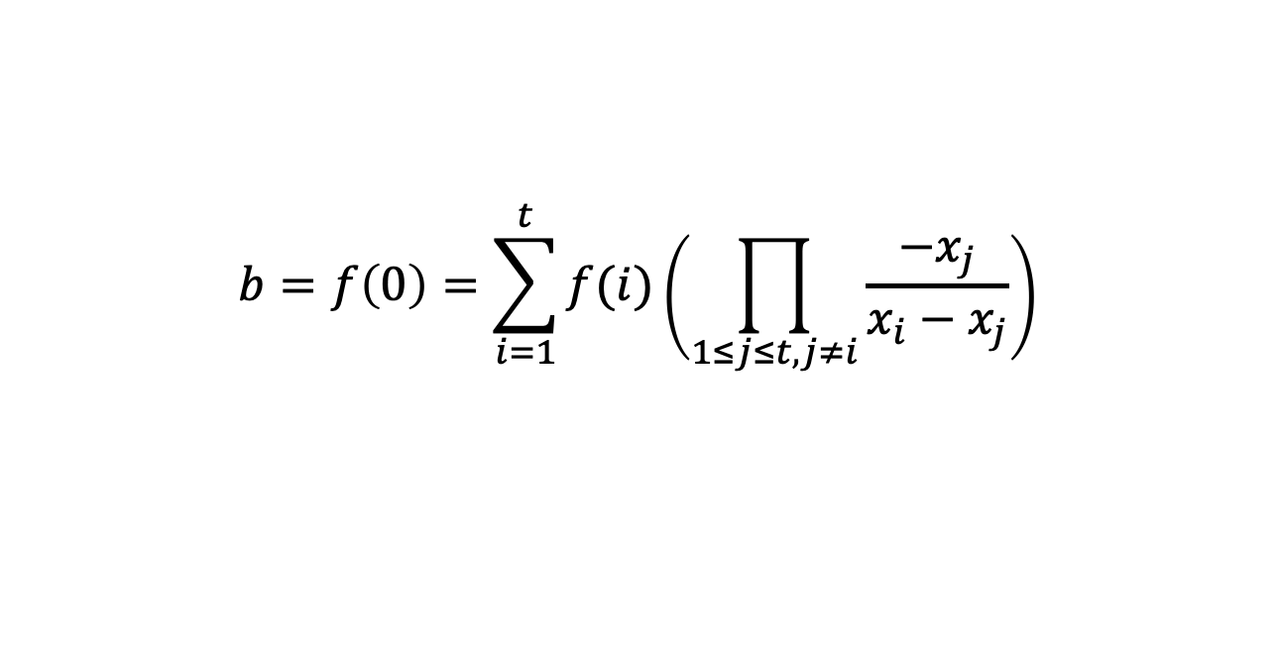
Shamir’s t-out-of-n Secret Sharing
Key Idea: Polynomials are Amazing!
$f\left(x\right)=a_{t−1}x^{t−1}+…+a_{1}x+b$
where $a_{i}$ are uniformly random mod $p$
$$s_{1}=f\left(1\right),s_{2}=f\left(2\right),…,s_{i}=f\left(i\right),{…,s}_{n}=f\left(n\right)$$
Correctness: Alternatively, Lagrange interpolation gives an explicit formula that recovers b.
$$b=f\left(0\right)=\sum_{i=1}^{t}{f(i)\left(\prod_{1≤j≤t,j≠i}{\frac{−x_{j}}{x_{i}−x_{j}}}\right)}$$

Slide 17
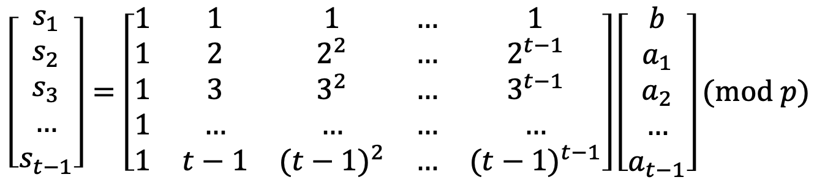
Shamir’s t-out-of-n Secret Sharing
Key Idea: Polynomials are Amazing!
$f\left(x\right)=a_{t−1}x^{t−1}+…+a_{1}x+b$
where $a_{i}$ are uniformly random mod $p$
$$s_{1}=f\left(1\right),s_{2}=f\left(2\right),…,s_{i}=f\left(i\right),{…,s}_{n}=f\left(n\right)$$
Security:
Let’s look at shares of parties $P_{1},P_{2},…,P_{t−1}.$
$$\left[\begin{matrix}s_{1} \\ s_{2} \\ s_{3} \\ … \\ s_{t−1}\end{matrix}\right]=\left[\begin{matrix}1 & 1 & 1 & … & 1 \\ 1 & 2 & 2^{2} & … & 2^{t−1} \\ 1 & 3 & 3^{2} & … & 3^{t−1} \\ 1 & … & … & … & … \\ 1 & t−1 & {(t−1)}^{2} & … & {(t−1)}^{t−1}\end{matrix}\right]\left[\begin{matrix}b \\ a_{1} \\ a_{2} \\ … \\ a_{t−1}\end{matrix}\right](mod p)$$
$(t−1)$-by-$t$ Vandermonde matrix

Slide 18
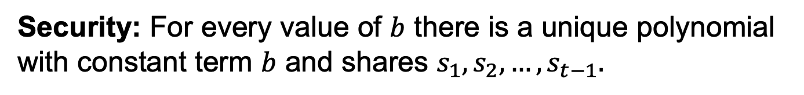
Shamir’s t-out-of-n Secret Sharing
Key Idea: Polynomials are Amazing!
$f\left(x\right)=a_{t−1}x^{t−1}+…+a_{1}x+b$
where $a_{i}$ are uniformly random mod $p$
$$s_{1}=f\left(1\right),s_{2}=f\left(2\right),…,s_{i}=f\left(i\right),{…,s}_{n}=f\left(n\right)$$
Security: For every value of $b$ there is a unique polynomial with constant term $b$ and shares $s_{1},s_{2},…,s_{t−1}.$
$$\left[\begin{matrix}s_{1} \\ s_{2} \\ s_{3} \\ … \\ s_{t−1}\end{matrix}\right]=\left[\begin{matrix}1 & 1 & 1 & … & 1 \\ 1 & 2 & 2^{2} & … & 2^{t−1} \\ 1 & 3 & 3^{2} & … & 3^{t−1} \\ 1 & … & … & … & … \\ 1 & t−1 & {(t−1)}^{2} & … & {(t−1)}^{t−1}\end{matrix}\right]\left[\begin{matrix}b \\ a_{1} \\ a_{2} \\ … \\ a_{t−1}\end{matrix}\right](mod p)$$
$(t−1)$-by-$t$ Vandermonde matrix

Slide 19
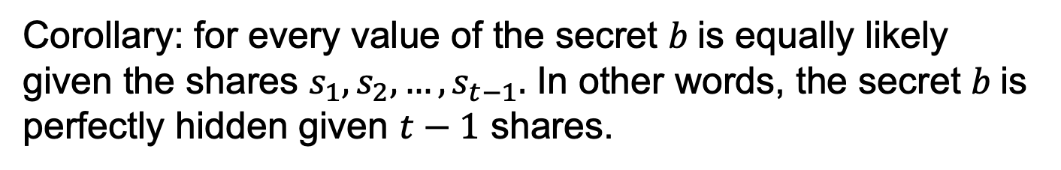
Shamir’s t-out-of-n Secret Sharing
Key Idea: Polynomials are Amazing!
$f\left(x\right)=a_{t−1}x^{t−1}+…+a_{1}x+b$
where $a_{i}$ are uniformly random mod $p$
$$s_{1}=f\left(1\right),s_{2}=f\left(2\right),…,s_{i}=f\left(i\right),{…,s}_{n}=f\left(n\right)$$
Security: For every value of $b$ there is a unique polynomial with constant term $b$ and shares $s_{1},s_{2},…,s_{t−1}.$
Corollary: for every value of the secret $b$is equally likely given the shares $s_{1},s_{2},…,s_{t−1}.$ In other words, the secret $b$is perfectly hidden given $t−1$ shares.

Slide 20
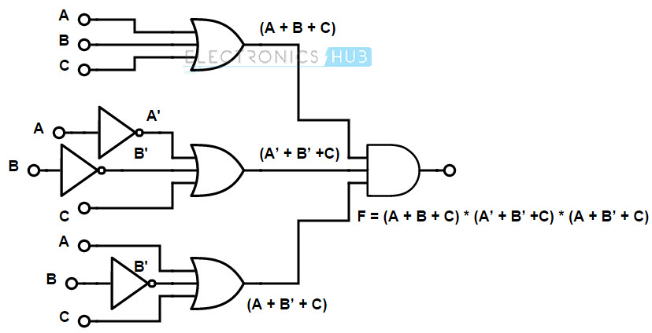


Secure Multiparty Computation
[BenOr-Goldwasser-Wigderson’88, Chaum-Crepeau-Damgard’88, BenOr-Rabin’89]
x
y
$$+$$
$$×$$
z
Arithmetic circuit for F
1. Each party secret-shares their input on a degree-t polynomial.
// so, security against t corruptions
2. Proceed gate by gate, maintaining the invariant that the parties holds a secret sharing of every wire value.
3. Exchange the output shares & reconstruct the output.

Slide 21
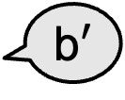













Secure Multiparty Computation
Key Insight: Can homomorphically compute on shares!
$$b$$
b$′$
$$s_{1}$$
$$s_{2}$$
$$b+b′$$
$$+$$
$$+$$
$$(3,s_{3})$$
$$s_{1}′$$
$$s_{2}′$$
$$(2,s_{2})$$
$$s_{3}$$
$$(1,s_{1})$$
$$+$$
$$b$$
$$s_{3}′$$
$$(3,s_{3}′)$$
$$(2,s_{2}′)$$
$$(1,s_{1}′)$$
Addition gate:
$$b′$$
Locally add shares

Slide 22


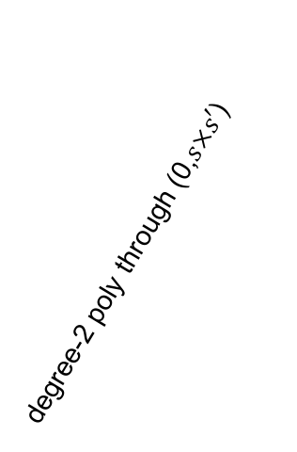




Secure Multiparty Computation
Key Insight: Can homomorphically compute on shares!
$$b$$
b$′$
degree-2 poly through (0,$s×s′$)
$$s_{1}$$
$$s_{2}$$
$$×$$
$$×$$
$$b×b′$$
$$(3,s_{3})$$
$$s_{1}′$$
$$s_{2}′$$
$$(2,s_{2})$$
$$s_{3}$$
$$(1,s_{1})$$
$$×$$
$$b$$
$$s_{3}′$$
$$(3,s_{3}′)$$
$$(2,s_{2}′)$$
$$(1,s_{1}′)$$
Multiplication gate:
$$b′$$
Locally multiply shares

Slide 23
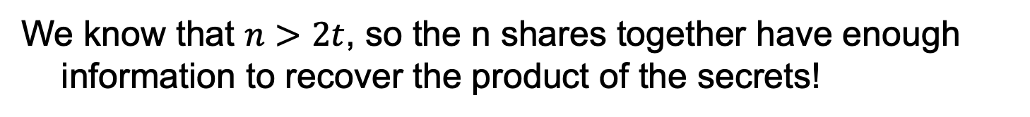
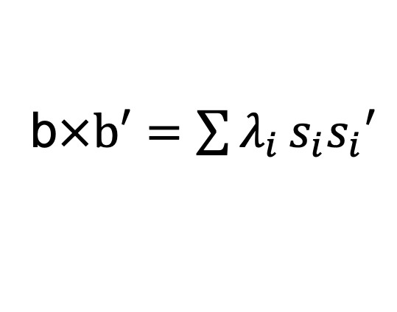
Multiplication
In general, after a single multiplication, the shares will live on a degree-2t polynomial.
Need $2t+1$ shares to reconstruct.
We know that $n>2t$, so the n shares together have enough information to recover the product of the secrets!
What’s more, we also know that this recovery process is a linear function of the shares.
b$×b′=\sum{λ_{i}}s_{i}s_{i}′$
for some publicly known coefficients $λ_{i}$.

Slide 24




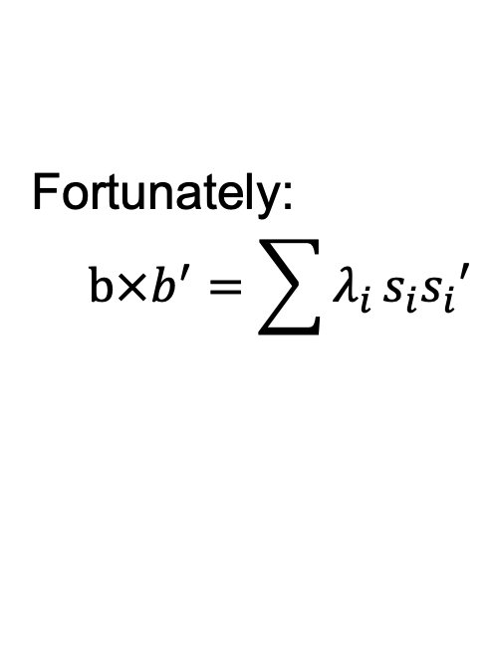



Degree Reduction Protocol
$$b$$
b$′$
degree-2 poly through (0,$s×s′$)
$$s_{1}$$
$$s_{2}$$
$$s_{1}′′$$
$$s_{2}′′$$
$$×$$
$$×$$
$$b×b′$$
Fortunately:
$$b×b^{′}=\sum{λ_{i}}s_{i}s_{i}′$$
$$s_{1}′$$
$$s_{2}′$$
$$s_{3}$$
$$(1,s_{1}′′)$$
$$s_{3}′′$$
$$×$$
$$s_{3}′$$
$$(2,s_{2}′′)$$
Multiplication gate:
$$(3,s_{3}′′)$$
Locally multiply shares & run a degree reduction protocol.

Slide 25
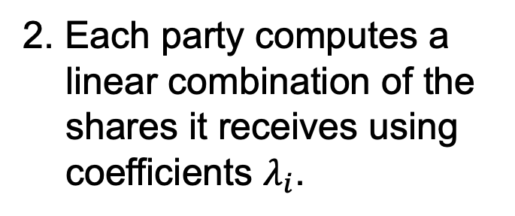
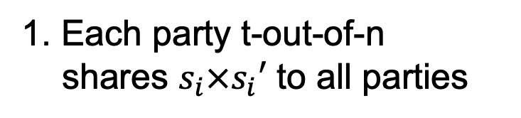


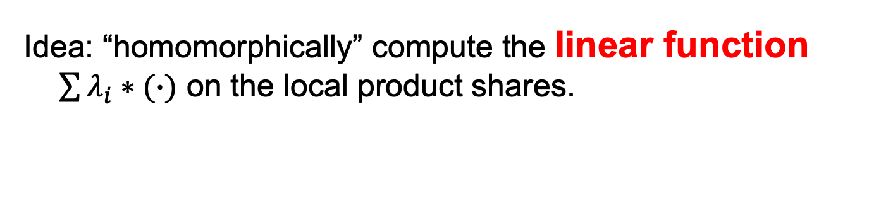
Degree Reduction Protocol
Convert shares on a degree-2t polynomial into shares on a degree-t polynomial
Idea: “homomorphically” compute the linear function $\sum{λ_{i}}∗(∙)$ on the local product shares.
1. Each party t-out-of-n shares $s_{i}×s_{i}′$ to all parties
$$s$$
$$s′$$
$$s_{1}$$
$$s_{2}$$
2. Each party computes a linear combination of the shares it receives using coefficients $λ_{i}$.
$$×$$
$$×$$
$$s_{1}′$$
$$s_{2}′$$
$$s_{3}$$
$$×$$
$$s_{3}′$$

Slide 26
This is the moral equivalent of bootstrapping in FHE!
Idea: “homomorphically” compute the linear function $\sum{λ_{i}}∗(∙)$ on the local product shares.
1. Each party t-out-of-n shares $s_{i}×s_{i}′$ to all parties
$$s$$
$$s′$$
$$s_{1}$$
$$s_{2}$$
2. Each party computes a linear combination of the shares it receives using coefficients $λ_{i}$.
$$×$$
$$×$$
$$s_{1}′$$
$$s_{2}′$$
$$s_{3}$$
$$×$$
$$s_{3}′$$

Slide 27
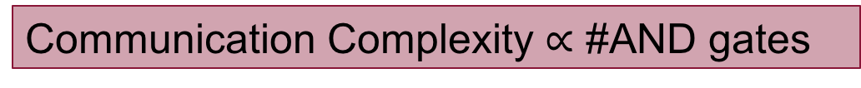


Secure Multiparty Computation
x
y
$$+$$
$$×$$
z
Arithmetic circuit for F
1. Each party secret-shares their input.
2. Proceed gate by gate:
ADD: locally add shares
MULT: locally mult shares and do degree reduction.
3. Exchange the output shares & reconstruct the output.
Communication Complexity $∝$ #AND gates

Slide 28
Security Intuition
1. Any subset of t parties do not get any information about other parties’ inputs from the input shares.
2. Security of the degree-reduction protocol: any subset of t parties sees completely random numbers
3. The output lives on a random polynomial of degree t whose constant term is the circuit output. The shares, therefore, reveal only the circuit output.

Slide 29
Threshold Decryption and Signing
Secret sharing is useful way beyond MPC.
An example: distributed storage of keys.
Another example, threshold decryption:
distributed storage of decryption key + non-interactive distributed (or threshold) decryption

Slide 30
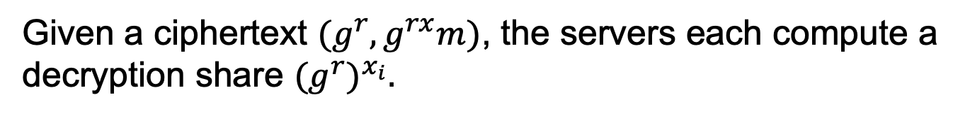
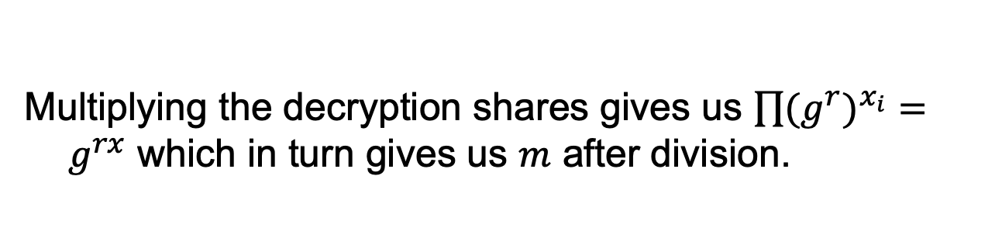
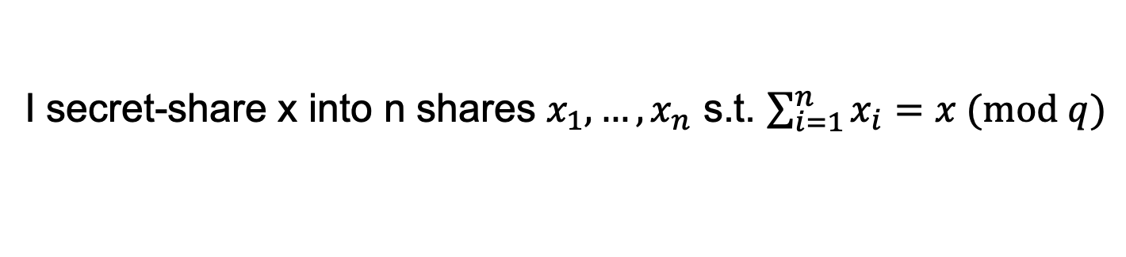
Threshold El Gamal
Public key: $g^{x}$
Secret key: $x$
I am paranoid about losing x so I share it among n servers.
I secret-share x into n shares $x_{1},…,x_{n}$ s.t. $\sum_{i=1}^{n}{x_{i}}=x (mod q)$
Threshold Decryption:
Given a ciphertext $(g^{r},g^{rx}m)$, the servers each compute a decryption share ${(g^{r})}^{x_{i}}.$
Multiplying the decryption shares gives us $\prod{{(g^{r})}^{x_{i}}}=g^{rx}$ which in turn gives us $m$ after division.

Slide 31
Threshold Decryption and Signing
Secret sharing is useful way beyond MPC.
An example: distributed storage of keys.
Another example, threshold decryption:
distributed storage of decryption key + non-interactive distributed (or threshold) decryption
Yet another example, threshold signing.

Slide 32

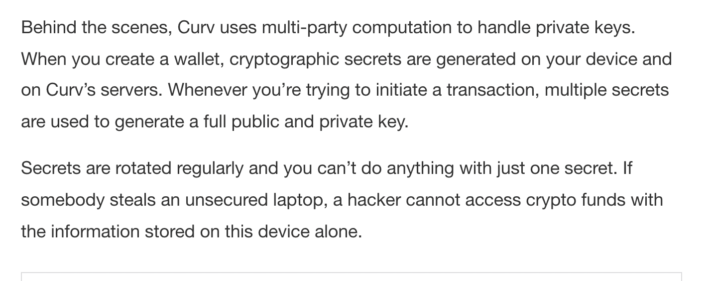

Slide 33
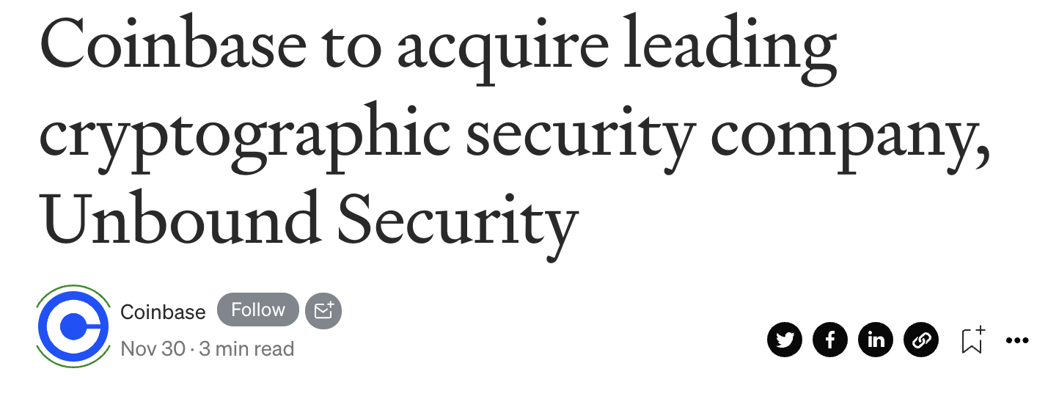
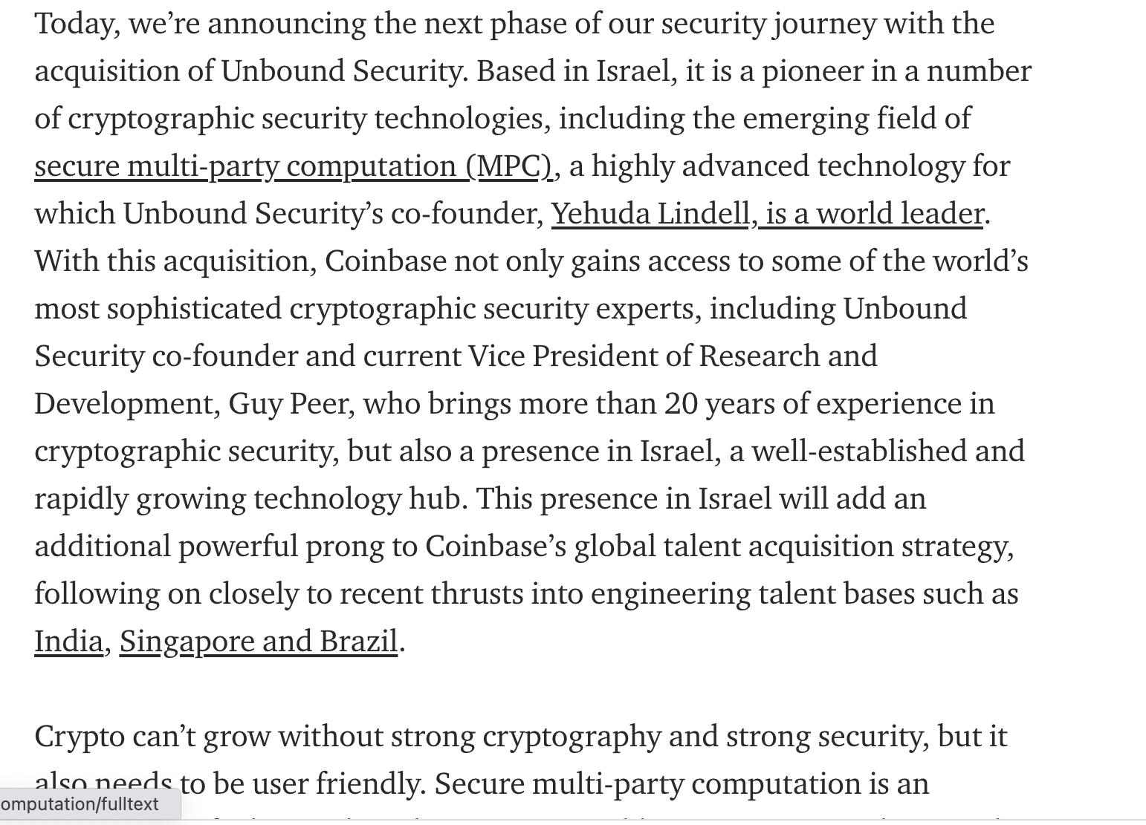

Slide 34
