Slide 1
MIT 6.875
Foundations of Cryptography
Lecture 15

Slide 2
Zero Knowledge Proofs
An Interactive Protocol (P,V) is a perfect/statistical/computational zero-knowledge proof system for a language $L$if it is
Complete
Sound and
Zero knowledge: for every PPT $V^{∗}$, there exists a (expected) poly time simulator S s.t. for every $x∈L$, the following two distributions are identical/statistically close/computationally close:
1. ${view}_{V^{∗}}(P,V^{∗})$
2. $S(x,1^{λ})$

Slide 3
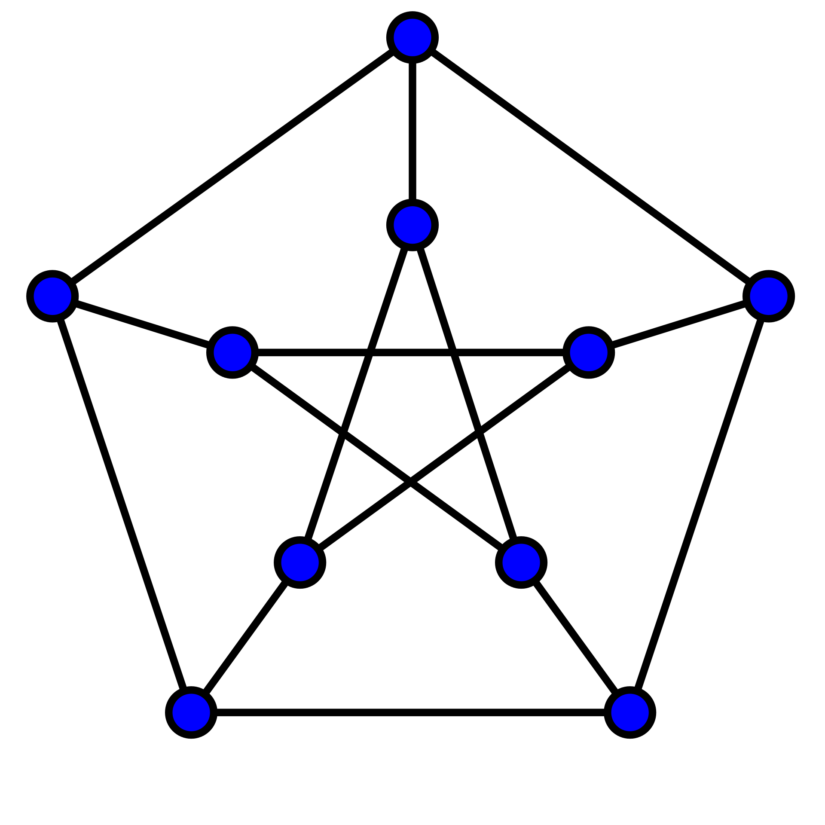
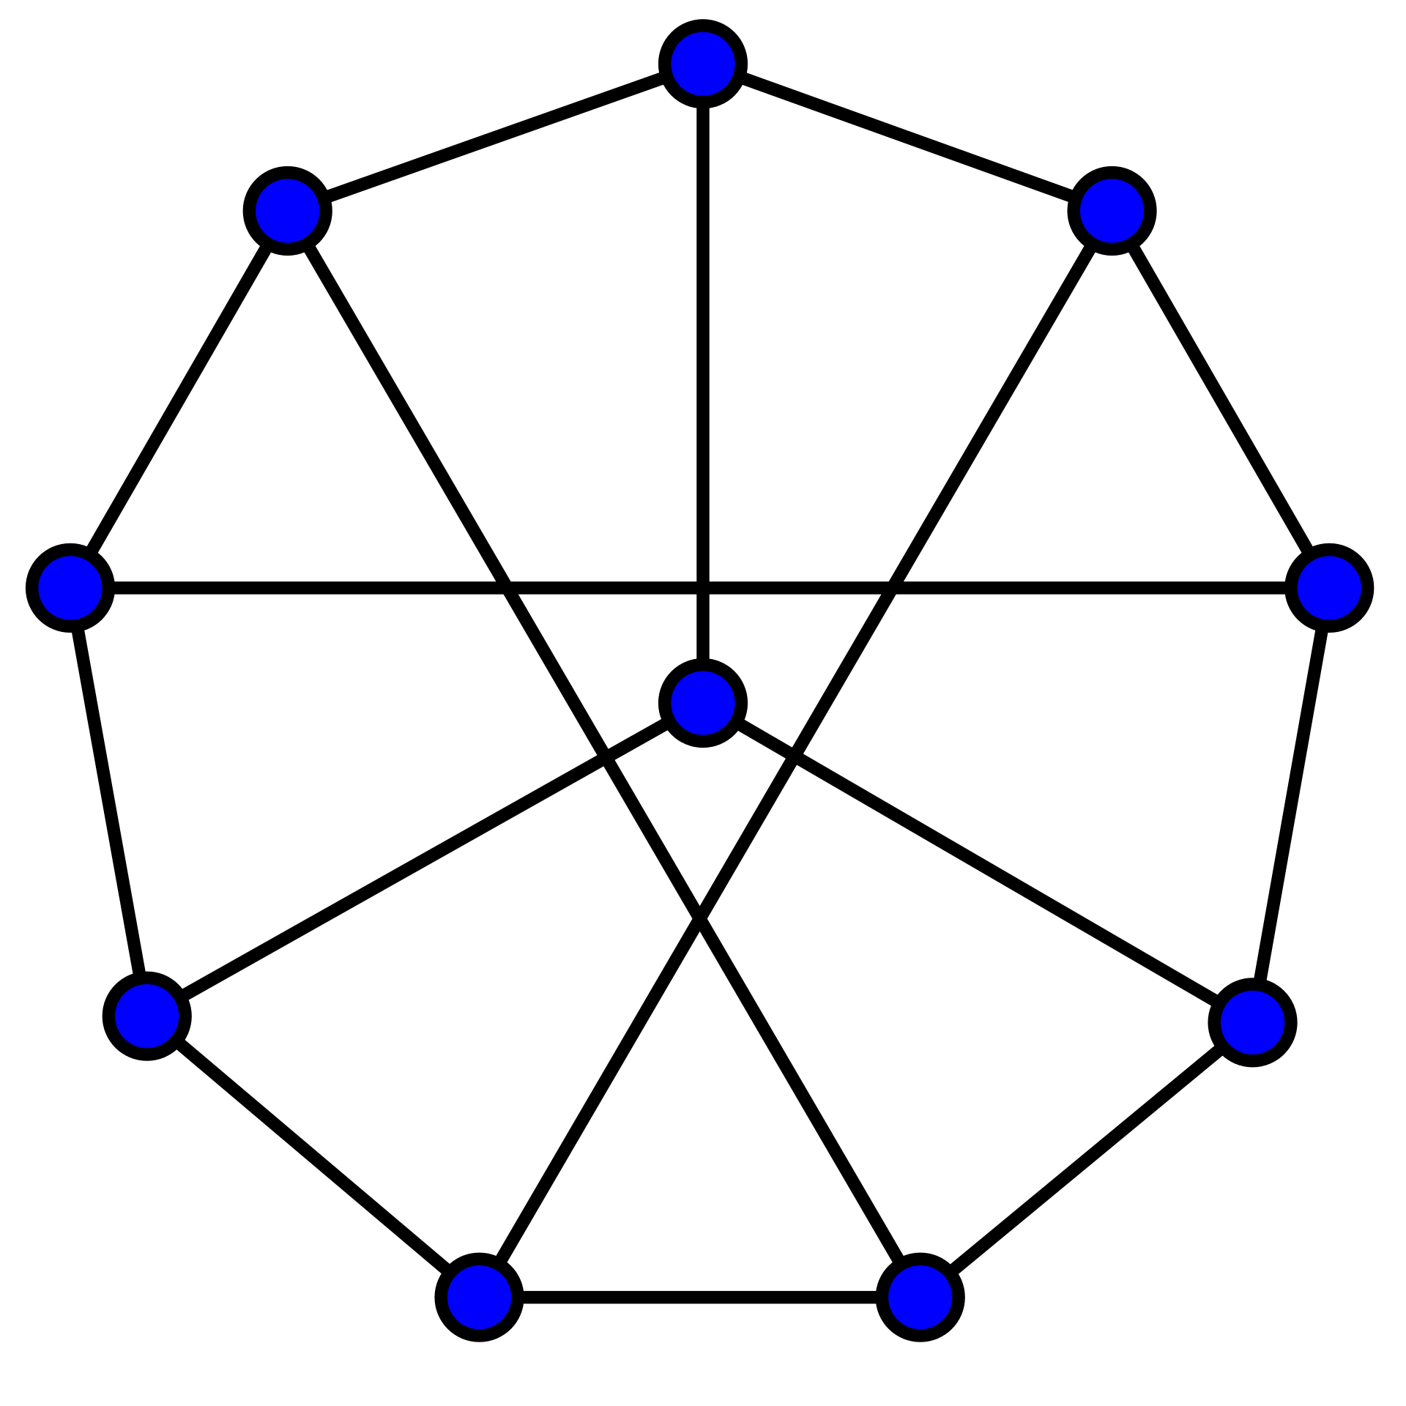
ZK Proof for Graph Isomorphism
1
1
2
6
2
6
5
7
10
3
8
5
8
9
4
10
3
4
Graph G
9
7
Graph H
$K=ρ(G)$
$$H=π(G)$$
where $ρ$ is a random permutation
random challenge bit $b$
Verifier
Prover
$b=0:$ send $π_{0}$ s.t. $K=π_{0}(G)$
$b=1:$ send $π_{1}$ s.t. $H=π_{1}(K)$

Slide 4
ZK Proof for Graph Isomorphism
Completeness?
$K=ρ(G)$
$$H=π(G)$$
where $ρ$ is a random permutation
random challenge bit $b$
Verifier
Prover
$b=0:$ send $π_{0}=ρ$
$b=1:$ send $π_{1}=π∘ρ^{−1}$

Slide 5
ZK Proof for Graph Isomorphism
Soundness: Suppose G and H are non-isomorphic, and a prover could answer both the verifier challenges. Then, $K=π_{0}(G)$ and $H=π_{1}\left(K\right).$
In other words, $H{=π}_{1}∘π_{0}(G)$, a contradiction!
$K=ρ(G)$
$$H=π(G)$$
where $ρ$ is a random permutation
random challenge bit $b$
Verifier
Prover
$b=0:$ send $π_{0}=ρ$
$b=1:$ send $π_{1}=π∘ρ^{−1}$

Slide 6
ZK Proof for Graph Isomorphism
Zero Knowledge?
$K=ρ(G)$
$$H=π(G)$$
where $ρ$ is a random permutation
random challenge bit $b$
Verifier
Prover
$b=0:$ send $π_{0}=ρ$
$b=1:$ send $π_{1}=π∘ρ^{−1}$

Slide 7
Efficient Prover (given a Witness)
In both these protocols, the (honest) prover is actually polynomial-time given the NP witness (the square root of $y$ in the case of QR, and the isomorphism in the case of graph-iso.)
Soundness is nevertheless against any, even computationally unbounded, prover $P^{∗}$.

Slide 8
Do all NP languages have Perfect ZK proofs?
We showed two languages with perfect ZK proofs. Can we show this for all NP languages?
Theorem [Fortnow’89, Aiello-Hastad’87] No, unless bizarre stuff happens in complexity theory (technically: the polynomial hierarchy collapses.)

Slide 9
Do all NP languages have ZK proofs?
Nevertheless, today, we will show:
Theorem [Goldreich-Micali-Wigderson’87] Assuming one-way functions exist, all of NP has computational zero-knowledge proofs.
This theorem is amazing: it tells us that everything that can be proved (in the sense of Euclid) can be proved in zero knowledge!

Slide 10
Zero Knowledge Proof for Hamiltonicity
NP-Complete Problem:
Every other problem in NP can be reduced to it.
Let us first design a protocol in the lead-box model.

Slide 11
Zero Knowledge Proof for 3-Coloring
NP-Complete Problem:
Every other problem in NP can be reduced to it.

Slide 12
We need a commitment scheme (aka a “promise hiding scheme” from pset 1).
Bit b
Commit to b:
b
b
Sender
Open: b,
Receiver
1. Hiding: The locked box should completely hide b.
2. Binding: Sender shouldn’t be able to open to 1-b.

Slide 13
In pset 1, you implemented a commitment scheme using PRGs. We will later show another construction using one-way permutations.
Bit b
Commit to b:
b
ACCEPT/REJECT
Sender
Open: b,
Receiver
1. Hiding: The locked box should completely hide b.
2. Binding: Sender shouldn’t be able to open to 1-b.

Slide 14
Zero Knowledge Proof for Hamiltonicity
1
2
1
2
Graph G
Graph G
$$\left[\begin{matrix}0 & 0 & 1 & 1 \\ 0 & 0 & 1 & 1 \\ 1 & 1 & 0 & 1 \\ 1 & 1 & 1 & 0\end{matrix}\right]$$
4
3
4
3
$$H=π(G)$$
$$G=\left[\begin{matrix}0 & 1 & 0 & 1 \\ 1 & 0 & 1 & 1 \\ 0 & 1 & 0 & 1 \\ 1 & 1 & 1 & 0\end{matrix}\right]$$
1
3
$$H=\left[\begin{matrix}0 & 0 & 1 & 1 \\ 0 & 0 & 1 & 1 \\ 1 & 1 & 0 & 1 \\ 1 & 1 & 1 & 0\end{matrix}\right]$$
4
2

Slide 15
Zero Knowledge Proof for Hamiltonicity
1
2
1
2
Graph G
Graph G
4
3
4
3
$$H=π(G)$$
$$H=\left[\begin{matrix}0 & 0 & 1 & 1 \\ 0 & 0 & 1 & 1 \\ 1 & 1 & 0 & 1 \\ 1 & 1 & 1 & 0\end{matrix}\right]$$
random challenge bit $b$
$b=0:$ send $π$ and open all edges
$b=1:$ open a Ham cycle in H
V (when b=0): Check all openings and check that $H=π\left(G\right).$

Slide 16
Zero Knowledge Proof for Hamiltonicity
1
2
1
2
Graph G
Graph G
4
3
4
3
$$H=π(G)$$
$$H=\left[\begin{matrix}0 & 0 & 1 & 1 \\ 0 & 0 & 1 & 1 \\ 1 & 1 & 0 & 1 \\ 1 & 1 & 1 & 0\end{matrix}\right]$$
random challenge bit $b$
$b=0:$ send $π$ and open all edges
$b=1:$ open a Ham cycle in H
V (when b=1): Check the openings correspond to a cycle.

Slide 17
Zero Knowledge Proof for 3COL
1
2
1
2
Graph G
=(V,E)
Graph G
4
3
4
3
$$…$$
$$ρ(1)$$
$$ρ(n)$$
$$ρ\left(1\right),…,ρ(n)$$
Come up with a random permutation of the colors
$$ρ:V→\{R,B,G\}$$
random edge $(i,j)$
open $ρ(i)$ and $ρ(j)$
Check the openings
Check: $ρ\left(i\right),$ $ρ\left(j\right)∈\{R,B,G\}$
3. Check: $ρ\left(i\right)≠$ $ρ\left(j\right)$ .

Slide 18
Zero Knowledge Proof for 3COL
1
2
1
2
Graph G
=(V,E)
Graph G
4
3
4
3
$$…$$
$$ρ(1)$$
$$ρ(n)$$
random edge $(i,j)$
open $ρ(i)$ and $ρ(j)$
Completeness: Exercise.

Slide 19
Zero Knowledge Proof for 3COL
1
2
1
2
Graph G
=(V,E)
Graph G
4
3
4
3
$$…$$
$$ρ(1)$$
$$ρ(n)$$
random edge $(i,j)$
open $ρ(i)$ and $ρ(j)$
Soundness: If the graph is not 3COL, in every 3-coloring (that P commits to), there is some edge whose end-points have the same color.
V will catch this edge and reject with probability $≥1/|E|$.

Slide 20
Zero Knowledge Proof for 3COL
1
2
1
2
Graph G
=(V,E)
Graph G
4
3
4
3
$$…$$
$$ρ(1)$$
$$ρ(n)$$
random edge $(i,j)$
open $ρ(i)$ and $ρ(j)$
Repeat $|E|∙λ$ times to get the verifier to accept with probability $≤(1−1/|E|)^{|E|∙λ}≤2^{−λ}$

Slide 21
Commitment Schemes

Slide 22
Commitment Schemes
ACCEPT/REJECT
Bit b
Commitment Protocol
$$\left(DEC,COM\right)←(S\left(b,1^{λ}\right),R\left(1^{λ}\right))$$
Receiver R
Sender S
DEC
COM
b, DEC
1. Completeness: R always accepts in an honest execution.

Slide 23
Commitment Schemes
ACCEPT/REJECT
Bit b
Commitment Protocol
$$\left(DEC,COM\right)←(S\left(b,1^{λ}\right),R\left(1^{λ}\right))$$
Receiver R
Sender S
DEC
COM
b, DEC
2. Computational Hiding: For every possibly malicious (PPT) $R^{∗},$
${view}_{R^{∗}}(S\left(0\right),R^{∗})≈_{c}$ ${view}_{R^{∗}}(S\left(1\right),R^{∗})$

Slide 24
Commitment Schemes
ACCEPT/REJECT
Bit b
Commitment Protocol
$$\left(DEC,COM\right)←(S\left(b,1^{λ}\right),R\left(1^{λ}\right))$$
Receiver R
Sender S
DEC
COM
b, DEC
3. Perfect Binding: For every possibly malicious $S^{∗},$ let COM be the receiver’s output in an execution of $\left(S^{∗},R\right).$ There is no pair of decommitments $\left({DEC}_{0},{DEC}_{1}\right)$ s.t. R accepts both $\left(com,0,{DEC}_{0}\right) and (com,1,{DEC}_{1}).$

Slide 25
A Commitment Scheme from any OWP
Bit b
$$COM=(f\left(r\right),HCB(r)⊕b)$$
Sender S
Receiver R
$$DEC=r$$
Let $COM=\left(x,y\right).$ Check that
1. $f\left(r\right)=x$ and
2. $HCB(r)$ $⊕b=y$
$$OPEN:(b,r)$$
1. Completeness: Exercise.
2. Comp. Hiding: by the hardcore bit property.
3. Perfect Binding: because f is a permutation.

Slide 26
Back to ZK Proof for 3COL
1
2
1
2
Graph G
=(V,E)
Graph G
4
3
4
3
$$\{Com\left(ρ\left(k\right);r_{k}\right)\}_{k=1}^{n}$$
random edge $(i,j)$
send openings $ρ\left(i\right), r_{i}$ and ${ρ\left(j\right),r}_{j}$

Slide 27
Why is this zero-knowledge?
Simulator S works as follows:
1. First pick a random edge $(i^{∗},j^{∗})$
Color vertices$i^{∗}$ and $j^{∗}$ with random, different colors
$$\{Com\left(ρ\left(k\right);r_{k}\right)\}_{k=1}^{n}$$
Color all other vertices red.
edge $(i,j)$
2. Feed the commitments of the colors to $V^{∗}$and get edge $(i,j)$
3. If $\left(i,j\right)≠(i^{∗},j^{∗})$, go back and repeat.
send openings $r_{i}$ and $r_{j}$
4. If $\left(i,j\right)=(i^{∗},j^{∗})$, output the commitments and openings $r_{i}$ and $r_{j}$ as the simulated transcript.

Slide 28
Why is this zero-knowledge?
Lemma:
Assuming the commitment is hiding, S runs in expected polynomial-time.
When S outputs a view, it is comp. indist. from the view of $V^{∗}$ in a real execution.
$$\{Com\left(ρ\left(k\right);r_{k}\right)\}_{k=1}^{n}$$
edge $(i,j)$
send openings $r_{i}$ and $r_{j}$

Slide 29
Why is this zero-knowledge?
Simulator S works as follows (call this Hybrid 0)
1. First pick a random edge $(i^{∗},j^{∗})$
Color vertices $i^{∗}$ and $j^{∗}$ with random, different colors
$$\{Com\left(ρ\left(k\right);r_{k}\right)\}_{k=1}^{n}$$
Color all other vertices red.
edge $(i,j)$
2. Feed the commitments of the colors to $V^{∗}$ and get edge $(i,j)$
3. If $\left(i,j\right)≠(i^{∗},j^{∗})$, go back and repeat.
send openings $r_{i}$ and $r_{j}$
4. If $\left(i,j\right)=(i^{∗},j^{∗})$, output the commitments and openings $r_{i}$ and $r_{j}$ as the simulated transcript.

Slide 30
Why is this zero-knowledge?
Not-a-Simulator S works as follows (call this Hybrid 1)
1. First pick a random edge $(i^{∗},j^{∗})$
Permute a legal coloring and color all vertices correctly.
$$\{Com\left(ρ\left(k\right);r_{k}\right)\}_{k=1}^{n}$$
edge $(i,j)$
2. Feed the commitments of the colors to $V^{∗}$ and get edge $(i,j)$
3. If $\left(i,j\right)≠(i^{∗},j^{∗})$, go back and repeat.
send openings $r_{i}$ and $r_{j}$
4. If $\left(i,j\right)=(i^{∗},j^{∗})$, output the commitments and openings $r_{i}$ and $r_{j}$ as the simulated transcript.

Slide 31
Why is this zero-knowledge?
Claim: Hybrids 0 and 1 are computationally indistinguishable, assuming the commitment scheme is computationally hiding.
Proof: By contradiction. Show a reduction that breaks the hiding property of the commitment scheme, assuming there is a distinguisher between hybrids 0 and 1.

Slide 32
Why is this zero-knowledge?
Not-a-Simulator S works as follows (call this Hybrid 1)
1. First pick a random edge $(i^{∗},j^{∗})$
Permute a legal coloring and color all vertices correctly.
$$\{Com\left(ρ\left(k\right);r_{k}\right)\}_{k=1}^{n}$$
edge $(i,j)$
2. Feed the commitments of the colors to $V^{∗}$ and get edge $(i,j)$
3. If $\left(i,j\right)≠(i^{∗},j^{∗})$, go back and repeat.
send openings $r_{i}$ and $r_{j}$
4. If $\left(i,j\right)=(i^{∗},j^{∗})$, output the commitments and openings $r_{i}$ and $r_{j}$ as the simulated transcript.

Slide 33
Why is this zero-knowledge?
Here is the real view of V* (Hybrid 2)
1. First pick a random edge $(i^{∗},j^{∗})$
Permute a legal coloring and color all edges correctly.
$$\{Com\left(ρ\left(k\right);r_{k}\right)\}_{k=1}^{n}$$
edge $(i,j)$
2. Feed the commitments of the colors to $V^{∗}$ and get edge $(i,j)$
3. If $\left(i,j\right)≠(i^{∗},j^{∗})$, go back and repeat.
send openings $r_{i}$ and $r_{j}$
4. If $\left(i,j\right)=(i^{∗},j^{∗})$, output the commitments and openings $r_{i}$ and $r_{j}$ as the transcript.

Slide 34
Why is this zero-knowledge?
Claim: Hybrids 1 and 2 are identical.
Hybrid 1 merely samples from the same distribution as Hybrid 2 and, with probability $1−1/|E|$, decides to throw it away and resample.

Slide 35
Put together:
Theorem: The 3COL protocol is zero knowledge.

Slide 36
Examples of NP Assertions
My public key is well-formed (e.g. in RSA, the public key is $N$, a product of two primes together with an e that is relatively prime to $φ\left(N\right).$)
Encrypted bitcoin (or Zcash): “I have enough money to pay you.” (e.g. I will publish an encryption of my bank account and prove to you that my balance is $≥\$X.)$
Running programs on encrypted inputs: Given Enc(x) and y, prove that y = PROG(x).

Slide 37
Examples of NP Assertions
Running programs on encrypted inputs: Given Enc(x) and y, prove that y = PROG(x).
More generally: A tool to enforce honest behavior without revealing information.

Slide 38
Interaction is Necessary for ZK
Suppose there were a non-interactive ZK proof system for 3COL.
Graph G
Graph G
$$π$$
Step 1. When G is in 3COL, V accepts the proof $π$.
(Completeness)

Slide 39
Interaction is Necessary for ZK
Suppose there were a non-interactive ZK proof system for 3COL.
Graph G
Graph G
$$\tilde{π }$$
Step 2. PPT Simulator S, given only G in 3COL, produces an indistinguishable proof $\tilde{π}$ (Zero Knowledge).
In particular, V accepts $\tilde{π}$.

Slide 40
Interaction is Necessary for ZK
Suppose there were a non-interactive ZK proof system for 3COL.
Graph G
Graph G
$$\tilde{π }$$
Step 3. Imagine running the Simulator S on a $G∉$3COL. It produces a proof $\tilde{π}$ which the verifier still accepts!
(WHY?! Because S and V are PPT. They together cannot tell if the input graph is 3COL or not)

Slide 41
Interaction is Necessary for ZK
Suppose there were a non-interactive ZK proof system for 3COL.
Graph G
Graph G
$$π$$
Step 4. Therefore, S is a cheating prover!
Produces a proof for a $G∉$3COL that the verifier nevertheless accepts.
Ergo, the proof system is NOT SOUND!

Slide 42
THE END
Or, is it?

Slide 43
Two Roads to Non-Interactive ZK (NIZK)
1. Random Oracle Model & Fiat-Shamir Transform.
Random Oracle
Graph G
Graph G
$$π$$
2. Common Random String Model.

Slide 44
Topic 1:
Proofs of Knowledge

Slide 45
So far: Decision Problems
$y∈L$ or $y∉L$
(e.g. $y$ is a quadratic residue mod $N$ or it is not)
Here is a different scenario:
$$x$$
$${y=g}^{x} (mod p)$$
Discrete log of $y$ always exists (assuming $g$ is a generator)…
Alice wants to convince Bob that she knows a solution to a problem, e.g. that she knows the discrete log of $y$

Slide 46
So far: Decision Problems
$$x$$
$$Acc/Rej$$
$${y=g}^{x} (mod p)$$
Completeness: When Alice and Bob run the protocol where Alice has input $x$, Bob outputs accept.
Soundness? How to define it?
Zero Knowledge: There is a simulator that, given only $y$, outputs a view of Bob that is indistinguishable from his view in an interaction with Alice.

Slide 47
Proof of Knowledge
$$x$$
$$Acc/Rej$$
$${y=g}^{x} (mod p)$$
If Alice knows $x$, there must be a way to “extract it from her”.
I will not define an extractor formally but will show you an example (see Goldreich’s book for more)

Slide 48
ZK Proof of Knowledge of Discrete Log
$$p=2q+1$$
$$x$$
$$Acc/Rej$$
$${y=g}^{x} (mod p)$$
$${z=g}^{r} (mod p)$$
$$c←\{0,1\}$$
$$s=r+cx (mod q)$$
Accept iff $g^{s}=z∙y^{c}$
Completeness and Zero Knowledge: Exercise.

Slide 49
Proof of Knowledge: Extractor
Assume $P^{∗}$ convinces the verifier with prob. $>\frac{1}{2}+1/poly$
$${y=g}^{x} (mod p)$$
$${z=g}^{r} (mod p)$$
Extractor runs $P^{∗}$ to get a $z$.
$P^{∗}$
Runs $P^{∗}$ with $c=0$ and gets $s_{0}$
$$c=0$$
$$c=1$$
Rewinds $P^{∗}$ to the first message.
Runs $P^{∗}$ with $c=1$ and gets $s_{1}$
$$s_{0}$$
$$s_{1}$$
$g^{s_{0}}=z$ and
$g^{s_{1}}=zy$ w.p. $1/poly$
$g^{s_{1}−s_{0}}=y$. So, $s_{1}−s_{0}$ is the discrete log of $y.$

Slide 50
Zero Knowledge vs. Proof of Knowledge
Zero knowledge is a property of the prover against malicious verifiers. A prover P reveals zero knowledge if for all $V^{∗}$ …
Soundness and Proof of knowledge are properties of the verifier against malicious provers. A verifier V is sound (resp. satisfied PoK) if for all $P^{∗}$ …

Slide 51
Zero Knowledge Proofs of Knowledge
Theorem [Goldreich-Micali-Wigderson’87] Assuming one-way functions exist, all of NP has computational zero-knowledge proofs of knowledge.

Slide 52
Topic 2:
The Round-Complexity of ZK

Slide 53
Reducing Soundness Error
The 3COL protocol has a large soundness error of $1−1/|E|$
(probability that $V$ accepts even though $G∉3COL$)
Theorem: Sequential Repetition reduces soundness error for interactive proofs (and preserves the ZK property.)
Problem: Lots of rounds
Theorem: Parallel Repetition reduces soundness error for interactive proofs. It is also honest-verifier ZK.

Slide 54
Theorem [Goldreich-Krawczyk’90] There exist ZK proofs whose parallel repetition is NOT (malicious verifier) zero knowledge.
But the GK 90 counterexample is quite contrived. How about “natural protocols”, e.g. the GMW 3-coloring protocol from the last lecture?

Slide 55
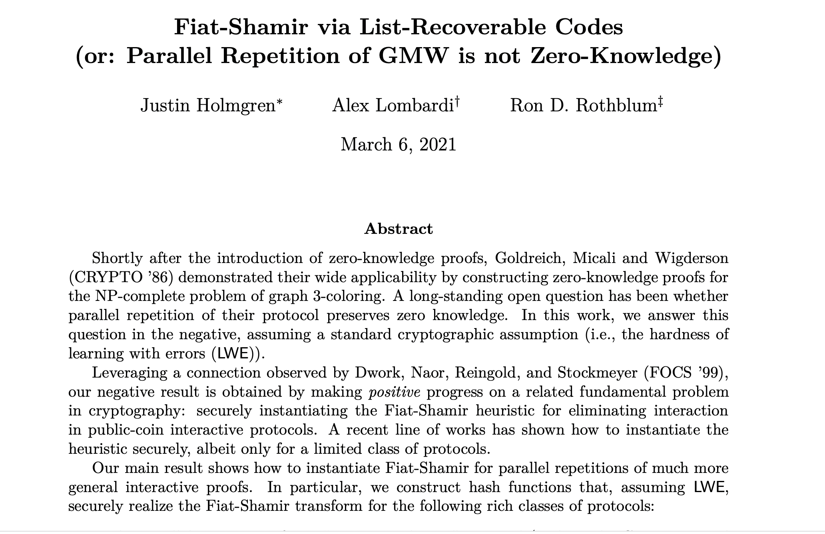
Theorem [Goldreich-Krawczyk’90] There exist ZK proofs whose parallel repetition is NOT (malicious verifier) zero knowledge.
Theorem [Holmgren-Lombardi-Rothblum’21] Parallel Repetition of the (Goldreich-Micali-Wigderson) 3COL protocol is not zero-knowledge.

Slide 56
Reducing Soundness Error
Fortunately, we have:
Theorem [Goldreich-Kahan’95] There is a constant-round ZK proof system for 3COL (with exponentially small soundness error), assuming discrete logarithms are hard (more generally, assuming the existence of collision-resistant hash functions).

Slide 57
Topic 3:
The Power of Interactive Proofs
What can we prove with interaction?

Slide 58
Interactive Proof for Graph Non-Isomorphism
$$≇$$
Completely unclear how to prove in NP.
Graph $G_{0}$
Graph $G_{1}$
$$ρ(G_{b})$$
Verifier
Prover
Pick a random bit $b$ and a random permutation $ρ$
$$b′$$
Accept if $b=b^{′}.$

Slide 59
A window into a promised land…

Slide 60
The Power of Interactive Proofs
Theorem [Nisan’90, Lund-Fornow-Karloff-Nisan’90]
There is an interactive proof for the statement that the number of satisfying assignments to a formula is a given number (this complexity class is called $\#P$).
Theorem [Shamir’90] $IP=PSPACE$.

Slide 61
The Power of Interactive Proofs
Definition of multi-prover interactive proofs [BenOr-Goldwasser-Kilian-Wigderson’88]
V
MIP
Theorem [Babai-Fornow-Lund’90] $MIP=NEXP$.

Slide 62
The Power of Interactive Proofs
Definition of probabilistically checkable proofs [Arora-Safra’92, Feige-Goldwasser-Lovasz-Safra-Szegedy’91]
$$π_{1}$$
$$π_{2}$$
$$π_{3}$$
$$π_{4}$$
$$π_{5}$$
$$π_{6}$$
$$…$$
$$…$$
$$…$$
$$π_{n}$$
V
Theorem [Arora-Lund-Motwani-Sudan-Szegedy’92] $PCP(3)=NP$.

Slide 63
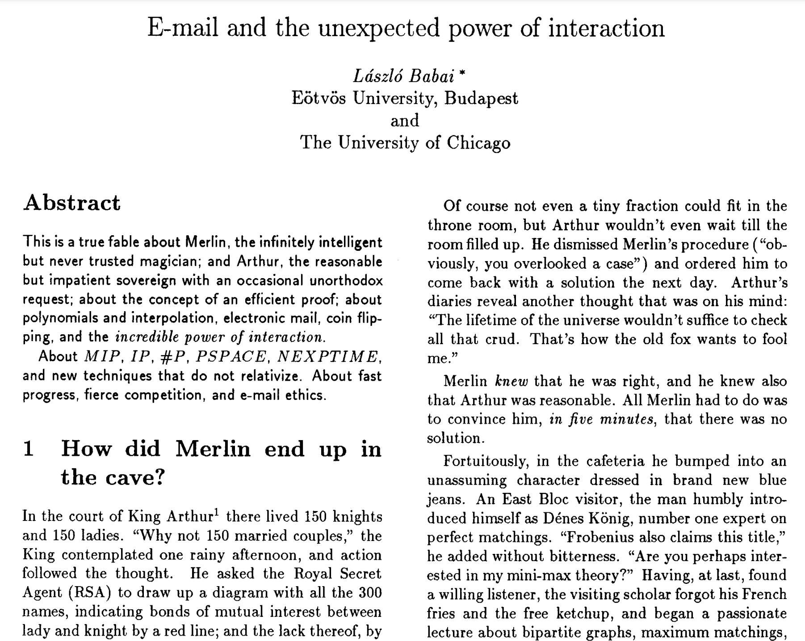

Slide 64
By Ryan O’Donnell

