Slide 1
MIT 6.875
Foundations of Cryptography
Lecture 19

Slide 2
TODAY (and the next lecture):
Lattice-based Cryptography

Slide 3
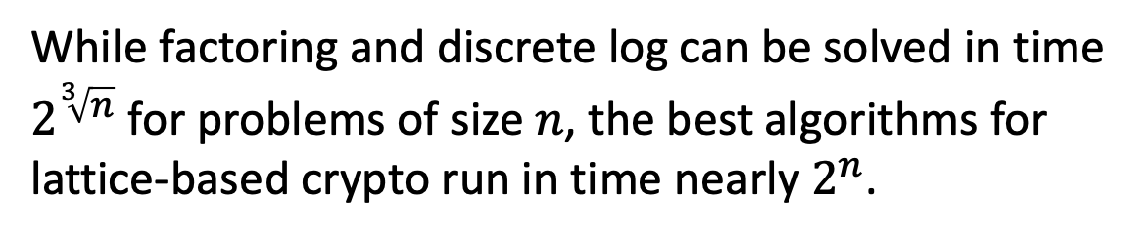
Why Lattice-based Crypto?
Exponentially Hard
(so far)
While factoring and discrete log can be solved in time $2^{\sqrt[3]{n}}$ for problems of size $n$, the best algorithms for lattice-based crypto run in time nearly $2^{n}$.

Slide 4
Why Lattice-based Crypto?
Exponentially Hard
(so far)
□ Quantum-Resistant
(so far)

Slide 5


Quantum Computers Break Crypto
(Very large scale)
(if they exist)
Shor’s Algorithm for Factoring and Discrete Logarithms.

Slide 6
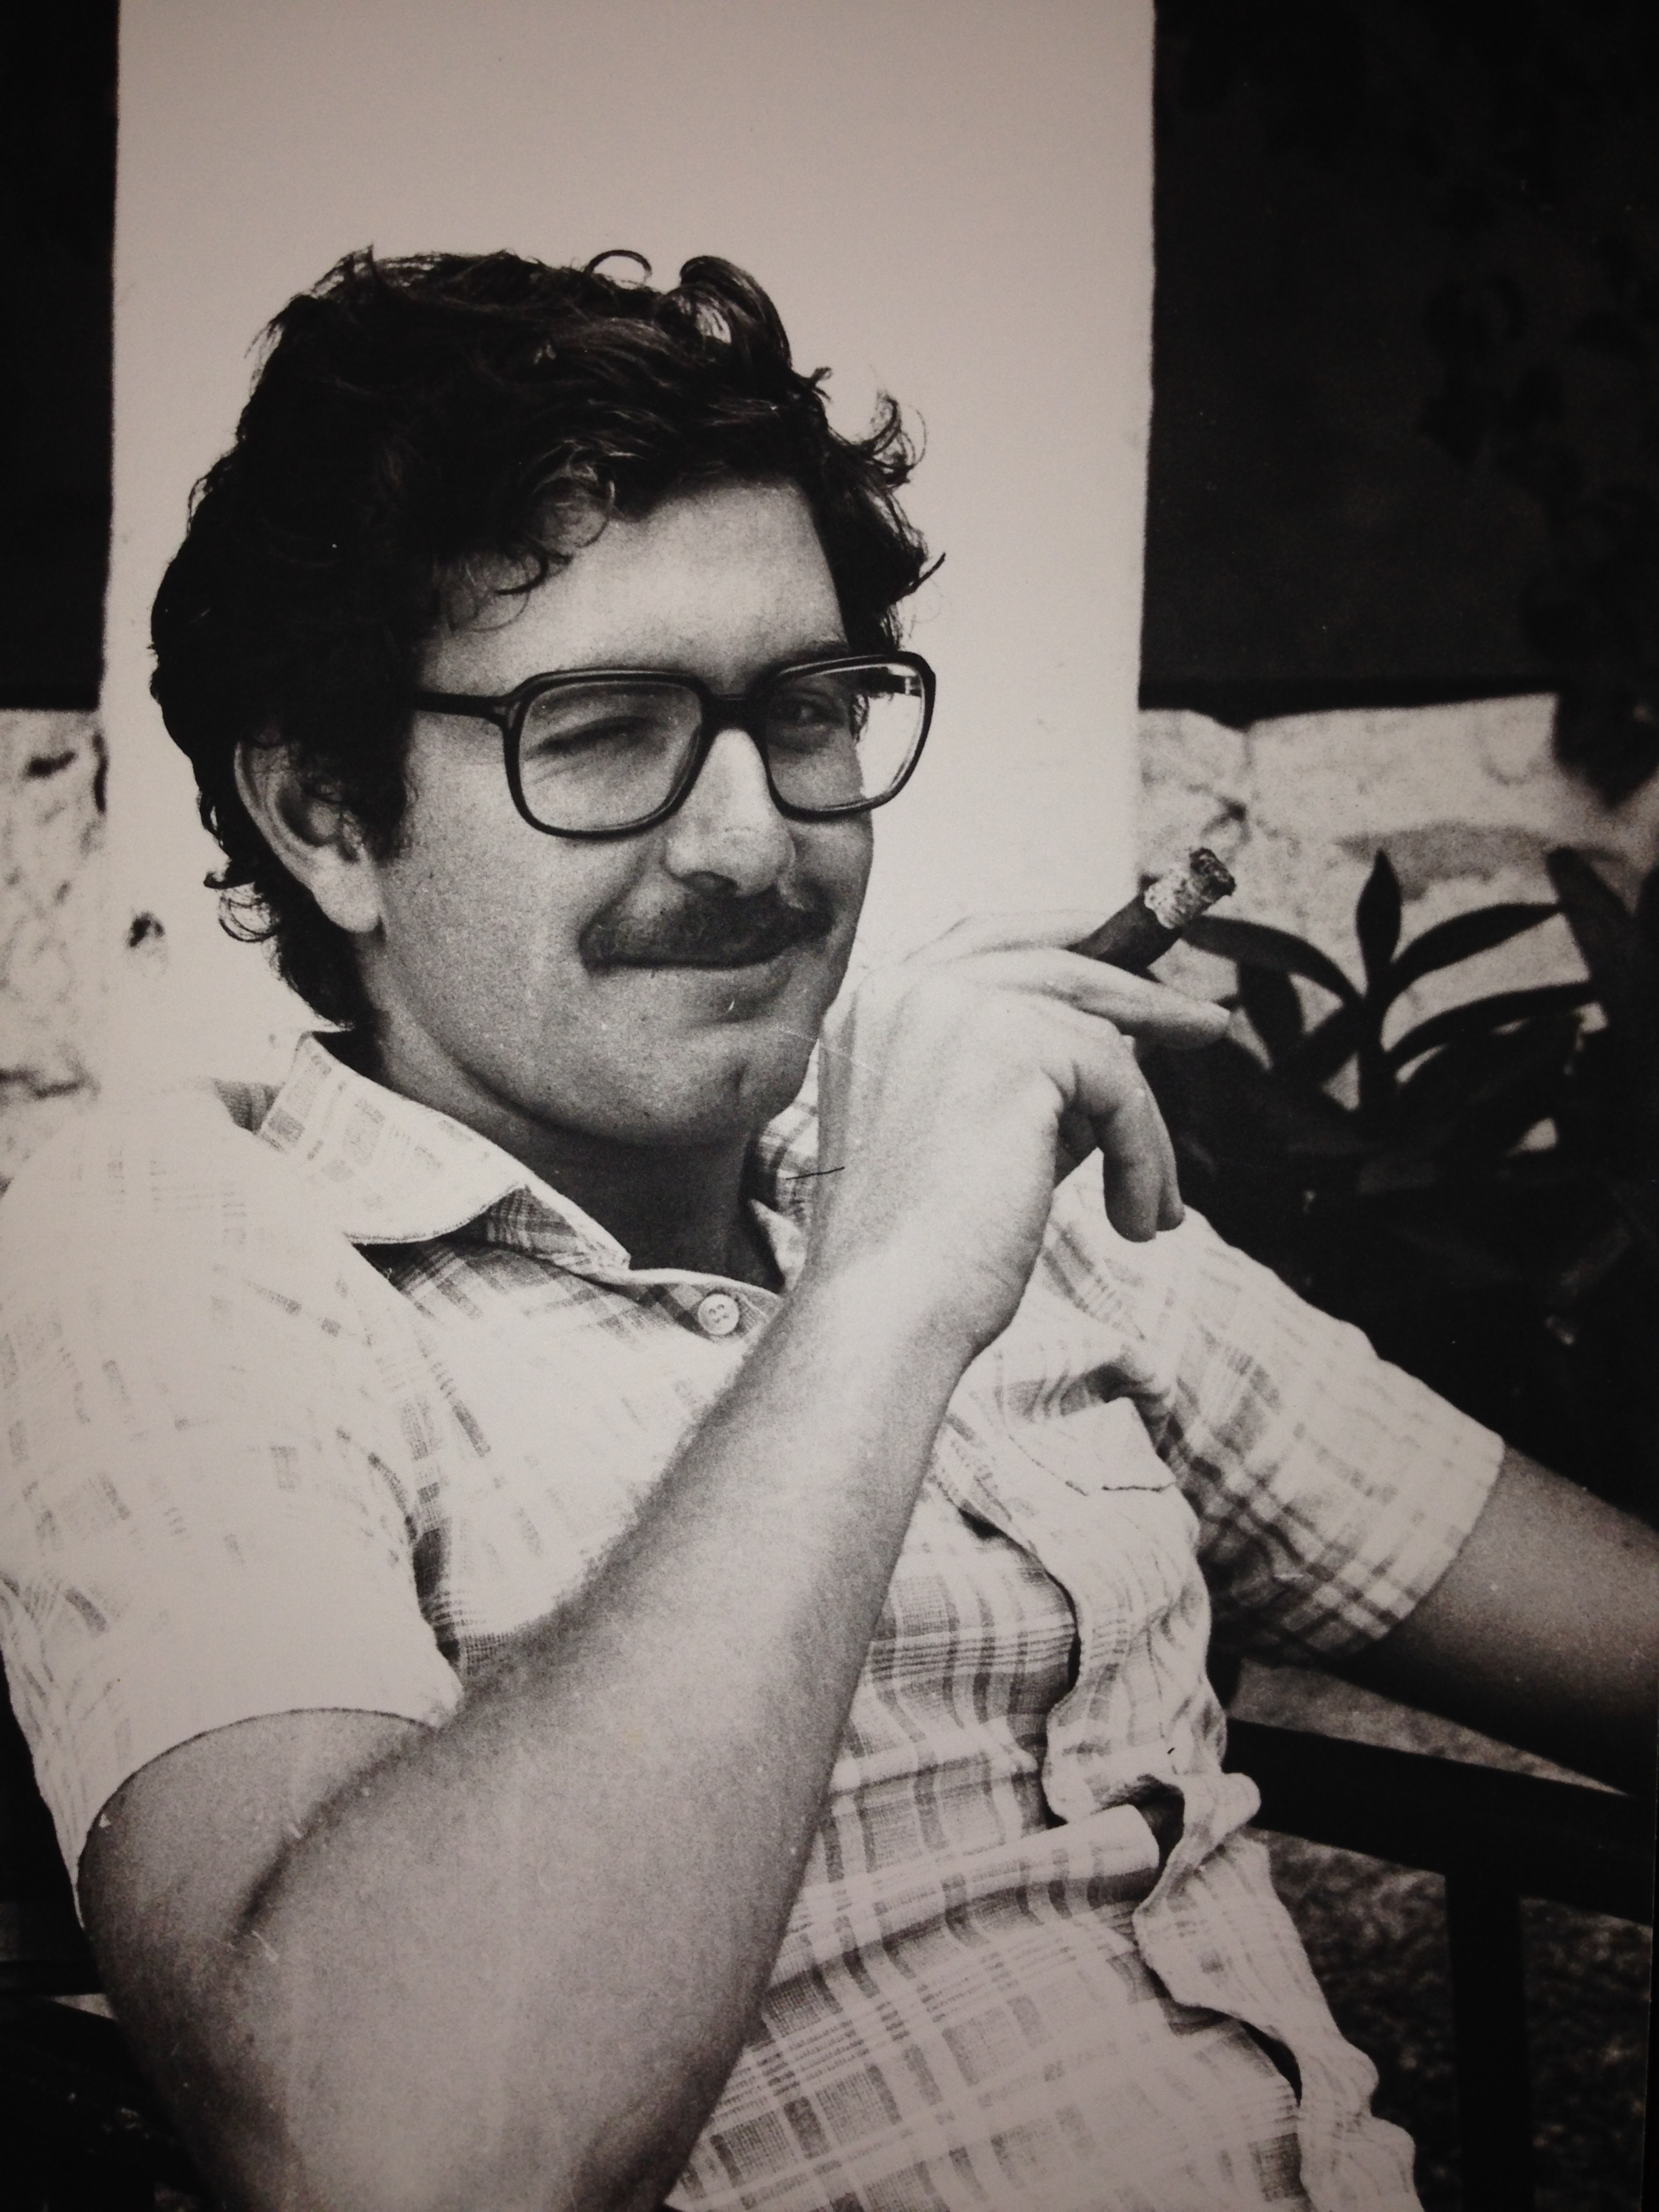

“Cryptographers seldom sleep well”.
[Silvio Micali, 1988]

Slide 7
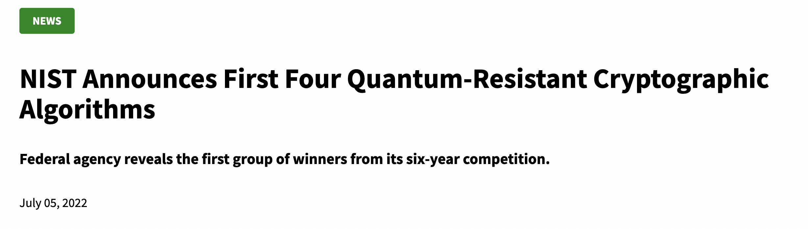
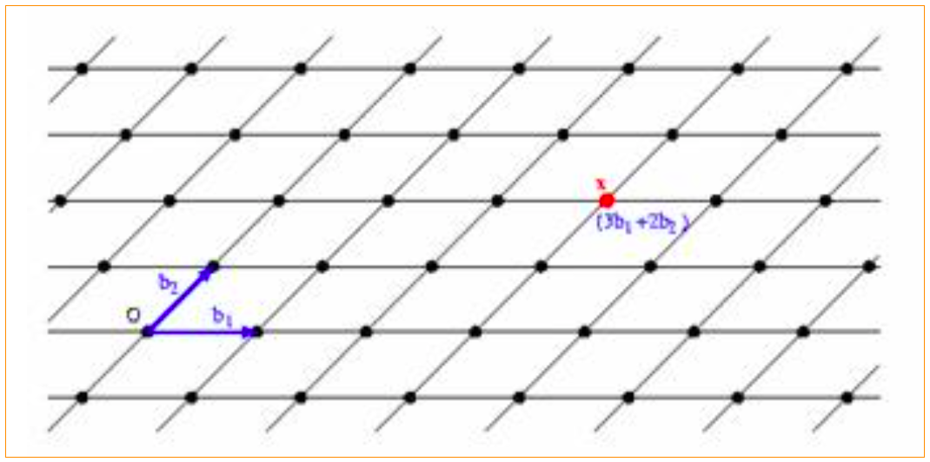
Post-Quantum Cryptography
Cryptography that is (believed to be) secure against quantum attacks.
3 out of 4: Lattice-based Cryptography

Slide 8
Why Lattice-based Crypto?
Exponentially Hard
(so far)
□ Quantum-Resistant
(so far)
Worst-case hardness
(unique feature of lattice-based crypto)
Simple and Efficient
Enabler of Surprising Capabilities
(Fully Homomorphic Encryption)

Slide 9

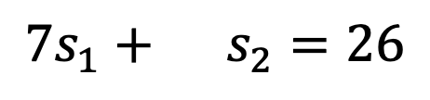
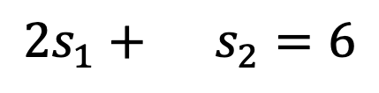
Solving Linear Equations
$$5s_{1}+11s_{2}=2$$
$$2s_{1}+ s_{2}=6$$
$$7s_{1}+ s_{2}=26$$
where all equations are over $ℤ$, the integers

Slide 10
Solving Linear Equations
s
Given:
A
and
A
GOAL: Find s.
More generally, $n$ variables and $m≫n$ equations.

Slide 11

Solving Linear Equations
s
Given:
A
and
A
GOAL: Find s.
EASY! For example, by Gaussian Elimination

Slide 12
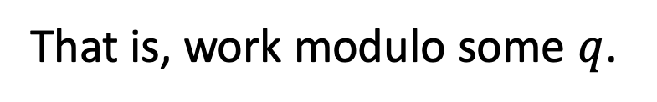

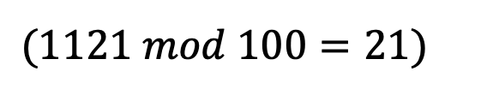
Solving Linear Equations
s
Given:
A
and
A
GOAL: Find s.
How to make it hard:
Chop the head?
That is, work modulo some $q$.
$(1121 mod 100=21)$
Still EASY! Gaussian Elimination mod $q$

Slide 13

Solving Linear Equations
s
Given:
A
and
A
+
e
GOAL: Find s.
How to make it hard: Chop the tail?
Add a small error to each equation.
Still EASY! Linear regression.

Slide 14

Solving Linear Equations
s
Given:
A
and
A
+
e
GOAL: Find s.
How to make it hard: Chop the head and the tail?
Add a small error to each equation and work mod $q$.
Turns out to be very HARD!

Slide 15
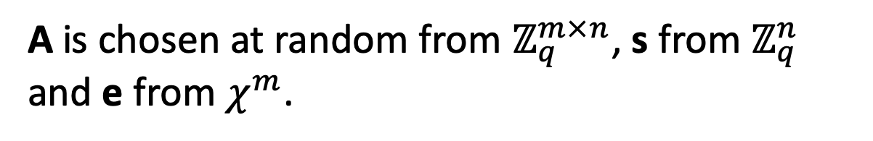
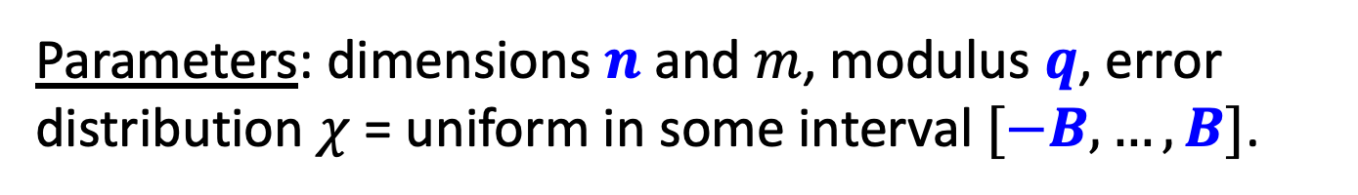
Solving Noisy Modular Linear Equations
Learning with Errors (LWE)
s
Given:
A
and
A
+
e
GOAL: Find s.
Parameters: dimensions $n$ and $m$, modulus $q$, error distribution $χ$ = uniform in some interval $[−B,…,B]$.
A is chosen at random from $ℤ_{q}^{m×n}$, s from $ℤ_{q}^{n}$ and e from $χ^{m}$.

Slide 16

Learning with Errors (LWE)
Decoding Random Linear Codes
(over F_{q} with L₁ errors)
Learning Noisy Linear Functions
Worst-case hard Lattice Problems
[Regev’05, Peikert’09]
Notes:
The same kind of problems with fhe

Slide 17
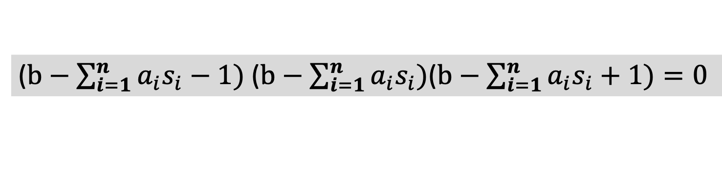

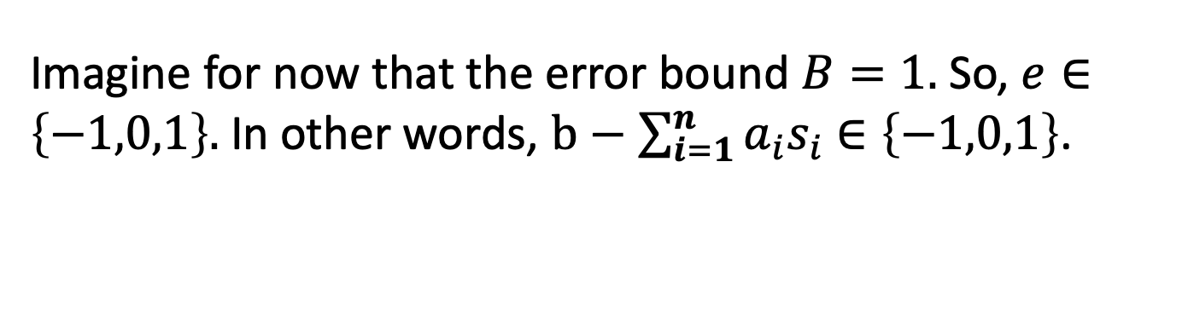
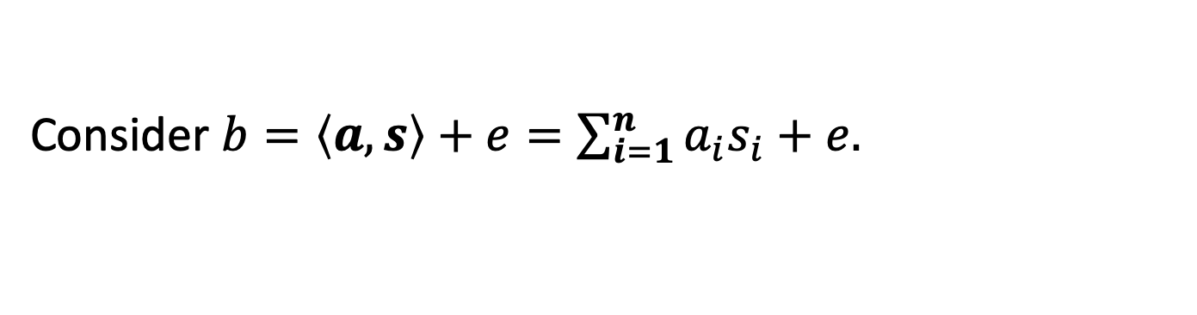
Attack 1: Linearization
Given $A,As+e$, find $s$.
Idea (a) Each noisy linear equation is an exact polynomial eqn.
Consider $b=\left\langle a,s\right\rangle +e=\sum_{i=1}^{n}{a_{i}s_{i}}+e.$
Imagine for now that the error bound $B=1.$ So, $e∈\left\{−1,0,1\right\}.$ In other words, $b−\sum_{i=1}^{n}{a_{i}s_{i}}$ $∈\left\{−1,0,1\right\}$.
So, here is a noiseless polynomial equation on $s_{i}:$
($b−\sum_{i=1}^{n}{a_{i}s_{i}}−1)$ ($b−\sum_{i=1}^{n}{a_{i}s_{i})}$($b−\sum_{i=1}^{n}{a_{i}s_{i}}+1)=0$

Slide 18

Attack 1: Linearization
Given $A,As+e$, find $s$.
BUT: Solving (even degree 2) polynomial equations is NP-hard.
($b−\sum_{i=1}^{n}{a_{i}s_{i}}−1)$ ($b−\sum_{i=1}^{n}{a_{i}s_{i})}$($b−\sum_{i=1}^{n}{a_{i}s_{i}}+1)=0$

Slide 19



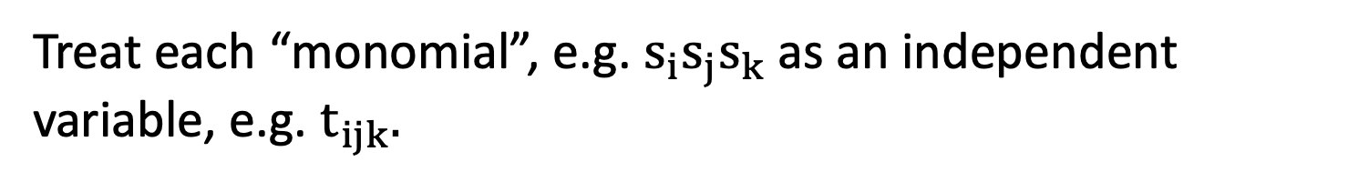
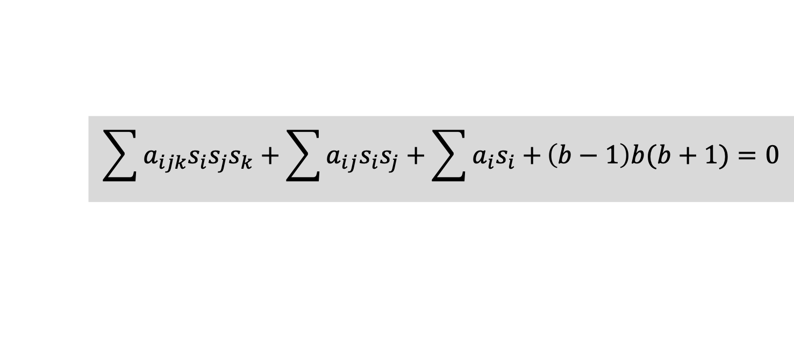
Attack 1: Linearization
($b−\sum_{i=1}^{n}{a_{i}s_{i}}−1)$ ($b−\sum_{i=1}^{n}{a_{i}s_{i})}$($b−\sum_{i=1}^{n}{a_{i}s_{i}}+1)=0$
Idea (b) Easy to solve given sufficiently many equations.
(using a technique called “linearization”)
$$\sum{a_{ijk}s_{i}s_{j}s_{k}}+\sum{a_{ij}s_{i}s_{j}+\sum{a_{i}s_{i}+}}\left(b−1\right)b(b+1)=0$$
Treat each “monomial”, e.g. $s_{i}s_{j}s_{k}$as an independent variable, e.g. $t_{ijk}.$
Now, you have a noiseless linear equation in $t_{ijk}$!!!

Slide 20

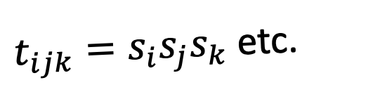
Attack 1: Linearization
$$\sum{a_{ijk}t_{ijk}}+\sum{a_{ij}t_{ij}+\sum{a_{i}t_{i}+}}\left(b−1\right)b(b+1)=0$$
Solution space
(with some eqns):
The real solution
$t_{ijk}=s_{i}s_{j}s_{k}$ etc.

Slide 21
Attack 1: Linearization
$$\sum{a_{ijk}t_{ijk}}+\sum{a_{ij}t_{ij}+\sum{a_{i}t_{i}+}}\left(b−1\right)b(b+1)=0$$
Solution space
(with more eqns):
The real solution
$t_{ijk}=s_{i}s_{j}s_{k}$ etc.

Slide 22
Attack 1: Linearization
$$\sum{a_{ijk}t_{ijk}}+\sum{a_{ij}t_{ij}+\sum{a_{i}t_{i}+}}\left(b−1\right)b(b+1)=0$$
Solution space
(with even more eqns):
The real solution
$t_{ijk}=s_{i}s_{j}s_{k}$ etc.

Slide 23
Attack 1: Linearization
$$\sum{a_{ijk}t_{ijk}}+\sum{a_{ij}t_{ij}+\sum{a_{i}t_{i}+}}\left(b−1\right)b(b+1)=0$$
Solution space
(keep going):
The real solution
$t_{ijk}=s_{i}s_{j}s_{k}$ etc.

Slide 24
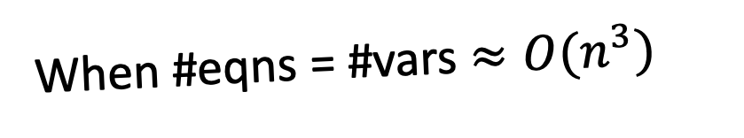
Attack 1: Linearization
$$\sum{a_{ijk}t_{ijk}}+\sum{a_{ij}t_{ij}+\sum{a_{i}t_{i}+}}\left(b−1\right)b(b+1)=0$$
When #eqns = #vars $≈O(n^{3})$
the only surviving solution to the linear system is the real solution.

Slide 25
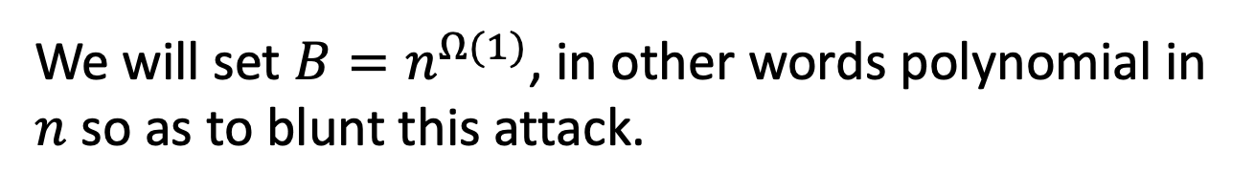

Attack 1: Linearization
Given $A,As+e$, find $s$.
Can solve/break as long as
$$m≫n^{2B+1}$$
We will set $B=n^{Ω(1)}$, in other words polynomial in $n$ so as to blunt this attack.

Slide 26
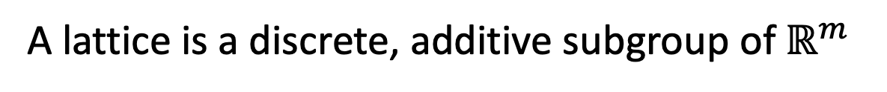
LWE and Lattices
_{a1*s1+a2*s2}
_{a1*s1+a2*s2+e}
_{a2}
_{a1}
O
A lattice is a discrete, additive subgroup of $ℝ^{m}$
Notes:
a1 and a2 are columns of A

Slide 27

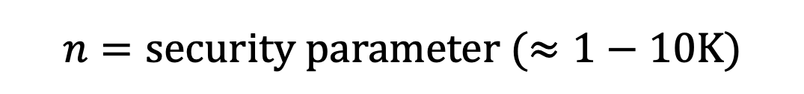
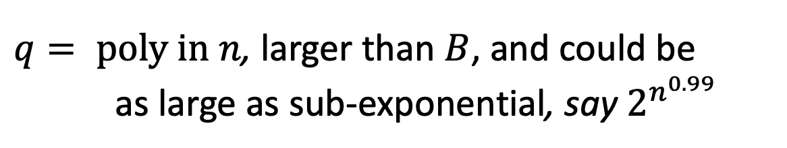


Setting Parameters
Cryptanalysis over three decades suggests we are safe with the following parameters:
$$n=security parameter (≈1−10K)$$
$$m=arbitrary poly in n$$
$$B=small poly in n, say \sqrt{n}$$
$q= poly in n$, larger than $B$, and could be
as large as sub-exponential, say $2^{n^{0.99}}$
even from quantum computers, AFAWK!

Slide 28
Decisional LWE
Can you distinguish between:
s
and
A
,
A
e
+
,
A
b
Theorem: “Decisional LWE is as hard as LWE”.

Slide 29
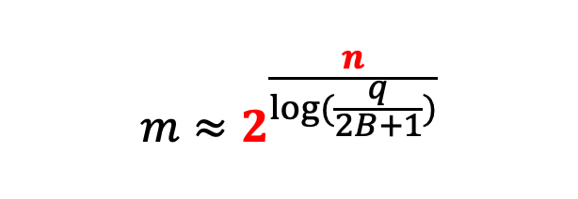

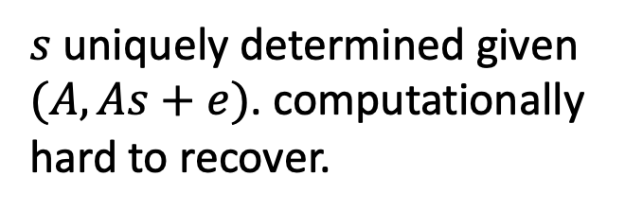
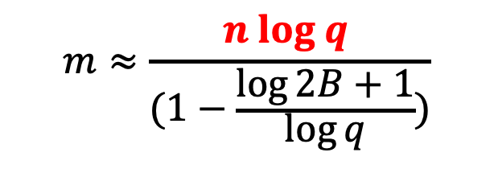

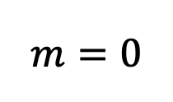
Information-Computation Gap
Fix $n, q,B.$
(Search) LWE:
easy
$$m=0$$
$$m≈2^{\frac{n}{\log{(\frac{q}{2B+1})}}}$$
$$m≈\frac{n log q }{(1−\frac{\log{2B+1}}{\log{q}}{)}}$$
Information-theoretically impossible to recover $s$.
$s$uniquely determined given $(A,As+e)$. computationally hard to recover.

Slide 30
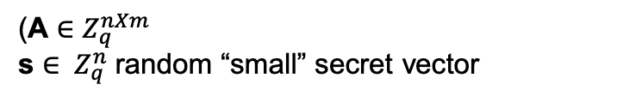

OWF and PRG
g_{A}(s,e) = As+e
(A $∈Z_{q}^{nXm}$
s ${∈ Z}_{q}^{n}$ random “small” secret vector
$e{∈ Z}_{q}^{n}$: random “small” error vector)
g_{A} is a one-way function (assuming LWE)
g_{A} is a pseudo-random generator (decisional LWE)
g_{A} is also a trapdoor function…
also a homomorphic commitment…
Notes:
The same kind of problems with fhe

Slide 31
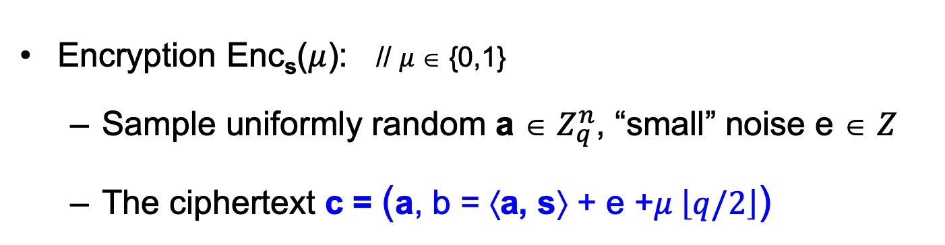
Basic (Secret-key) Encryption
[Regev05]
n = security parameter, q = “small” modulus
Secret key sk = Uniformly random vector s ∈ $Z_{q}^{n}$
Encryption Enc_{s}($μ$): // $μ$∈ {0,1}
  Sample uniformly random a ∈ $Z_{q}^{n}$, “small” noise e ∈ $Z$
  The ciphertext c = (a, b = ⟨a, s⟩ + e +$μ \left\lfloor q/2\right\rfloor$)
Decryption Dec_{sk}(c): Output Round_{q/2}(b − ⟨a, s⟩ mod q)
// correctness as long as |e| < q/4
Notes:
First iteration is incorrect because you only recover e+m upon decrypting
Solution: “error correct” or “make sure that m is a large number compared to e”

Slide 32
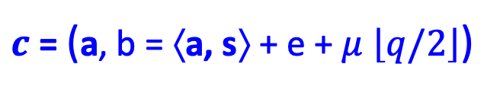

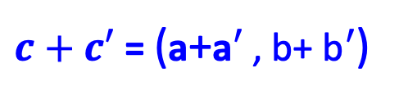
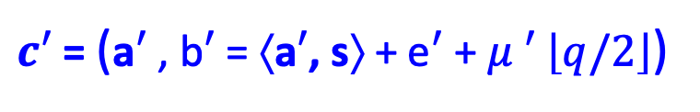
Basic (Secret-key) Encryption
[Regev05]
This scheme is additively homomorphic.
$c$ = (a, b = ⟨a, s⟩ + e + $μ$ $\left\lfloor q/2\right\rfloor$)
$$+$$
Enc_{s}(m)
$c′$ = (a$′$ , b$′$ = ⟨a$′$, s⟩ + e$′$ + $μ ′$ $\left\lfloor q/2\right\rfloor$)
Enc_{s}(m’)
$c+c′$ = (a+a$′$ , b+ b$′$ = ⟨ a +a$′$, s⟩ + (e+e$′$) + ($μ$+ $μ ′)$ $\left\lfloor q/2\right\rfloor$)
$c+c′$ = (a+a$′$ , b+ b$′$)
In words: $c+c′$ is an encryption of $μ$+ $μ ′$ (mod 2)
Notes:
First iteration is incorrect because you only recover e+m upon decrypting
Solution: “error correct” or “make sure that m is a large number compared to e”

Slide 33

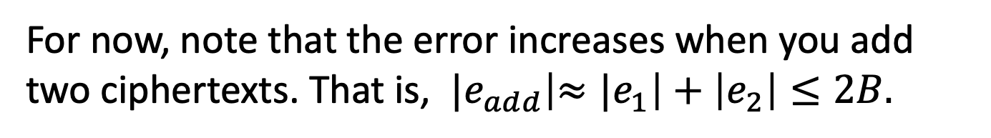
Basic (Secret-key) Encryption
[Regev05]
You can also negate the encrypted bit easily.
We will see how to make this scheme into a fully homomorphic scheme.
For now, note that the error increases when you add two ciphertexts. That is, ${|e}_{add}\left|{≈|e}_{1}\right|+\left|e_{2}\right|≤2B.$
Setting $q=n^{\log{n}}$ and $B=\sqrt{n}$ (for example) lets us support any polynomial number of additions.
Notes:
First iteration is incorrect because you only recover e+m upon decrypting
Solution: “error correct” or “make sure that m is a large number compared to e”

Slide 34
NEXT UP:
1. Public-key Encryption from LWE and
2. Fully Homomorphic Encryption

Slide 35
LWE with Small Secrets
s
Given:
A
and
A
+
e
GOAL: Find s.
Parameters: dimensions $n$ and $m$, modulus $q$, error distribution $χ$ = uniform in some interval $[−B,…,B]$.
A is chosen at random from $ℤ_{q}^{m×n}$, s from $χ^{n}$and e from $χ^{m}$.

Slide 36
LWE with Small Secrets
s
Given:
A
and
A
+
e
GOAL: Find (the small secret) s.
Theorem: LWE with small secrets is as hard as LWE.
Proof on the board.

Slide 37
Public-key Encryption
[Regev05, Micciancio’10, Lyubashevsky-Peikert-Regev’10]
Secret key sk = Small secret s from $χ^{n}$
Public key pk: for $i from 1 to n$
$$c_{i}=(a_{i},\left\langle a_{i},s\right\rangle +e_{i})$$

Slide 38
Public-key Encryption
[Regev05, Micciancio’10, Lyubashevsky-Peikert-Regev’10]
Secret key sk = Small secret s from $χ^{n}$
Public key pk: for $i from 1 to n$
$$(A,b=As+e)$$
A
,
s
e
A
+
Encrypting a message bit $μ$: pick a random vector $r$ from $χ^{n}$
$$(rA+e^{′}, rb+e^{′′}+μ \left\lfloor q/2\right\rfloor )$$
Decryption: compute
($rb+e^{′′}+μ \left\lfloor q/2\right\rfloor )−\left(rA+e^{′}\right)s$
and round to nearest multiple of q/2.

Slide 39
Correctness
Encrypting a message bit $μ$: pick a random vector $r$ from $χ^{n}$
$$(rA+e^{′}, rb+e^{′′}+μ \left\lfloor q/2\right\rfloor )$$
Decryption:
$$\text{(}rb+e^{′′}+μ \left\lfloor q/2\right\rfloor )−\left(rA+e^{′}\right)s$$
$$=r(As+e)+e^{′′}+μ \left\lfloor q/2\right\rfloor −\left(rA+e^{′}\right)s$$
$=re+e^{′′}−e^{′}s+μ \left\lfloor q/2\right\rfloor$
Decryption works as long as |$re−e^{′}s+e′′|<\frac{q}{4}.$

Slide 40
Security
Theorem: under decisional LWE, the scheme is IND-secure. In fact, even more: a ciphertext together with the public key is pseudorandom.
We show this by a hybrid argument.
Let’s stare at a public key, ciphertext pair.
$$pk= \left(A,b=As+e\right), c=Enc\left(pk,μ\right)=rA+e^{′}, rb+e^{′′}+μ \left\lfloor q/2\right\rfloor )$$
Call this distribution Hybrid 0.

Slide 41
Security
Theorem: under decisional LWE, the scheme is IND-secure. In fact, even more: a ciphertext together with the public key is pseudorandom.
Hybrid 1. Change the public key to random (from LWE).
$$\tilde{pk}= \left(A,b\right), \tilde{c}=Enc\left(\tilde{pk},μ\right)=rA+e^{′}, rb+e^{′′}+μ \left\lfloor q/2\right\rfloor )$$
Hybrids 0 and 1 are comp. indist. by decisional LWE.

Slide 42
Detour: Leftover Hash Lemma
[Impagliazzo-Levin-Luby’90]
We want to understand how $rA, rb=r\left[A \right|b]$ is distributed when $A, b$ is random (and public).
$$r$$
$$c$$
$$a′$$
$$b′$$
$$A$$
$$b$$
$$≈$$
If $r$ is truly random, so is $r\left[A \right|b]$.
But $r$ is NOT truly random! It has small entries.
Nevertheless, $r$ has entropy. Leftover hash lemma tells us that matrix multiplication turns (sufficient) entropy into true randomness. We need $m≫\left(n+1\right)\log{q.}$

Slide 43
Security
Theorem: under decisional LWE, the scheme is IND-secure. In fact, even more: a ciphertext together with the public key is pseudorandom.
Hybrid 1. Change the public key to random (from LWE).
$$\tilde{pk}= \left(A,b\right), \tilde{c}=Enc\left(\tilde{pk},μ\right)=rA, rb+μ \left\lfloor q/2\right\rfloor )$$
Hybrids 0 and 1 are comp. indist. by decisional LWE.

Slide 44
Security
Theorem: under decisional LWE, the scheme is IND-secure. In fact, even more: a ciphertext together with the public key is pseudorandom.
Hybrid 2. Change $rA+e^{′}, rb+e′′$ into random.
$$\tilde{pk}= \left(A,b\right), \tilde{c}=Enc\left(\tilde{pk},μ\right)=a′, b′+μ \left\lfloor q/2\right\rfloor )$$
Hybrids 1 and 2 are comp. indist. by LWE.

Slide 45
Security
Theorem: under decisional LWE, the scheme is IND-secure. In fact, even more: a ciphertext together with the public key is pseudorandom.
Hybrid 2. Change $rA+e^{′}, rb+e′′$ into random.
$$\tilde{pk}= \left(A,b\right), \tilde{c}=Enc\left(\tilde{pk},μ\right)=a′, b′+μ \left\lfloor q/2\right\rfloor )$$
Now, we have the message $μ$ encrypted with a one-time pad which perfectly hides $μ$.

Slide 46
Public-key Encryption
[Regev05, Micciancio’10, Lyubashevsky-Peikert-Regev’10]
Secret key sk = Small secret s from $χ^{n}$
Public key pk: for $i from 1 to n$
$$(A,b=As+e)$$
Encrypting a message bit $μ$: pick a random vector $r$ from $χ^{n}$
$$(rA+e^{′}, rb+e^{′′}+μ \left\lfloor q/2\right\rfloor )$$
Decryption: compute
($rb+e^{′′}+μ \left\lfloor q/2\right\rfloor )−\left(rA+e^{′}\right)s$
and round to nearest multiple of q/2.

Slide 47
Homomorphic Encryption

Slide 48


Application 1. Secure Outsourcing
Input: x
Program: P
Enc(x)
x
Enc(P(x))
P(x)
Client
Server (the Cloud)
A Special Case: Encrypted Database Lookup
also called “private information retrieval” (we’ll see in two lectures)

Slide 49


Application 2. Secure Collaboration
Hospital
ID
Genome
ID
Phenotype
“Parties learn the genotype-phenotype correlations and nothing else”

Slide 50
Homomorphic Encryption: Syntax
(can be either secret-key or public-key enc)
4-tuple of PPT algorithms $(Gen,Enc,Dec,Eval)$ s.t.
$\left(sk,ek\right)←Gen\left(1^{n}\right).$
PPT Key generation algorithm generates a secret key as well as a (public) evaluation key.
$c←Enc\left(sk,m\right).$
Encryption algorithm uses the secret key to encrypt message $m$.
$c′←Eval\left(ek,f,c\right).$
Homomorphic evaluation algorithm uses the evaluation key to produce an “evaluated ciphertext” $c′$.
$m←Dec\left(sk,c\right).$
Decryption algorithm uses the secret key to decrypt ciphertext $c$.

Slide 51
Homomorphic Encryption: Correctness
$Dec(sk,Eval\left(ek,f,Enc(x))\right)=f(x).$
Plaintext world
$$x$$
$$f(x)$$
$${Enc}_{pk}$$
$${Enc}_{sk}$$
$$c$$
$$c′$$
$${Eval}_{f}$$
Ciphertext world

Slide 52
Homomorphic Encryption: Security
Input: x
Function: f
Enc(sk,x)
$$x$$
Enc(f(x))
Client
Server (the Cloud)
Security against the “curious cloud” = standard IND-security of secret-key encryption
Key Point: Eval is an entirely public algorithm with public inputs.

Slide 53
Here is a homomorphic encryption scheme…
$\left(sk,−\right)←Gen\left(1^{n}\right).$
Use any old secret key enc scheme.
$c←Enc\left(sk,m\right).$
Just the secret key encryption algorithm…
$c′←Eval\left(ek,f,c\right).$
Output $c′$ = $c || f$. So Eval is basically the identity function!!
$m←Dec\left(sk,c′\right).$
Parse $c^{′}=c||f$ as a ciphertext concatenated with a function description. Decrypt $c$ and compute the function $f$.
This is correct and it is IND-secure.

Slide 54
Homomorphic Encryption: Compactness
The size (bit-length) of the evaluated ciphertext and the runtime of the decryption is independent of the complexity of the evaluated function.
A Relaxation: The size (bit-length) of the evaluated ciphertext and the runtime of the decryption depends sublinearly on the complexity of the evaluated function.

Slide 55


How to Compute Arbitrary Functions
For us, programs = functions = Boolean circuits with XOR ($+ mod 2$) and AND ($× mod 2$) gates.
$$Enc({(x_{1}+x_{2})x}_{3}x_{4})$$
X
$$Enc(x_{1}+x_{2})$$
$$Enc(x_{3}x_{4})$$
X
+
$$Enc(x_{3})$$
$$Enc(x_{4})$$
$$Enc(x_{2})$$
$$Enc(x_{1})$$
Takeaway: If you can compute XOR and AND on encrypted bits, you can compute everything.

Slide 56
How to Compute Arbitrary Functions
For us, programs = functions = Boolean circuits with XOR ($+ mod 2$) and AND ($× mod 2$) gates.
$$Enc({(x_{1}+x_{2})x}_{3}x_{4})$$
X
$$Enc(x_{1}+x_{2})$$
$$Enc(x_{3}x_{4})$$
X
+
$$Enc(x_{3})$$
$$Enc(x_{4})$$
$$Enc(x_{2})$$
$$Enc(x_{1})$$
We already know how to add (XOR), can we multiply?? Next lecture…

