Slide 1
MIT 6.875
Foundations of Cryptography
Lecture 16

Slide 2
NP Proofs
For the NP-complete problem of graph 3-coloring
Proof =
Verifier V checks: (a) only 3 colors are used & (b) any two vertices connected by an edge are colored differently.
Prover P has a witness, the 3-coloring of G

Slide 3
Zero-Knowledge (Interactive) Proof
Because NP proofs reveal too much
Commitments
$$e←E$$

Slide 4
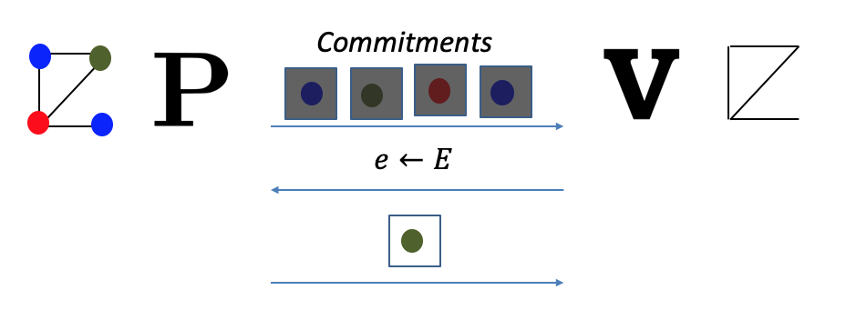
Zero-Knowledge (Interactive) Proof
Because NP proofs reveal too much
1. Completeness: For every $G∈$3COL, V accepts P’s proof.
2. Soundness: For every $G∉$3COL and any cheating $P^{∗}$, V rejects $P^{∗}$’s proof with probability $≥1−neg(n)$
3. Zero Knowledge: For every cheating $V^{∗},$there is a PPT simulator S such that for every $G∈$ 3COL, S simulates the view of $V^{∗}$.

Slide 5
Zero Knowledge Proofs
Theorem [Goldreich-Micali-Wigderson’87] Assuming one-way functions exist, all of NP has computational zero-knowledge proofs.

Slide 6
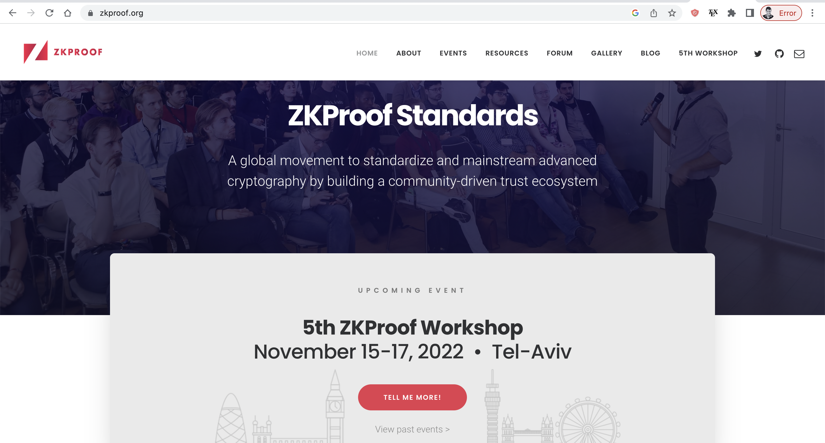

Slide 7
Topic 1:
Proofs of Knowledge

Slide 8
So far: Decision Problems
$y∈L$ or $y∉L$
(e.g. $y$ is a quadratic residue mod $N$ or it is not)
Here is a different scenario:
$$x$$
$${y=g}^{x} (mod p)$$
Discrete log of $y$ always exists (assuming $g$ is a generator)…
Alice wants to convince Bob that she knows a solution to a problem, e.g. that she knows the discrete log of $y$

Slide 9
So far: Decision Problems
$$x$$
$$Acc/Rej$$
$${y=g}^{x} (mod p)$$
Completeness: When Alice and Bob run the protocol where Alice has input $x$, Bob outputs accept.
Soundness? How to define it?
Zero Knowledge: There is a simulator that, given only $y$, outputs a view of Bob that is indistinguishable from his view in an interaction with Alice.

Slide 10
Proof of Knowledge
$$x$$
$$Acc/Rej$$
$${y=g}^{x} (mod p)$$
If Alice knows $x$, there must be a way to “extract it from her”.
I will not define an extractor formally but will show you an example (see Goldreich’s book for more)

Slide 11
ZK Proof of Knowledge of Discrete Log
$$p=2q+1$$
$$x$$
$$Acc/Rej$$
$${y=g}^{x} (mod p)$$
$${z=g}^{r} (mod p)$$
$$c←\{0,1\}$$
$$s=r+cx (mod q)$$
Accept iff $g^{s}=z∙y^{c}$
Completeness and Zero Knowledge: Exercise.

Slide 12
Proof of Knowledge: Extractor
Assume $P^{∗}$ convinces the verifier with prob. $>\frac{1}{2}+1/poly$
$${y=g}^{x} (mod p)$$
$${z=g}^{r} (mod p)$$
Extractor runs $P^{∗}$ to get a $z$.
$P^{∗}$
Runs $P^{∗}$ with $c=0$ and gets $s_{0}$
$$c=0$$
$$c=1$$
Rewinds $P^{∗}$ to the first message.
Runs $P^{∗}$ with $c=1$ and gets $s_{1}$
$$s_{0}$$
$$s_{1}$$
$g^{s_{0}}=z$ and
$g^{s_{1}}=zy$ w.p. $1/poly$
$g^{s_{1}−s_{0}}=y$. So, $s_{1}−s_{0}$ is the discrete log of $y.$

Slide 13
Zero Knowledge vs. Proof of Knowledge
Zero knowledge is a property of the prover against malicious verifiers. A prover P reveals zero knowledge if for all $V^{∗}$ …
Soundness and Proof of knowledge are properties of the verifier against malicious provers. A verifier V is sound (resp. satisfied PoK) if for all $P^{∗}$ …

Slide 14
Zero Knowledge Proofs of Knowledge
Theorem [Goldreich-Micali-Wigderson’87] Assuming one-way functions exist, all of NP has computational zero-knowledge proofs of knowledge.

Slide 15
Topic 2:
The Round-Complexity of ZK

Slide 16
Reducing Soundness Error
The 3COL protocol has a large soundness error of $1−1/|E|$
(probability that $V$ accepts even though $G∉3COL$)
Theorem: Sequential Repetition reduces soundness error for interactive proofs (and preserves the ZK property.)
Problem: Lots of rounds
Theorem: Parallel Repetition reduces soundness error for interactive proofs. It is also honest-verifier ZK.

Slide 17
Theorem [Goldreich-Krawczyk’90] There exist ZK proofs whose parallel repetition is NOT (malicious verifier) zero knowledge.
But the GK 90 counterexample is quite contrived. How about “natural protocols”, e.g. the GMW 3-coloring protocol from the last lecture?

Slide 18
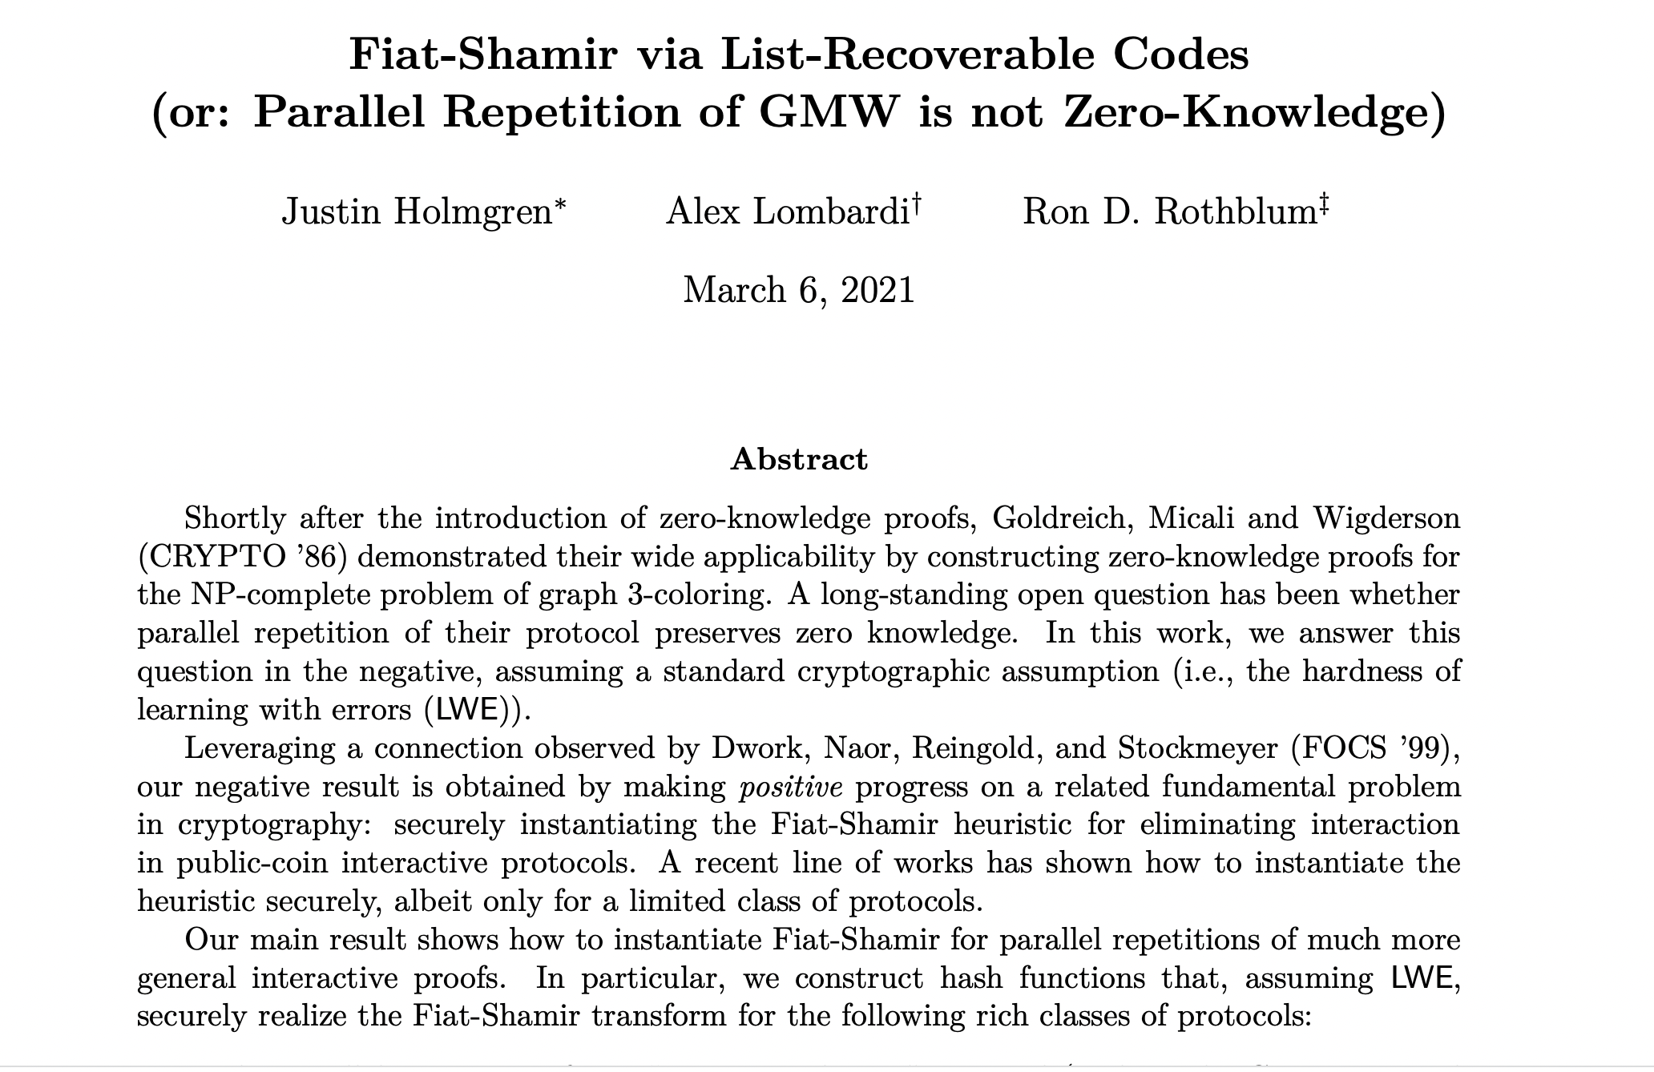
Theorem [Goldreich-Krawczyk’90] There exist ZK proofs whose parallel repetition is NOT (malicious verifier) zero knowledge.
Theorem [Holmgren-Lombardi-Rothblum’21] Parallel Repetition of the (Goldreich-Micali-Wigderson) 3COL protocol is not zero-knowledge.

Slide 19
Reducing Soundness Error
Fortunately, we have:
Theorem [Goldreich-Kahan’95] There is a constant-round ZK proof system for 3COL (with exponentially small soundness error), assuming discrete logarithms are hard (more generally, assuming the existence of collision-resistant hash functions).

Slide 20
Topic 3:
Can we make proofs non-interactive again?
Why?
V does not need to be online during the proof process.
Proofs are not ephemeral, can stay into the future.

Slide 21
Topic 3:
Can we make proofs non-interactive again?
NO!
YES, WE CAN!

Slide 22
Non-Interactive ZK is Impossible
Suppose there were an NIZK proof system for 3COL.
Graph G
Graph G
$$π$$
Step 1. When G is in 3COL, V accepts the proof $π$.
(Completeness)

Slide 23
Non-Interactive ZK is Impossible
Suppose there were an NIZK proof system for 3COL.
Graph G
Graph G
$$\tilde{π }$$
Step 2. PPT Simulator S, given only G in 3COL, produces an indistinguishable proof $\tilde{π}$ (Zero Knowledge).
In particular, V accepts $\tilde{π}$.

Slide 24
Non-Interactive ZK is Impossible
Suppose there were an NIZK proof system for 3COL.
Graph G
Graph G
$$\tilde{π }$$
Step 3. Imagine running the Simulator S on a $G∉$3COL. It produces a proof $\tilde{π}$ which the verifier still accepts!
(WHY?! Because S and V are PPT. They together cannot tell if the input graph is 3COL or not)

Slide 25
Non-Interactive ZK is Impossible
Suppose there were an NIZK proof system for 3COL.
Graph G
Graph G
$$π$$
Step 4. Therefore, S is a cheating prover!
Produces a proof for a $G∉$3COL that the verifier nevertheless accepts.
Ergo, the proof system is NOT SOUND!

Slide 26
THE END
Or, is it?

Slide 27
Two Roads to Non-Interactive ZK (NIZK)
1. Random Oracle Model & Fiat-Shamir Transform.
Random Oracle
Graph G
Graph G
$$π$$
2. Common Random String Model (We won’t go into this in the course, but if you are curious, see L16 slides from Fall 2021.)

Slide 28
NIZK Proof for 3COL
1
2
1
2
Graph G
=(V,E)
Graph G
4
3
4
3
random challenge c
Start with the parallel repetition of the 3COL protocol.
Recall: it is complete, has exponentially small soundness error, and is HVZK.

Slide 29
NIZK Proof for 3COL
1
2
Random Oracle
1
2
Graph G
=(V,E)
H
Graph G
4
3
4
3
a
a, c=H(a), z
random challenge c
z
Fiat and Shamir 1986: Let c = H(a). Now the prover can compute the challenge herself!
Potentially harmful for soundness. But in the random oracle model for H, can prove soundness.

Slide 30
Topic 4:
The Power of Interactive Proofs
What can we prove with interaction?

Slide 31
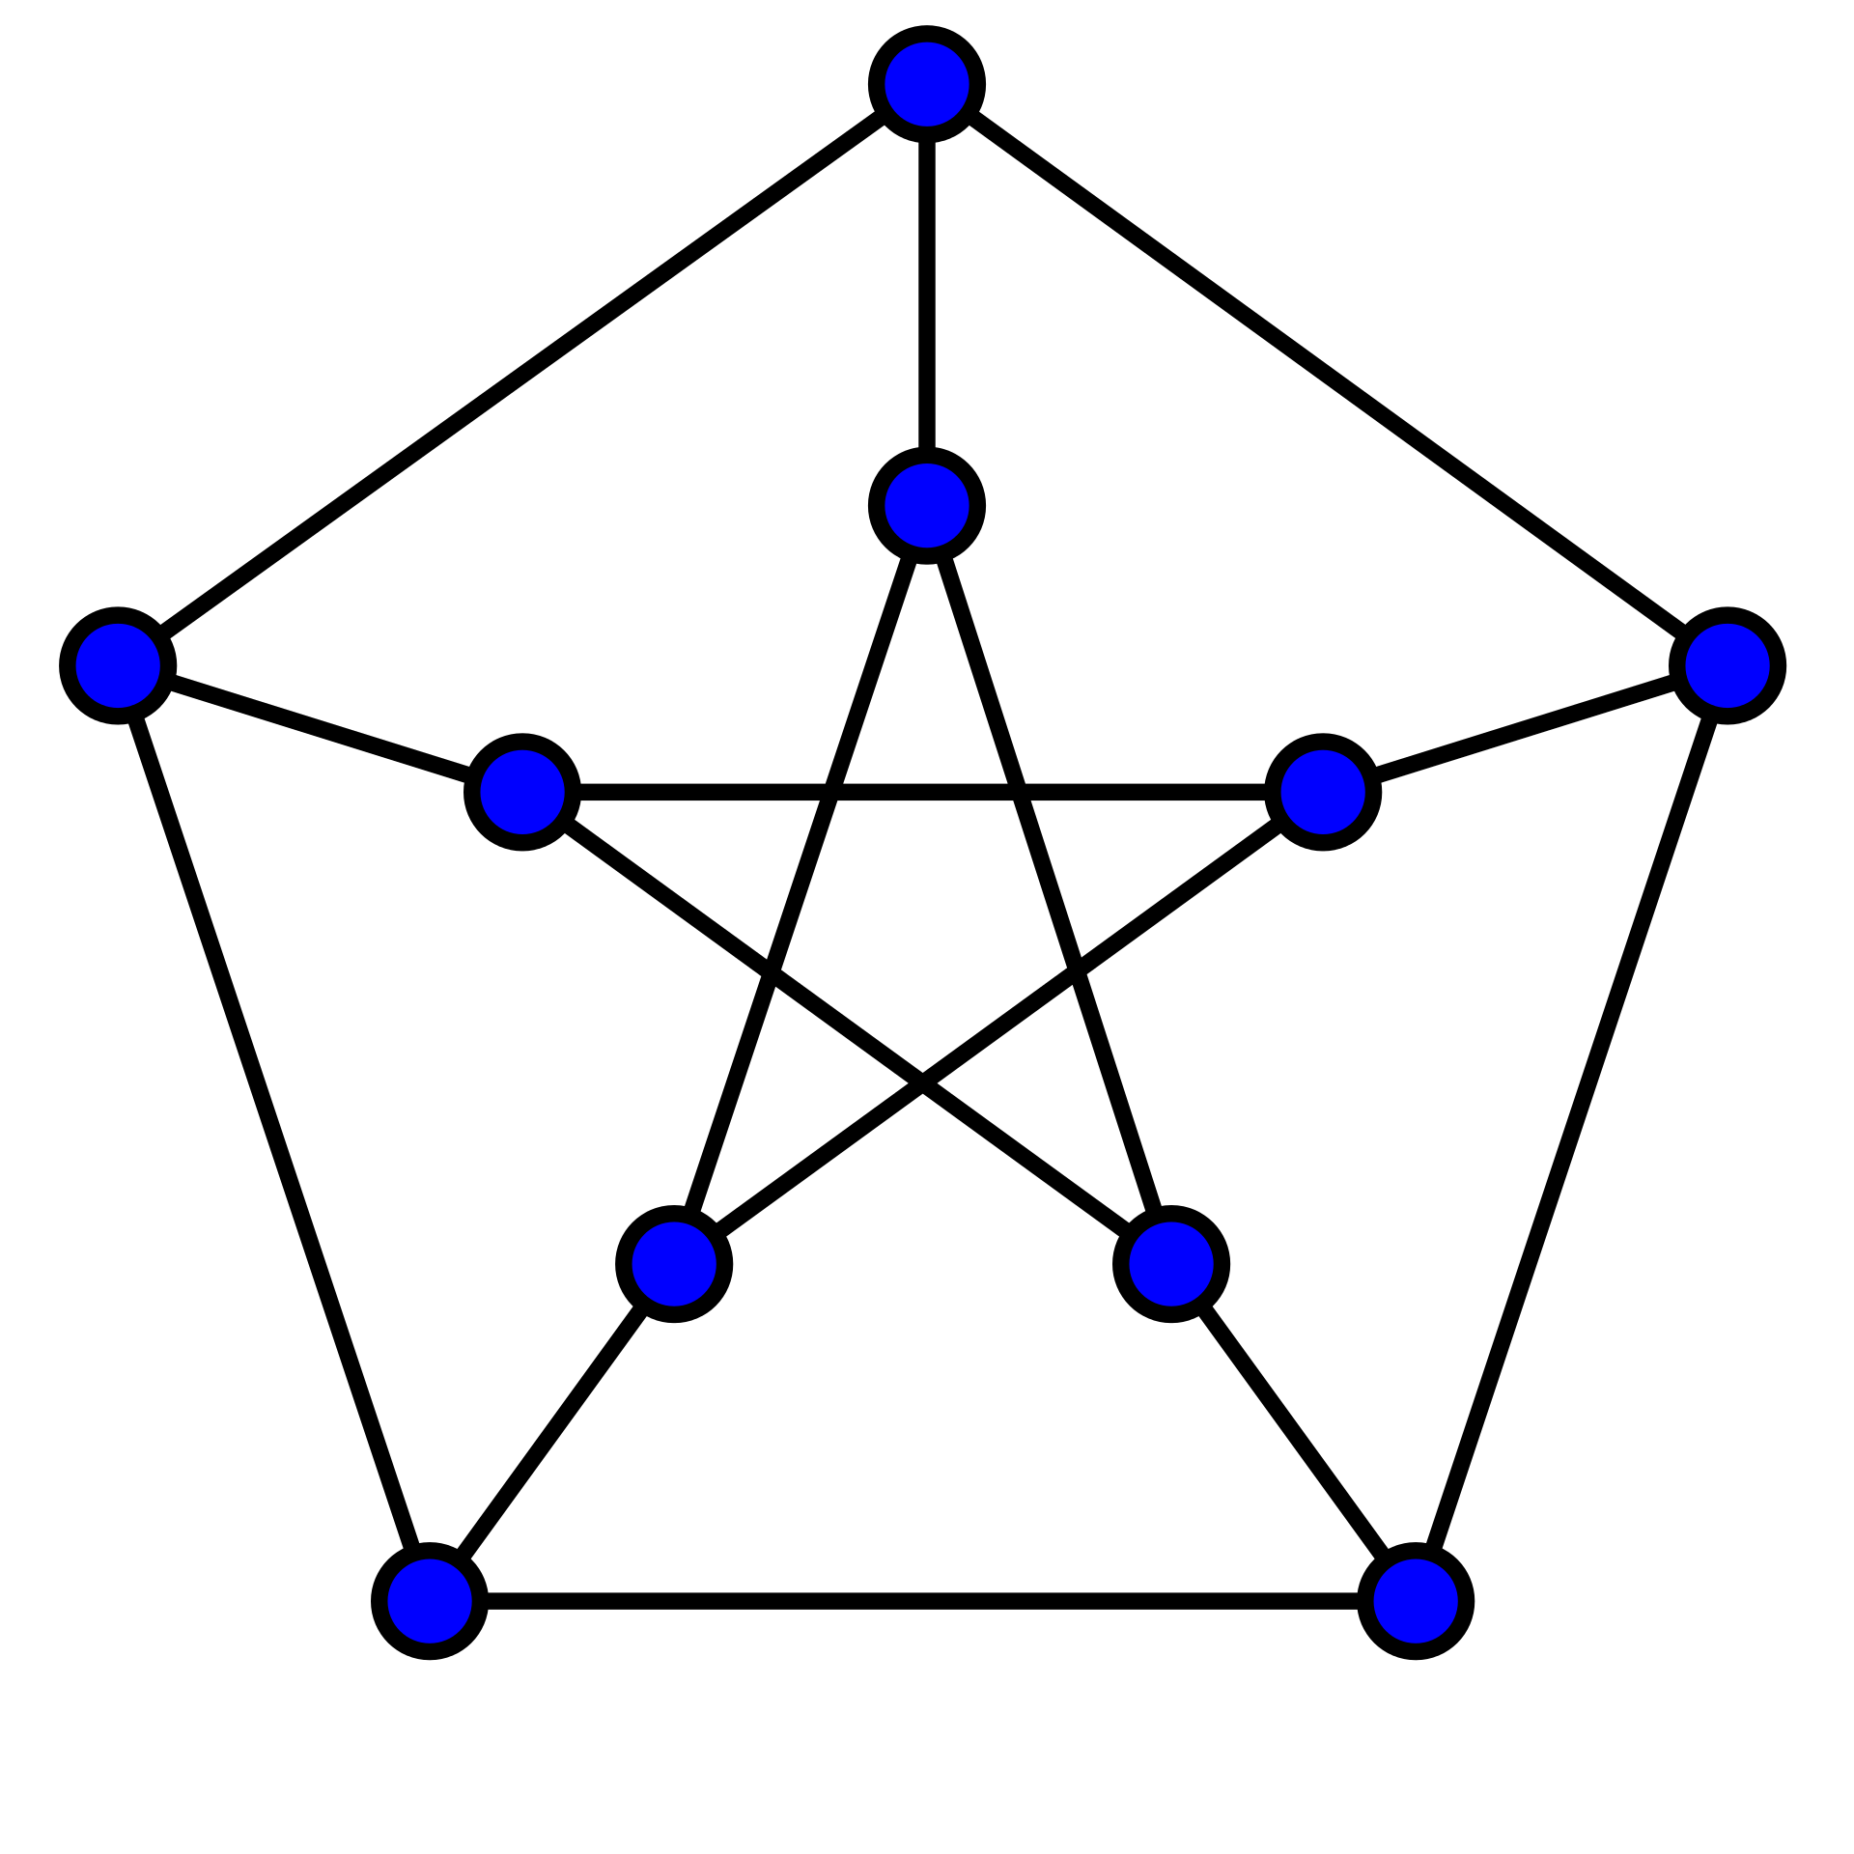
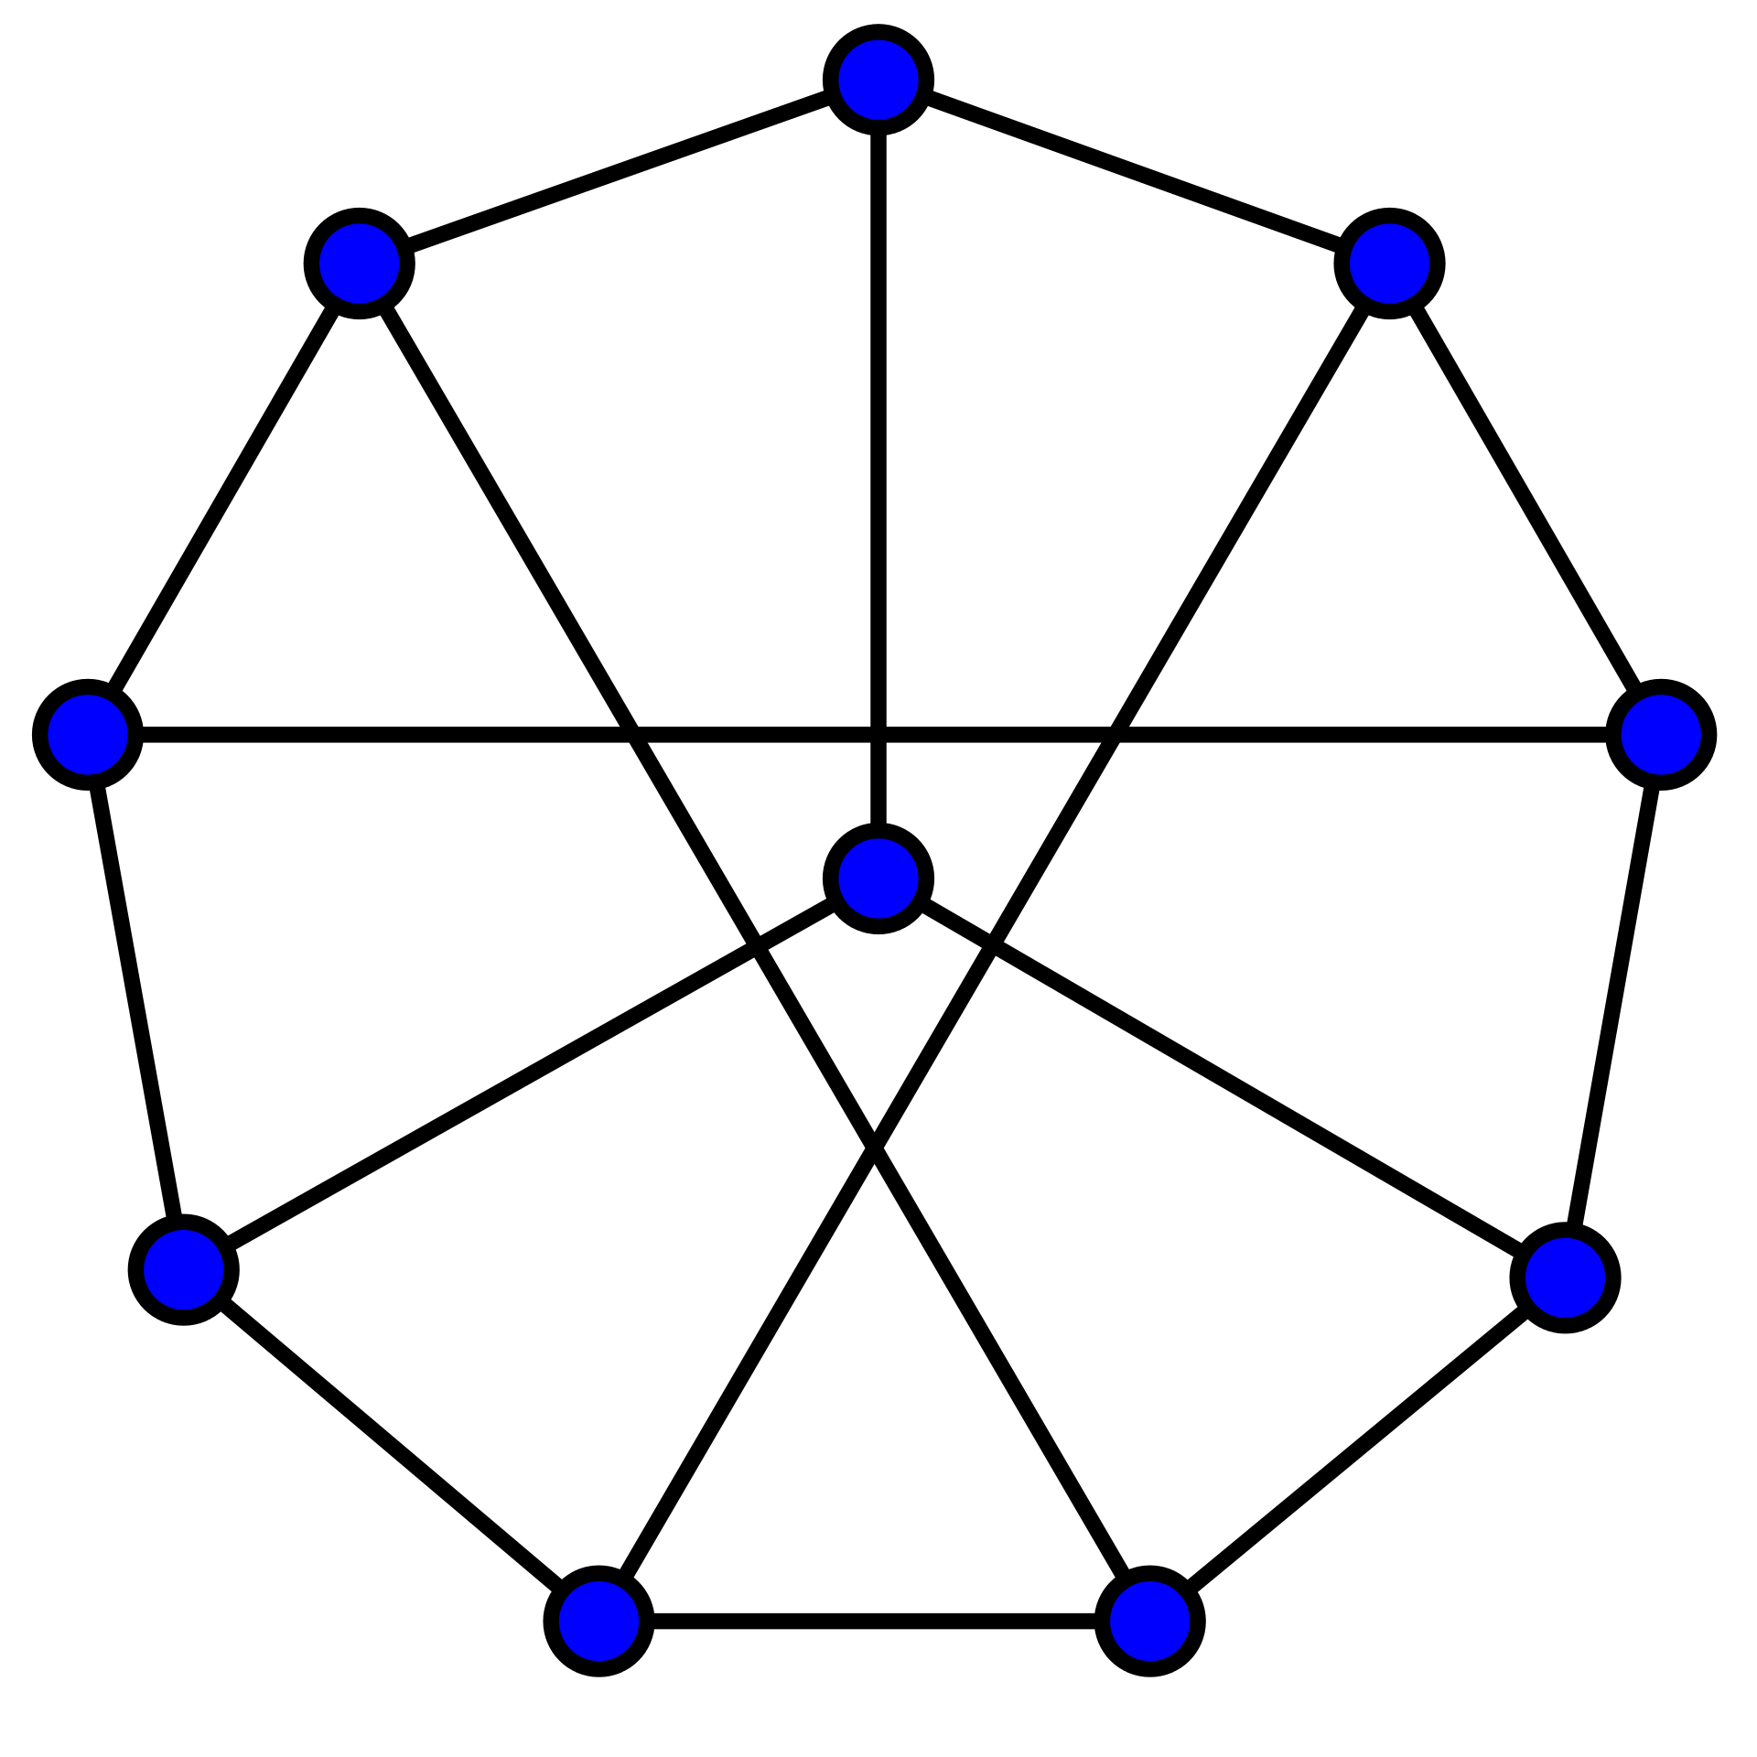
Interactive Proof for Graph Non-Isomorphism
$$≇$$
Completely unclear how to prove in NP.
Graph $G_{0}$
Graph $G_{1}$
$$ρ(G_{b})$$
Verifier
Prover
Pick a random bit $b$ and a random permutation $ρ$
$$b′$$
Accept if $b=b^{′}.$

Slide 32
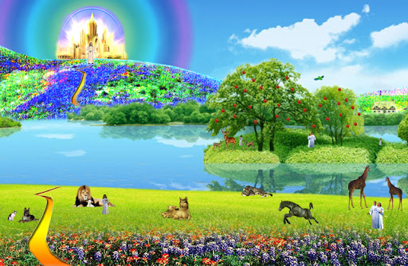
A window into a promised land…

Slide 33
The Power of Interactive Proofs
Theorem [Nisan’90, Lund-Fornow-Karloff-Nisan’90]
There is an interactive proof for the statement that the number of satisfying assignments to a formula is a given number (this complexity class is called $\#P$).
Theorem [Shamir’90] $IP=PSPACE$.

Slide 34
The Power of Interactive Proofs
Definition of multi-prover interactive proofs [BenOr-Goldwasser-Kilian-Wigderson’88]
V
MIP
Theorem [Babai-Fornow-Lund’90] $MIP=NEXP$.

Slide 35
The Power of Interactive Proofs
Definition of probabilistically checkable proofs [Arora-Safra’92, Feige-Goldwasser-Lovasz-Safra-Szegedy’91]
$$π_{1}$$
$$π_{2}$$
$$π_{3}$$
$$π_{4}$$
$$π_{5}$$
$$π_{6}$$
$$…$$
$$…$$
$$…$$
$$π_{n}$$
V
Theorem [Arora-Lund-Motwani-Sudan-Szegedy’92] $PCP(3)=NP$.

Slide 36
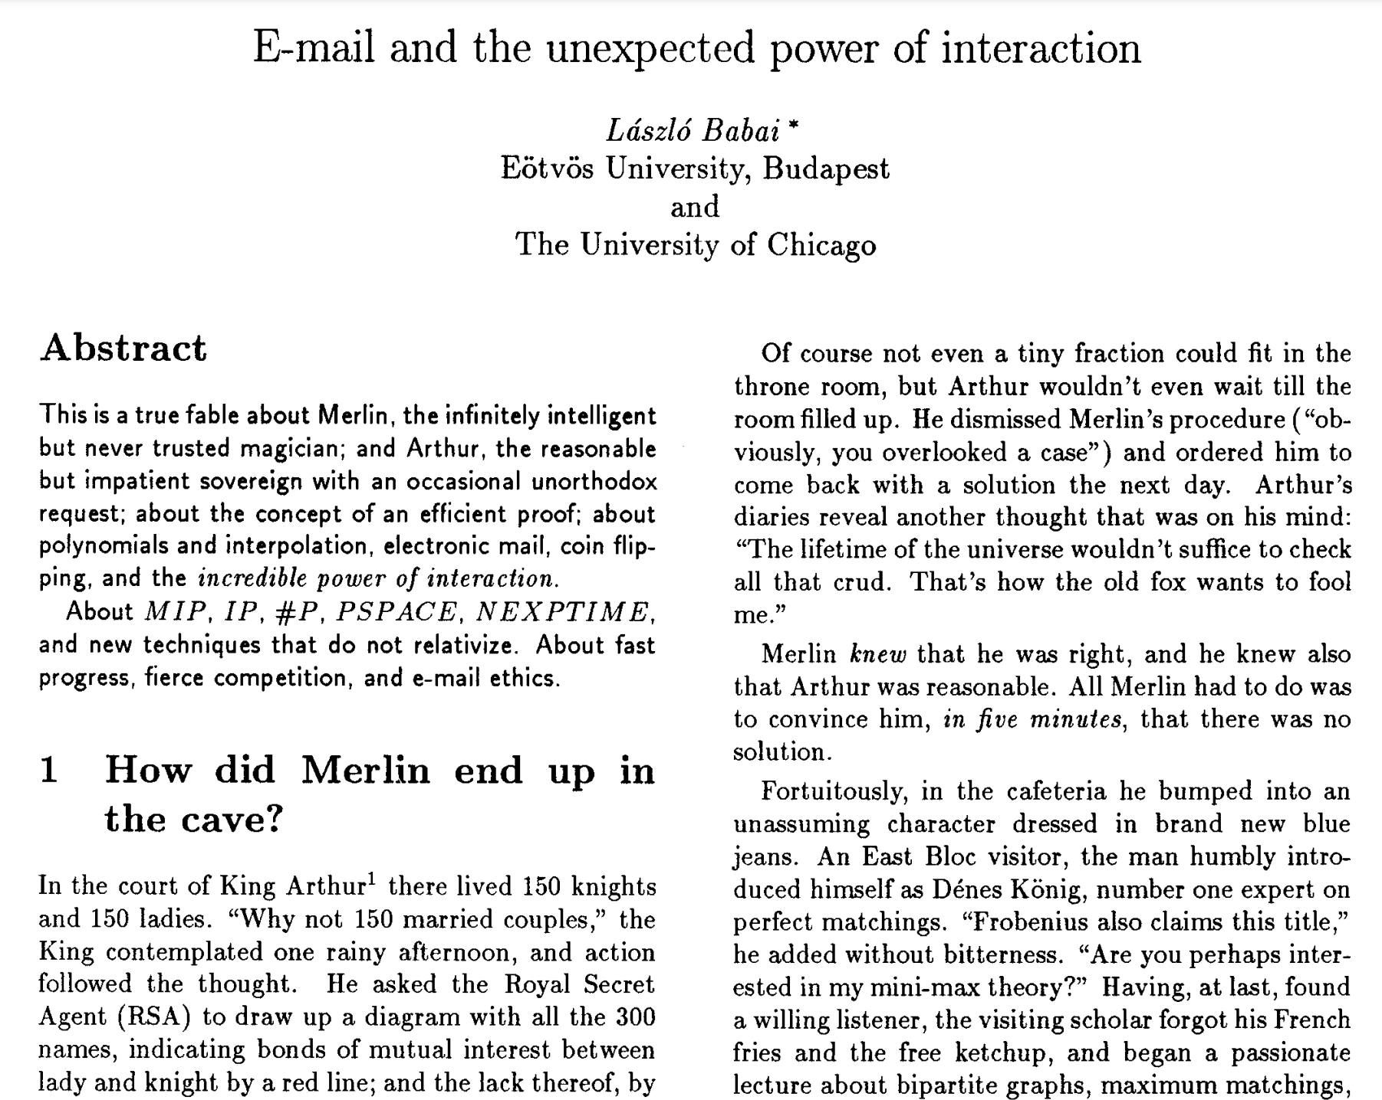

Slide 37
By Ryan O’Donnell

Slide 38
Next Lecture:
Succinct Interactive Proofs*:
SNARGs, SNARKs and other beasts of the crypto zoo
Vitalik Buterin, founder of Ethereum: “I expect zk-SNARKs to be a significant revolution as they permeate the mainstream world over the next 10-20 years.”

